Slide 1


A Comparison of Filter-based Approaches for Model-based Prognostics
Matthew Daigle¹, Bhaskar Saha², and Kai Goebel¹
¹NASA Ames Research Center, Moffett Field, CA, USA
²Palo Alto Research Center, Palo Alto, CA, USA

Slide 2
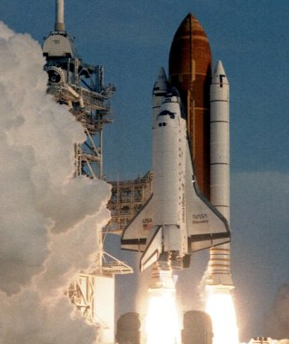
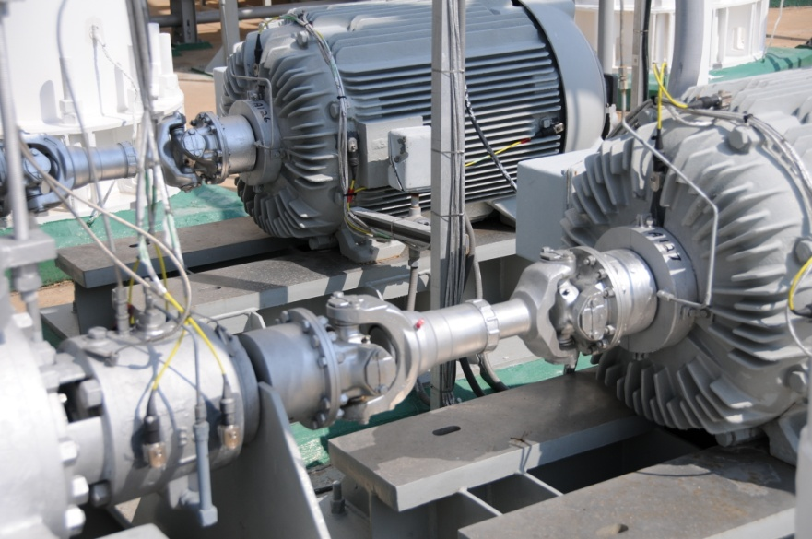
Motivation
Prognostics is the problem of estimating end of life (EOL) and remaining useful life (RUL)
  Key to condition-based maintenance
  Applications in many domains including aerospace
Model-based prognostics approach consists of
  Damage estimation – a joint state-parameter estimation problem
  Prediction – projects current joint-state parameter distribution into the future to determine EOL
Damage estimation phase is typically performed through the use of a filter
  Exact filters (e.g., Kalman, Benes, Daum filters)
  Approximate filters (e.g., extended Kalman, unscented Kalman, and particle filters)
  Compare Daum, unscented Kalman, and particle filters, in terms of practical application and prognostics performance

Slide 3
Outline
Problem Formulation
Model-based Prognostics Architecture
Damage Estimation
  Daum Filter
  Unscented Kalman Filter
  Particle Filter
Prediction
Case Study: Centrifugal Pump
Conclusions

Slide 4

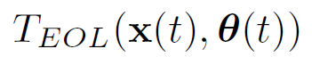



Problem Formulation
Prognostics goal
  Compute EOL = time point at which component no longer meets specified performance criteria
  Compute RUL = time remaining until EOL
System model
Define threshold from performance specs that is 1 when system is considered failed, 0 otherwise
EOL and RUL defined as
State
Parameters
Input
Process Noise
Output
Sensor Noise
Compute and/or

Slide 5
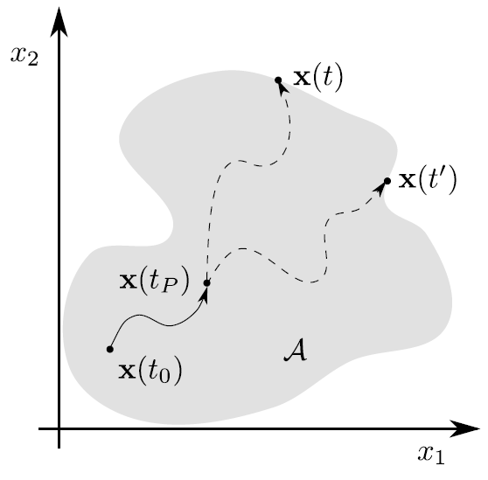
Defining EOL
Failure threshold T_{EOL} defined with functional specifications and linked to boundary in multi-dimensional damage space
  Beyond the boundary, the component does not conform to functional specifications
  Within the boundary, the component is still functioning properly
From time t₀ to prediction time t_{P}, system behaves within specs
Interested at what time t system will exit this region
May use this information to find time t’>t at which system exits the region

Slide 6
Prognostics Architecture
1
2
System receives inputs, produces outputs
Identify active damage mechanisms
3
4
Estimate current state and parameter values
Predict EOL and RUL as probability distributions

Slide 7
Damage Estimation
Damage estimation computes an estimate of the state-parameter distribution given the inputs and outputs of the system
  Several algorithms solve this problem
  We focus here on filtering approaches
Filtering approaches are based on an underlying model of the system
  For prognostics, these underlying models are almost always nonlinear, because the damage progression models are nonlinear
  Further, adding unknown parameters as states almost always creates a nonlinear system
  Therefore, nonlinear filters are required
Filters possess different features
  Exact vs approximate
  Class of dynamics handled
  Type of noise handled (additive vs multiplicative, Gaussian vs non-Gaussian)
  Deterministic vs stochastic

Slide 8
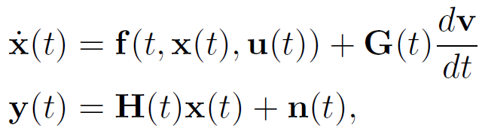
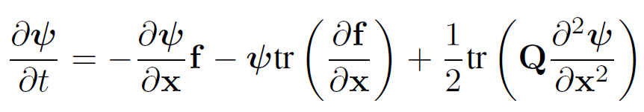
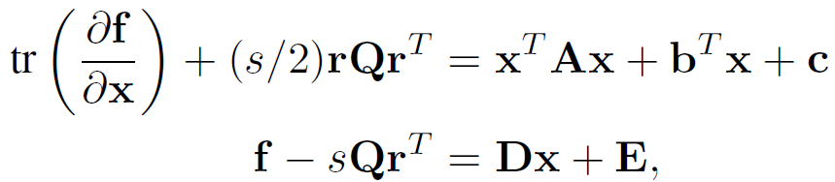

Daum Filter
The Daum filter is an exact nonlinear filter for a certain class of nonlinear dynamics
  Brownian process noise, Gaussian sensor noise
Dynamics restricted to satisfy several assumptions
  Must exist a function ψ(x,t) where
  Must exist A, b, c, D, E to satisfy

Slide 9
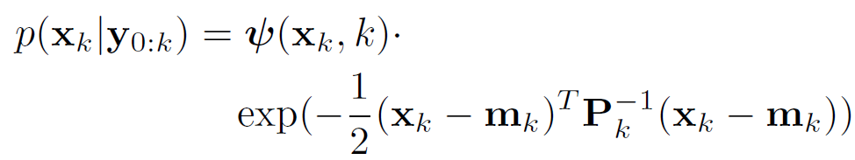
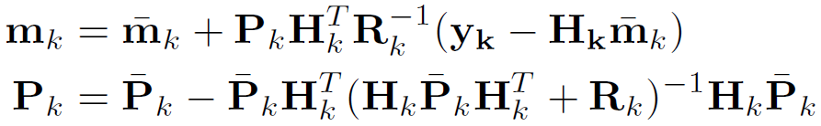
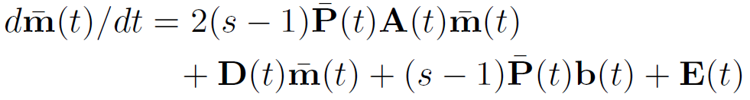
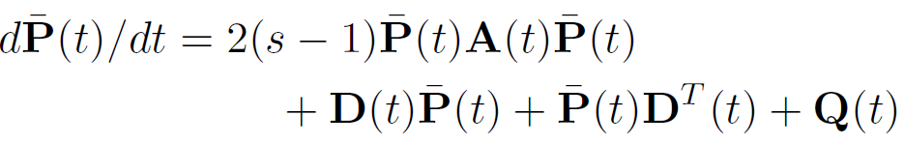
Daum Filter
Given these assumptions (and a few others)
  where m and P are filter variables, analogous to mean and covariance
Filter equations look similar to Kalman filter equations
The main advantages are that the filter is exact and has low computational complexity
The main disadvantage is that the class of dynamics it covers is very restrictive in practice
  An approximate version exists but ψ(x,t) is still needed

Slide 10
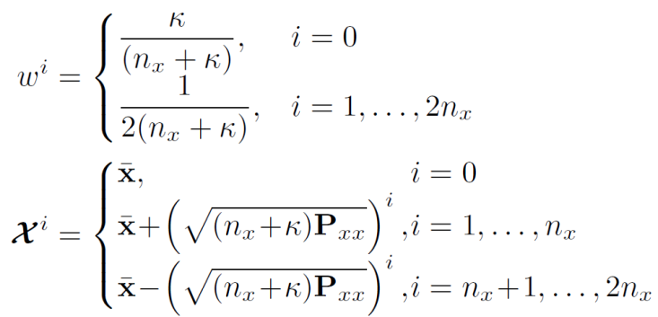
Unscented Kalman Filter
The UKF is an approximate nonlinear filter, and assumes additive, Gaussian process and sensor noise
Handles nonlinearity by using the concept of sigma points
  Transform mean and covariance of state into set of samples, called sigma points, selected deterministically to preserve mean and covariance
  Sigma points are transformed through the nonlinear function and recover mean and covariance of transformed sigma points
Number of sigma points is linear in the size of the state dimension
  In comparison, Kalman and Daum filters effectively use one “sigma point”
Unscented transform
Symmetric Unscented Transform

Slide 11
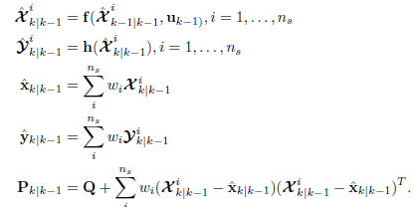
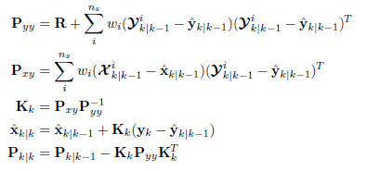
Unscented Kalman Filter
Kalman filter equations extended to use sigma points
Has medium computational complexity and covers a very large class of dynamics, but is an approximate filter
Prediction Step
Update Step

Slide 12

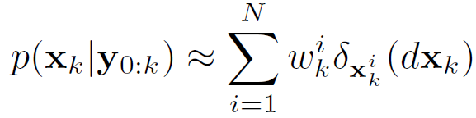
Particle Filter
Particle filters can be applied to general nonlinear processes with non-Gaussian noise – does not restrict the dynamics in any way
  But is an approximate filter, and is stochastic in nature
Approximate state distribution by set of discrete weighted samples (i.e., particles):
  Suboptimal, but approach optimality as N→ ∞
Approximates posterior as
State represented with discrete probability distribution
Distribution evolves in time

Slide 13
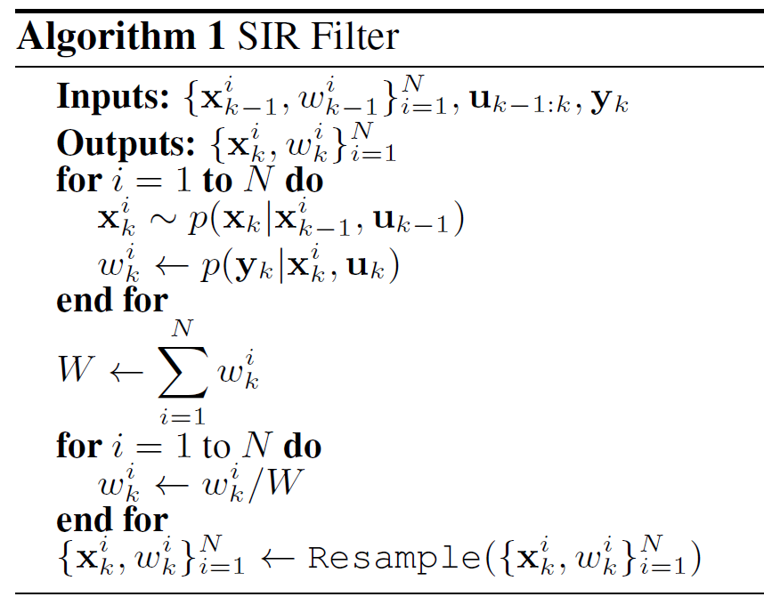
Particle Filter
Begin with initial particle population
Predict evolution of particles one step ahead
Compute particle weights based on likelihood of given observations
Resample to avoid degeneracy issues
  Degeneracy is when small number of particles have high weight and the rest have very low weight
  Avoid wasting computation on particles that do not contribute to the approximation

Slide 14

Joint State-Parameter Estimation
Joint state-parameter estimation is performed within a filtering framework by augmenting the state vector with the unknown parameter vector
Must assign an evolution to the parameters, typically a random walk
The particle filter adopts this equation directly, but for the Daum and UKF filters, it is represented in the corresponding diagonal of the process noise matrix
Selection of variance of random walk noise is important
  Variance must be large enough to ensure convergence, but small enough to ensure precise tracking
  Optimal value depends on unknown parameter value
  Should tune online to maximize performance

Slide 15
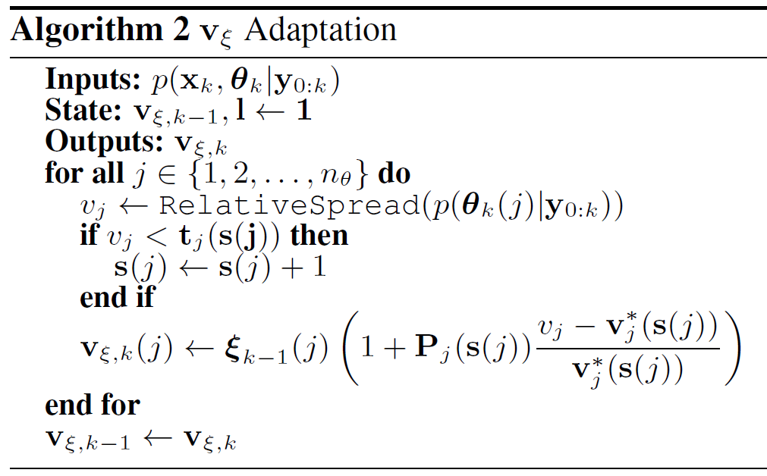
Variance Control
ξ values tuned initially for maximum possible wear rates
Try to control the amount of relative spread of parameter estimate to a desired level (e.g., 10%)
  Since it is relative, applies equally to any wear parameter value
  Can use relative median absolute deviation (RMAD), relative standard deviation (RSD), among others
Several stages to control adaptation
  Convergence: Control to large spread (eg 50%) until threshold reached (eg 60%)
  Tracking: Control to desired spread (eg 10%)
Control based on percent error between actual spread and desired spread with parameter P
  Increase random walk variance if parameter variance is too low, else decrease
Proportional control based on error between actual and desired relative spread
Move to next stage when threshold crossed

Slide 16
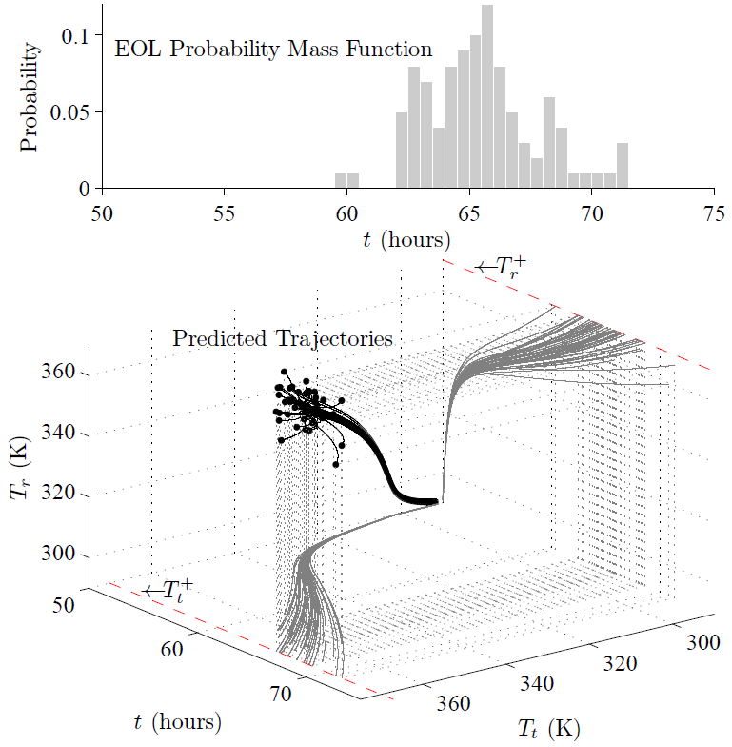
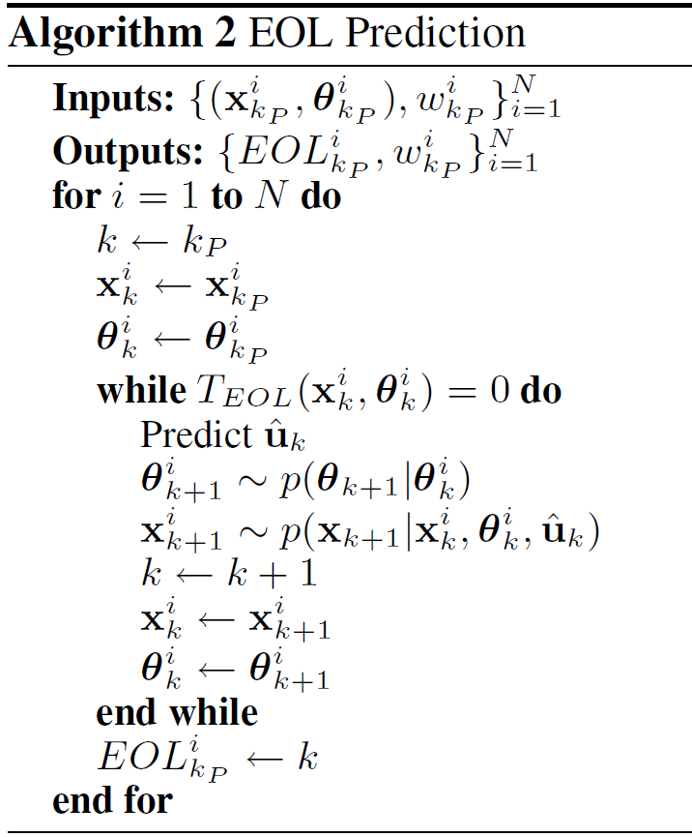
Prediction
Sample from the state-parameter distribution, and simulate each sample forward to EOL
  For PF and UKF, use particles/sigma points directly
Hypothesized inputs
Sample simultaneous progression of thrust bearing and radial bearing wear in a centrifugal pump

Slide 17
Case Study: Centrifugal Pump
Apply framework to centrifugal pump
  Complex electro-mechanical devices used for fluid delivery in water systems, spacecraft fueling, etc.
  Often undergo continuous usage, so require regular maintenance
  Provide a critical function, so failures can cause loss of mission
Centrifugal pump operation
  Fluid enters the inlet, impeller
  rotation forces fluid through
  the outlet
  Impeller rotation driven by
  electric motor
  Bearings help minimize friction
  Bearing housing contains
  lubricating oil
  Wear rings prevent excessive
  internal leakage
Centrifugal Pump

Slide 18
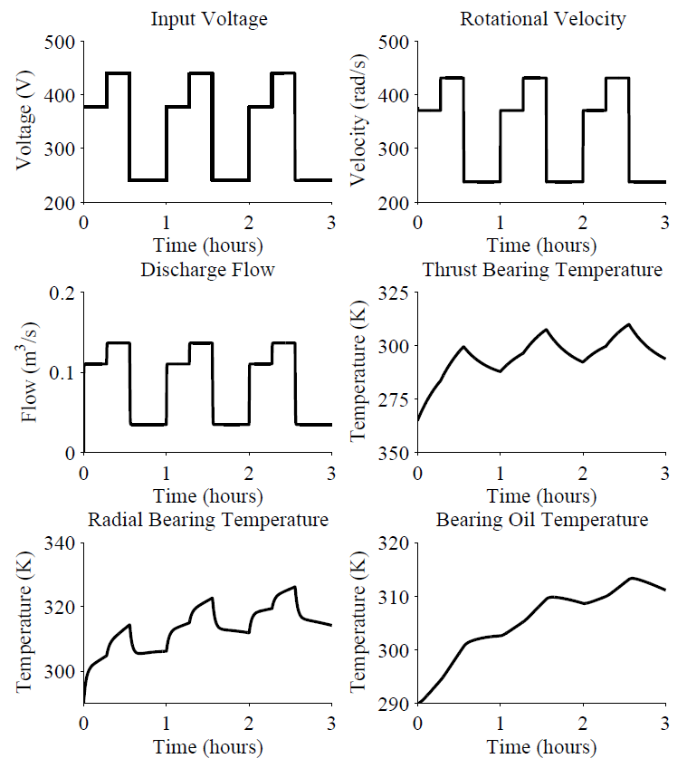
Centrifugal Pump Modeling
Impeller rotation governed by
  Motor torque (driven by input voltage and line frequency)
  Friction torque
  Load torque (function of impeller speed and fluid flow)
Pump flow determined by
  Pump pressure (function of impeller speed)
  Suction and discharge pressures (inputs to this model)
  Internal leakage flow
Pump temperatures governed by
  Heat transfer between bearings, oil, and environment
  Heat due to friction
Failure defined by limits on pump efficiency and pump temperatures
Sensors measure impeller speed, discharge flow, and bearing and oil temperatures

Slide 19

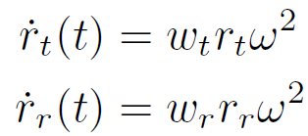
Modeling Damage
Impeller damage characterized by decrease in impeller area, caused by erosive wear due to the flow
  Decreases pump efficiency
Thrust and radial bearing damage characterized by increases in friction coefficients, caused by bearing wear due to sliding and rolling friction
  Increases bearing temperatures

Slide 20
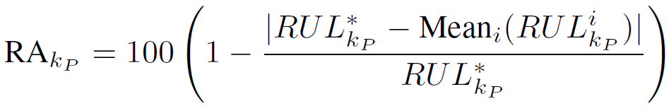
Evaluation
Metrics
  For estimation accuracy, use percent root mean square error (PRMSE) of wear parameter
  For estimation spread, use relative standard deviation (RSD)
  For prediction accuracy, use relative accuracy metric¹ (RA)
    where RUL_{kp}* indicates true RUL
  For prediction spread, use RSD
  Relative accuracy¹ (RA), where RUL_{kp}* indicates true RUL
Experiments
  Daum filter is not applicable to the dynamics of the pump, so apply only to PF and UKF
  Wear parameters for damage modes selected randomly within ranges
  Number of particles varied
  Level of sensor noise varied
¹ Saxena et al. IJPHM 2010

Slide 21
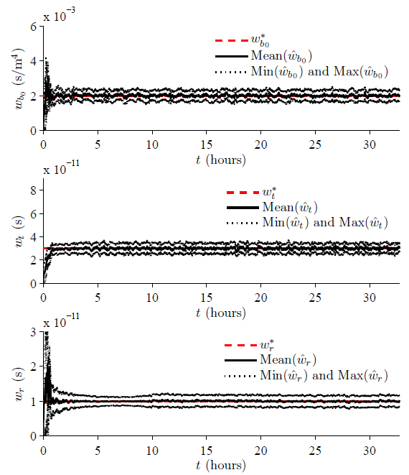
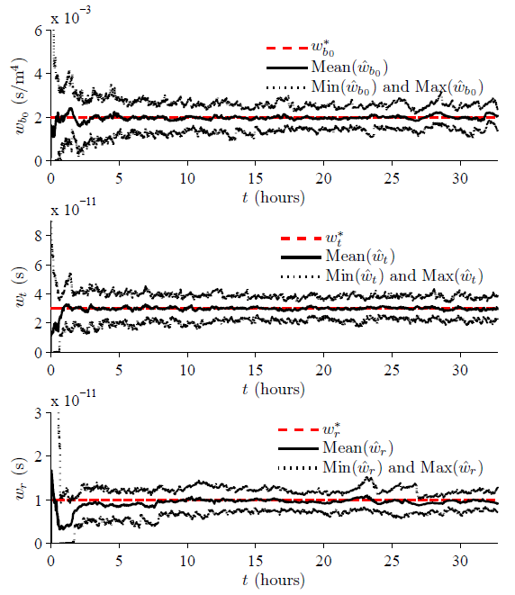
Results
Wear Parameter Estimation: UKF
Wear Parameter Estimation: PF
Fast convergence, small spread, and good accuracy.
Slower convergence, larger spread, and comparable accuracy.

Slide 22
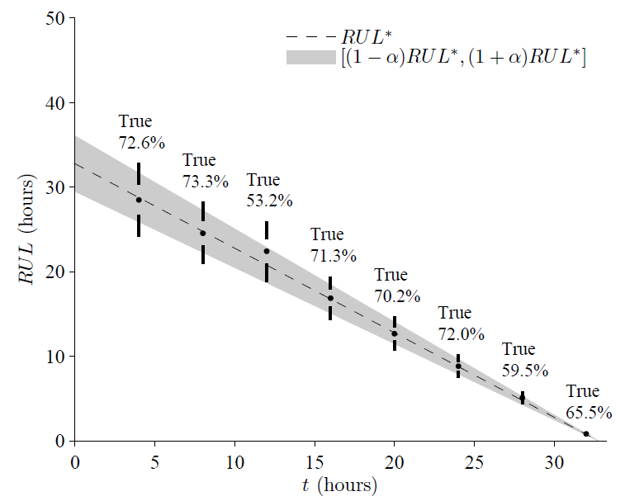
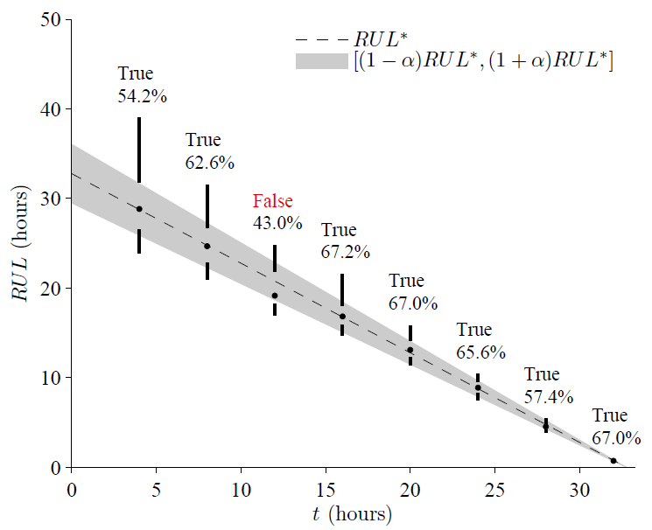
Results
Prediction: UKF
α=10%, β=50%
Prediction: PF
α=10%, β=50%
Predictions based on UKF estimates have a larger amount of the RUL distribution within the desired bounds. Accuracy based on the means are comparable.
Sigma point predictions require only 23 simulations, compared to the 500 for the particle filter.

Slide 23
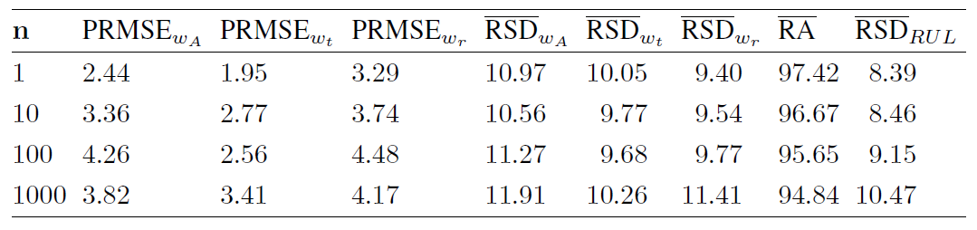
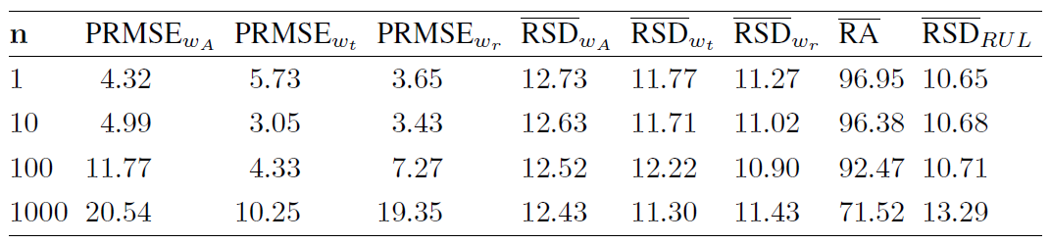
Results
Overall, UKF was more accurate and precise, and behaved better with higher levels of sensor noise
UKF outperforms the PF with much fewer computations
  But, UKF cannot be applied to all systems
Overall Results: UKF
Overall Results: PF

Slide 24
Conclusions
Described model-based prognostics framework using filters for the damage estimation step
Compared three different filters covering features like exact vs approximate and deterministic vs stochastic
  For prognostics, nonlinear filters are almost always required
  Although the Daum filter has some nice properties, it was found to be inappropriate for the pump, and likely for many practical systems for prognostics
  UKF is applicable to the pump and outperformed the PF in all respects, but the PF captures any type of dynamics (even mixed continuous/discrete) so has the highest level of applicability
Future work
  Investigate the approximate version of the Daum filter
  Investigate other exact filters
  Determine whether additional effort required for Daum filter is justified by the possible gain in performance

