Slide 1
Biospecimen Sharing Program (BSP)
Prepared by: Rebecca Klotz
Space Biology Science Definition and BSP Lead
May 31, 2018
Technical Exchange Meeting 2 (TEM-2)

Slide 2
BSP Overview
PURPOSE
The mission of the Biospecimen Sharing Program (BSP) is to maximize scientific return from specimens flown in space. BSP provides access to tissues that otherwise are not available to the scientific community. Tissue samples not used by the PI during Flight missions (non-treated, vehicle) are collected by the BSP team and then stored in the Ames Life Science Data Archive (ALSDA) and are available upon request/approval.
Core team members:
Yi-Chun Chen, Christina Cheung, Yael Kisel, Rebecca Klotz, Tyler Marsh, Karin Perkins, Hami Ray, America Reyes, Ryan Scott, Vandana Verma
ALSDA support: Alison French

Slide 3
BSP Process- Rodent Research
BSP Planning Phase
(up to 1 year of planning before Launch)
International agreements
Directed BSP- PI collaborators
Grant call for proposals
Dissection Phase
(up to 6 different timepoints; Baseline, Live Animal Return, ISS frozen carcasses, Ground Controls)
Sample Shipment
(i.e. pre-agreement with IMBP, JAXA, co-collaborator)
Sample Storage
Ames Life Science Data Archives (ALSDA)
LAUNCH
Tissues/Data can be requested by Science Community

Slide 4
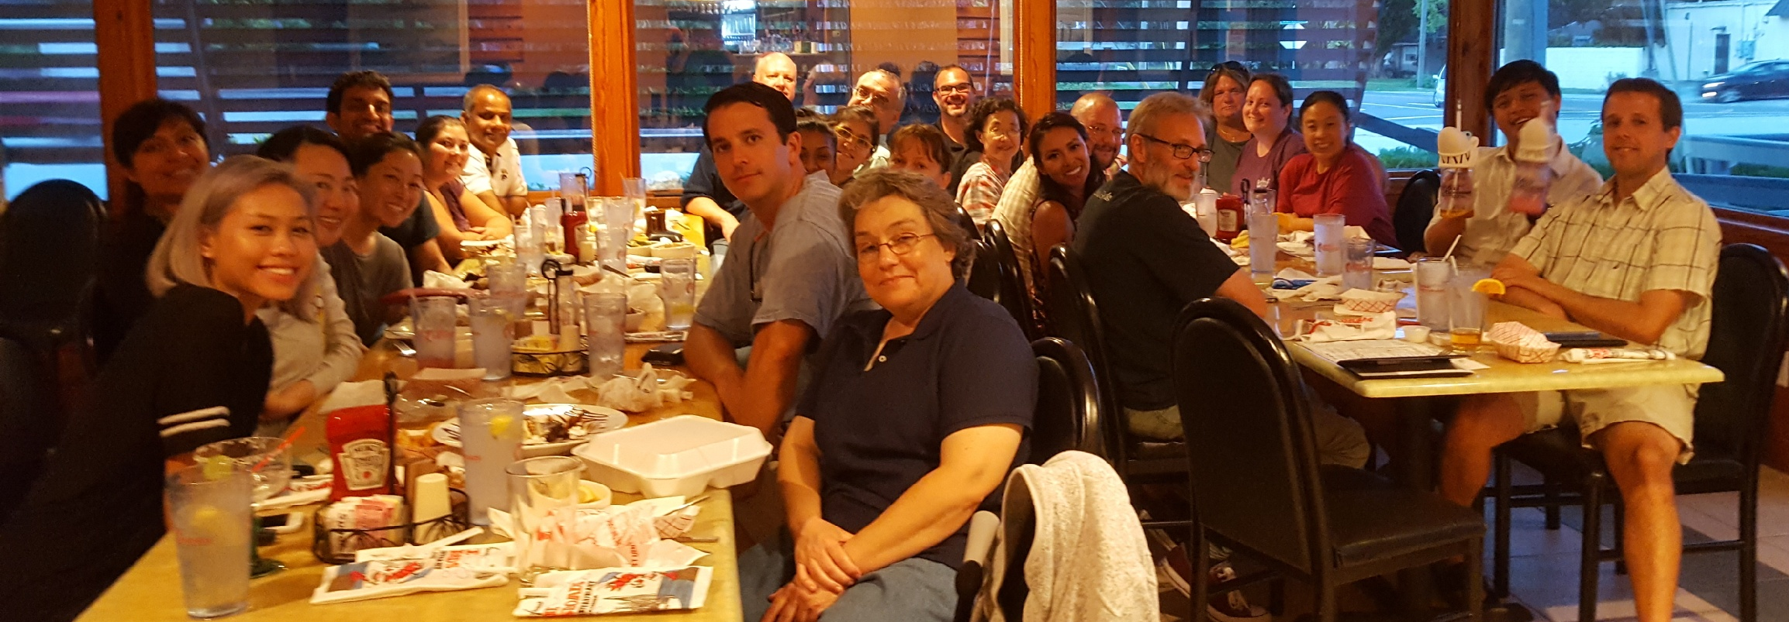
Current BSP Schedule
2018
JAXA MHU-2 completed in March (Tsukuba Space Center, Japan)
Rutkove rat experiment completed in April (Beth Israel Deaconess Medical Center, MA)
RR6 will be completed in the end of May (Houston Method Research Institute, TX)
RR9 will be completed in the end of June (Kennedy Space Center, FL)
RR7 will be completed by the end of this year (Northwestern University, IL)

Slide 5
Contact Information
For more information on Spaceflight Biospecimens visit:
Life Sciences Data Archive (LSDA)
https://lsda.jsc.nasa.gov/cf/scripts/biospecimens/bio_search_start_adv.cfm
Tissue/Data Requests
https://lsda.jsc.nasa.gov/Request/dataRequest
ALSDA
Alison French
alison.j.french@nasa.gov
650-604-0711
Biospecimen Sharing Program
Rebecca Klotz
rebecca.a.klotz@nasa.gov
650-604-1119

