Slide 1
SLS Element Definitions: Planetary Protection
NMCC: NASA Microbial Culture Collection

Slide 2
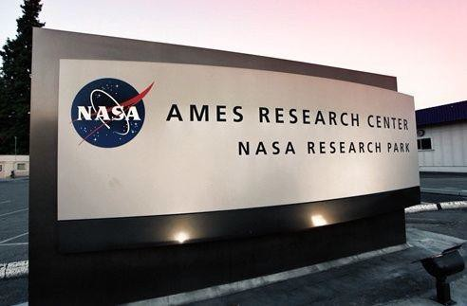
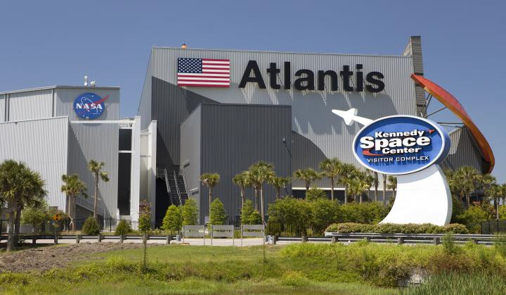
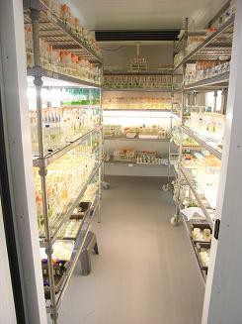
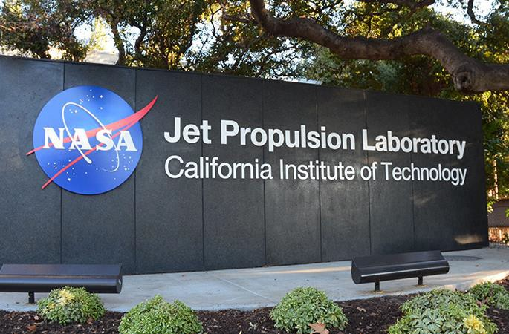
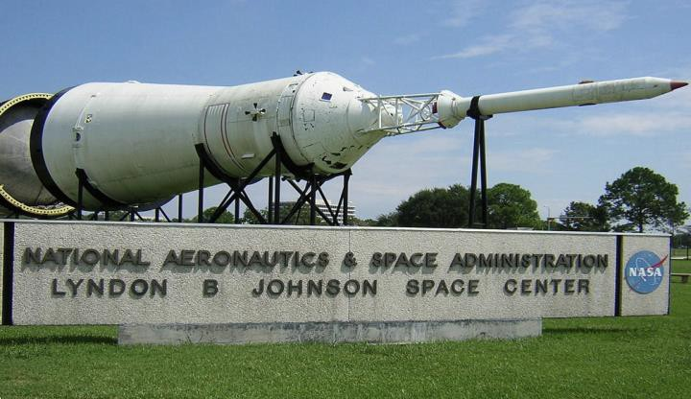
NASA Microbial Culture Collection (NMCC): A Multi-institutional initiative to safeguard NASA’s microbial repositories.
Proposed Concept from Parag Vaishampayan, et al.

Slide 3
Agenda
NMCC mission statement
NASA microbial collections across institutions and Technical Capabilities
Strategic Benefits to NASA
NMCC working group
Current Status: NMCC Phase I and Next Steps
Risks

Slide 4
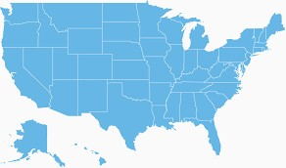
NMCC Proposed Mission Statement:
NASA Microbial Culture Collection (NMCC) will bring together multiple NASA centers for an organized effort to systematically:
document,
identify,
provide a means for long-term preservation, and
provide accessibility
to microbial isolates generated from NASA missions and funded research activities.
AMES
Other NASA Centers?
JPL
KSC
JSC

Slide 5
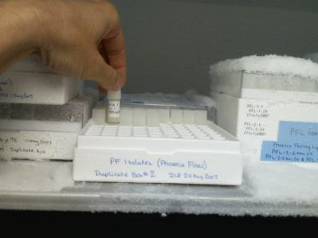
Why Archive Microbial Isolates ?
To meet requirements for microbial storage of:
ISS Microbial Monitoring for Human Health (e.g. human
pathogen) and
Planetary Protection (e.g. biological contamination
knowledge).
Scientific reproducibility, future application, and historical significance.
Potential commercial applications of isolates, and
byproducts.
Notes:
You can point to the bold text above as one element within the four SLS supported at ARC. OK

Slide 6
Status at NASA Facilities (~7000 isolates)
Kennedy Space Center
~500 isolates originating from the international space station and space shuttle projects
NASA Ames Research Center
~300 microbial isolates originating from NASA funded research projects in the upper atmosphere
Jet Propulsion Laboratory
~5000 microbial isolates originating from planetary protection implementation over the
course of ~45 years and 7 mars missions
~500 isolates originating from space biology research, and microbial observatory projects on the international space station.
Johnson Space Center
~200 isolates originating from NASA funded space biology research, relevant cleanrooms
at JSC, microbial monitoring of space suits.
~500 isolates originating from International Space station microbial monitoring

Slide 7
Technical Capabilities
AMES
Storage Facility, Data Archive (leveraging current ALSDA & Gene Lab resources)
JSC
Distribution Network, BSL-2 facilities (leveraging currently established protocols for distributing astromaterials)
KSC
Microbial Identification, Documentation (leveraging currently established
protocols for identification of ISS relevant microbial isolates)
JPL
Microbial Identification, Documentation (leveraging currently established
protocols for high throughput identification of planetary protection isolates)

Slide 8
Strategic Benefits of NMCC to NASA centers
1. Systematic documentation, identification, and long term preservation of existing in-house microbial isolates.
NMCC will ensure back-up of each institutional microbial repository in two geographically distinct locations.
NMCC will facilitate multi-institutional collaborative research across different NASA centers.
NMCC will lead to infrastructure and technology development of each participating NASA centers
support microbial curation activities.
NMCC will standardize best practices in microbial curations, and identification across NASA facilities to ensure safe long term storage of microbial isolates.
NMCC will establish local educational research collaborations, engaging local students in NASA research.
Notes:
I assume the Center benefits are related to procedures, methods, facilities, and collaborations. YES

Slide 9
Strategic Benefits of NMCC to NASA
NMCC will safeguard microbial repositories generated during the years of NASA funded research.
NMCC will serve as a centralized microbial repository for current and future NASA funded research
activities: ROSES, ISS, Astrobiology, Space Biology, HEOMD.
NMCC will engage Principal Investigators conducting NASA funded research for biological knowledge capture.
NMCC will facilitate physical resource sharing across multiple NASA institutions, strengthening
capabilities and collaboration. E.g. NASA Data Portal.
NMCC will facilitate exploration of microbial isolates for potential commercial applications: Bioreactors, Primary and Secondary Metabolites, Industrial production of enzymes, amino acids and pharmaceuticals.
Applications in future NASA science mission objectives: Planetary Protection technology development, and Life Detection Research.
Notes:
Are these benefits NASA-wide with both internal and external benefits? NASA WIDE

Slide 10
Current NMCC Working Group
Identified NMCC Working Group Members
David Smith (Deputy branch chief of space biosciences research) - NASA
Ames Research Center
Aaron Regberg (Astromaterials curator)- Johnson Space Center
Mary Hummerick (Vencore Services and Solutions)- Kennedy Space Center
Parag Vaishampayan (Planetary Protection Researcher), Arman Seuylemezian (Planetary Protection Researcher), James Benardini (Group Supervisor 352N)- Jet Propulsion Lab

Slide 11
Need for formalized culture collection
All working group members have confirmed that:
Isolates are not checked for viability
There are no duplicate collections present that could serve as a backup
Isolates are not redundantly stored
Isolates are not submitted to a formal culture collection (ATCC, DSMZ)
and Viability testing
Notes:
May be too much detail…
1. -Risk of losing physical culture due to insufficient maintenance
2. -Risk of losing the entire collection due to natural phenomena
3. -Risk of loss in viability
-Limited capabilities for distribution
4. -No visibility to the greater scientific community

Slide 12
Partial Phase I Requirements
Identify and coordinate with NMCC working group members. (completed)
Organize NMCC working group meetings (conference calls). (ongoing)
Develop a questionnaire/ survey to gather information about the ‘current microbial archive’ status at participating NASA centers. (completed)
Coordinate and update JPL line management, Center of Excellence project (COE), Mars Program
office and JPL Office of the Chief Scientist about on going NMCC efforts. (ongoing)
Gather inputs from all JPL stake holders and customers. (ongoing)
Develop a ‘NMCC Phase I’ package to present at NASA HQ. (ongoing)
Identify requirements to establish a formal microbial culture collection by working with currently
established industrial, and governmental culture collections. (ongoing)
Draft a NMCC SOP for systematic documentation, identification, long term archiving and accessibility to microbial isolates. (ongoing)
With the inputs from NASA HQ and working group members, we will develop a working model for
NMCC Phase. (ongoing)
Notes:
This is your STATUS slide… YES

Slide 13
Next Steps in upcoming Q2-3 (FY18)
Define the scope of NMCC in the following categories:
Distribution capabilities- to what extent will we be distributing the materials stored within NMCC
Accepting microbial isolates- what kinds of materials/isolates will NMCC accept
Document written buy in from currently identified stake holders
Identify potential funding sources at each institution, as well as at NASA HQ
Out brief of activities at upcoming life science definition team/workshop
(TBD)
Identify and reach out to additional NMCC working group members, potential technical consultants.
Brief Lisa Pratt on NMCC activities and path forward (Planetary Protection Officer).

Slide 14
RISKS
Outreach to the scientific community
Not doing viability testing on microbial collections
Need of a NASA core facility for housing model organism
Not maximizing ROI
Non-existence of a common NMCC database
Notes:
Good one….

Slide 15
BACKUP

Slide 16
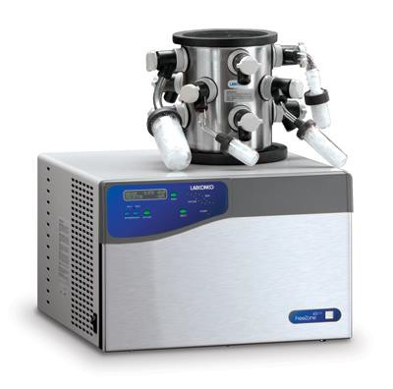
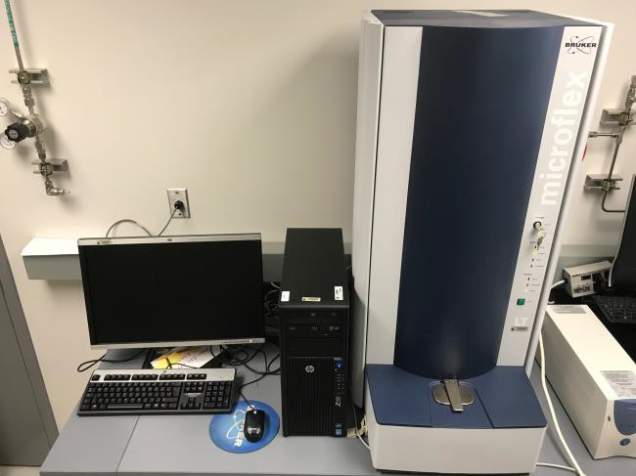
Space Microbiology Lab
-80 ℃ Freezers for long term preservation
Freezer Dryer
DNA Extraction and Quantification
MALDI-TOF Mass Spec for
rapid bacterial ID
Biochemical Microbial ID system

Slide 17
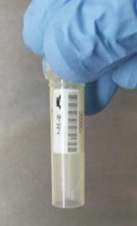
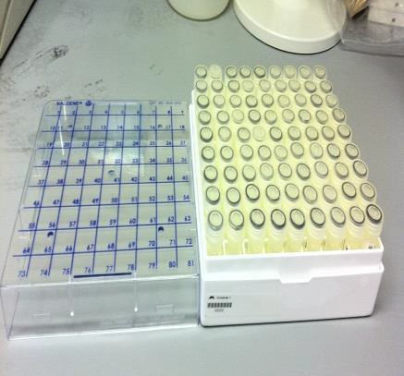
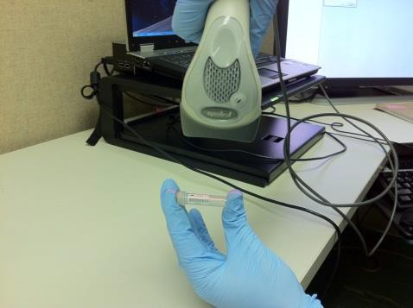
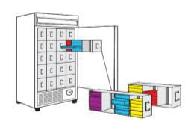
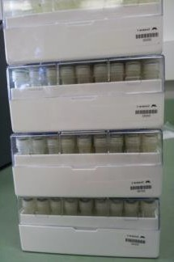
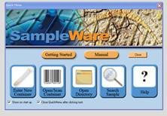
JPL Microbial Culture Collection: A
model for NMCC
Viking (1975): 1454 strains
Mars Pathfinder (1996): 62 strains
Mars Odyssey (2001): 97 strains
Mars Exploration Rovers (2003): 870 strains
Phoenix (2007): 824 strains
Mars Science Laboratory (2012): 1437 strains
InSight (2018): 374 strains
• M2020 (2020): 556 strains
Sample labeling and storage
Easy sample Tracking
(-80°C freezer)
SIMS
Long Term Sample storage
In total, JPL microbial archive includes 5,674 spacecraft related cultures that span NASA’s robotic exploration of Mars ranging from 1975-2017.

Slide 18
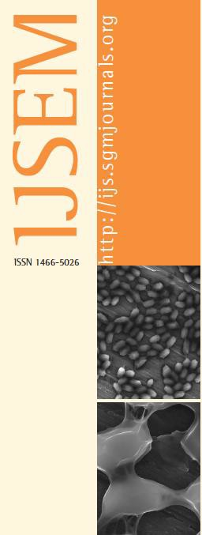
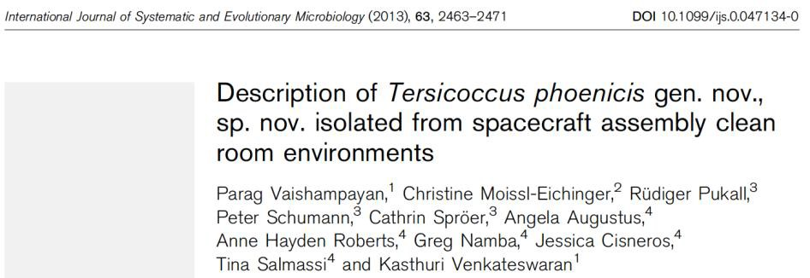
Untapped microbial resources: A model for NMCC
JPL currently houses an estimated ~150 novel bacterial species.
We have characterized >15 novel bacterial isolates from spacecraft and associated surfaces.
These novel isolates may have potential industrial applications.
Researchers around the world will be interested in exploring these untapped resources.
Established collaborations with local institutions (Cal Poly Pomona, California State University, Northridge) to characterize and publish novel microbial species.
Commercial Applications

Slide 19
NPD 7100.10F
“It is NASA's policy to provide for the curation of NASA's institutional scientific collections as a set of physical specimens, living or inanimate, created for the purpose of supporting science and serving as a long-term research asset, and, as appropriate and feasible, the associated specimen data and materials. The materials in NASA's scientific collections represent a unique and limited national resource and an important legacy to future generations.”
The following groups have been informed of ongoing NMCC Efforts:
Chief scientists at all 4 institutions are aware of the above mentioned requirement
and each respective individuals involvement in this working group.
Dr. Fuk Li (Director of the Mars Program Office) at JPL has been informed of ongoing efforts in this regard
Dr. Melissa Jones (Assistant Section Manager, 352), and PP Center of Excellence manager (Dr. Alvin Smith) at JPL has been informed.
Dr. Patricia Beauchamp (Chief Technologist ESD)

Slide 20
NMCC Proposed Structure:
Depositors
Nasa centers, NASA funded research projects
NMCC
Lead
Identification
Documentation and accessibility
Long-term Preservation
Distribution
JPL
JPL
KSC, JSC
AMES
KSC, JSC, JPL, AMES
NASA centers, University based Researchers
10

Slide 21
Rationale:
A large number of microbial repositories are present in each NASA centers.
Planetary protection (JPL)- 5000 strains
Space biology research (Ames, KSC)- 500 strains
ISS microbial observatory (KSC, JPL)- 1000 strains
HEOMD (Nasa centers)- 500 strains
Astrobiology/ Exobiology research projects (NASA centers)- 1000 strains
Existing collections are within the discretion of individual PI’s with no transparency to the scientific
community at large, and under risk of being lost due to lack of maintenance.
No traceability:
Unorganized: lack of standard documentation.
Unavailability:
Lack of systematic documentation and long-term archiving may result in loss of partial or
complete microbial repository.
Several other Federal Agencies support microbial culture collection activities.
CDC- Centers for Disease Control
USDA ARS NRRL- Agriculture Research Service Culture Collection
National Center for Marine Algae and Microbiota

Slide 22
Can NASA submit isolates to an existing
culture collection? No.
Existing culture collections are agency specific.
National Center for Marine Algae and Microbiota
CDC- Centers for Disease Control
USDA ARS NRRL- Agriculture Research Service Culture Collection
Government or university based archiving facilities (eg. NRRL) have limited infrastructure and resources and can only accept 100 cultures/year
With ~17,000 cultures in total it will take 100s of years for NASA to deposit.
Majority of public microbial culture collections are small biologically niche specific:
E.coli Stock Center- ~2,500 strains
Bacillus Stock Center- 2,439 strains
Phaff Yeast Collection- 6,000 strains
Commercial microbial culture collections (ATCC) will accept only commercially relevant microbes.
Depositing microbial isolates in a commercial microbial culture collection such as ATCC will cost ~68 M and is therefore not an economically viable option.
Notes:
This is part of the rationale, right? yes

