Slide 1
Ames Life Sciences Data Archive (ALSDA) and ARC Biobank and Institutional Scientific Collection (ISC) Collaborative Life Sciences Technical Exchange Meeting NASA ARC, May 31, 2018 Alan Wood ALSDA Information Systems Lead

Slide 2
Ames Life Sciences Data Archive (ALSDA)
ARC Biobank an Institutional Scientific Collection (ISC)
The ALSDA Assets and Services include:
The Research Data Management System (RDMS)
Experiment, payload, hardware, mission & etc. descriptions.
The Collaborative Life Sciences Repository (CLSR)
Cloud resource for capturing and making available ISS downlink video and data.
The Ames Biobank and Institutional Scientific Collection(ISC).
All SpaceBio, Ames HRP HHC non-human biospecimens.
Specimens available for sharing are part of the ISC.
Cryotrack biospecimen inventory management system tracks specimens for:
SpaceBio and the ISC
GeneLab
JSC Human Research Repository (not astronaut medical specimens)
Support to NASA Space Radiation Lab biospecimen sharing program.
Notes:
This is the central slide and will be basis of presentation with other slides included for backup.

Slide 3
Ames Life Sciences Data Archive (ALSDA)
ARC Biobank an Institutional Scientific Collection (ISC)
Q1- What is your current data/sample archiving status or plan?
The ALSDA captures, curates, preserves and disseminates Ames-managed flight and ground based research. Currently ALSDA data repository includes over 800 life sciences experiments dating back to the Gemini Program. The ARC Biobank, a NASA ICS, collects biospecimens from space flight experiments conducted aboard the Space Shuttle and ISS.
Q2 - What do you collect in your archive? What metadata is collected?
NASA Space Life Sciences human and model organisms research data. Standardized life science research metadata.
Q3 - How is your collection accessed and who are the users?
Users range from NASA Management, Investigators and the public. Accessed online through public web as well as through NASA secure network access for non-validated data.
Q4 - What are the projected benefits of your archiving efforts? (to NASA, Science Community and the Public)
Provide resource for proposals, basis for NASA life sciences evidence base.
Q5 - What are your greatest risks? Current, projected?
Making the data accessible and long term preservation.
Q6 - What is your roadmap for the Beyond LEO era?
Look at how to hand over necessary portions to commercial LEO operators and package products for Deep Space activity/availability.
Q7 – Do you want to collaborate with others across SLS? If so, whom and how?
Absolutely necessary for providing (at least) coherent User Interface for the User Community.
Notes:
This is the central slide and will be basis of presentation with other slides included for backup.

Slide 4
Ames Life Sciences Data Archive (ALSDA)
ARC Biobank an Institutional Scientific Collection (ISC)
Background of the LSDA
Early work started in 1989-90 and first funding 1993
Object was to address congressional mandate to archive and make available NASA Life Sciences Data.
Learned from Planetary Data Systems (PDS), NSSCD at Goddard and participated in the development of the OAIS (see next slide) with CCSDS & ISO which used Dublin Core, Medline and other standards and data collections.
Originally composed of teams from Goddard, KSC, JSC and ARC.
Early challenges included
Resistance from the life science investigators to sharing their raw and analyzed data.
Rapidly changing digital formats (videocassettes, film reels, CD, DVD and then WWW).
Uncertain commitment to funding.
Problems associated with a distributed system.
Current Challenges:
Long-term preservation: changing file and media formats, application and OS evolution
Access; probably biggest of all, how to provide users with reasonable discovery tools in an increasingly crowded world of big data.
How to promote translational science on biobanked samples to the science community
Domestic and international science outreach
Notes:
This is the central slide and will be basis of presentation with other slides included for backup.

Slide 5
The LSDA is Based on the
Open Archival Information System (OAIS)
OAIS reference model provides: fundamental concepts for preservation
Fundamental definitions so people can speak without confusion
Provides vocabulary – widely applicable
Defines important roles in digital preservation
Conformance defined
OAIS approach to digital preservation:
Covers all types of digitally encoded information
Provides a way to test whether preservation is successful
Does not require seeing into the future
Does require transparency
Does not require “open access”
Does not cover:
Social and organizational aspects
Finance etc.
Many detailed aspects noted in the "roadmap of follow-on standards"
is not meant as a design/blueprint for a repository because it must allow greater flexibility for implementations
OAIS does provide a good basis for certification
It is the most widely accepted reference model for digital archives worldwide.
Notes:
This is the central slide and will be basis of presentation with other slides included for backup.

Slide 6
Life Sciences Data Archive (LSDA) and GeneLab Dataflow
JSC Astronaut Medical Data
LSDA Public Web Site
https://lsda.jsc.nasa.gov
JSC Human Research Experiments
GeneLab Public Website
(https://genelab.nasa.gov/)
2
2
Genelab
2
2
Bio-repositories
Verified & ready for public release experiment descriptions & data
NASA Exp Desc
Space Radiation Labs (NSRL) Specimen Sharing
KSC
3
Omics Data Sets
Non-NASA Exp Desc
KSC Life Sciences Data Archive
Relational Database Management System (RDMS) & CLSR (Cloud)
JSC HRP Institutional Bio-Repository
ALSDA and BSF (ARC ISC)
JSC
ARC
HCC
TSP
Cryotrack Biospecimen Inventory Db
Selecting for JSC Life Sciences
Selecting for KSC Life Sciences
Selecting for ARC Life Sciences
CASIS/National Labs
Selecting for Space Life Genomics
1
1
Archivists collect and harvest data from many sources
2
Nodes transfer verified data & metadata to Central Node
PI & Project Science Data
Task Book
Grants
ISS Website
Conferences
3
Nodes transfer data between Nodes
Data and metadata sources
Possible and planned connections

Slide 7
Ames Life Sciences Data Archive (ALSDA)
ARC Biobank an Institutional Scientific Collection (ISC)
Reference Slides

Slide 8
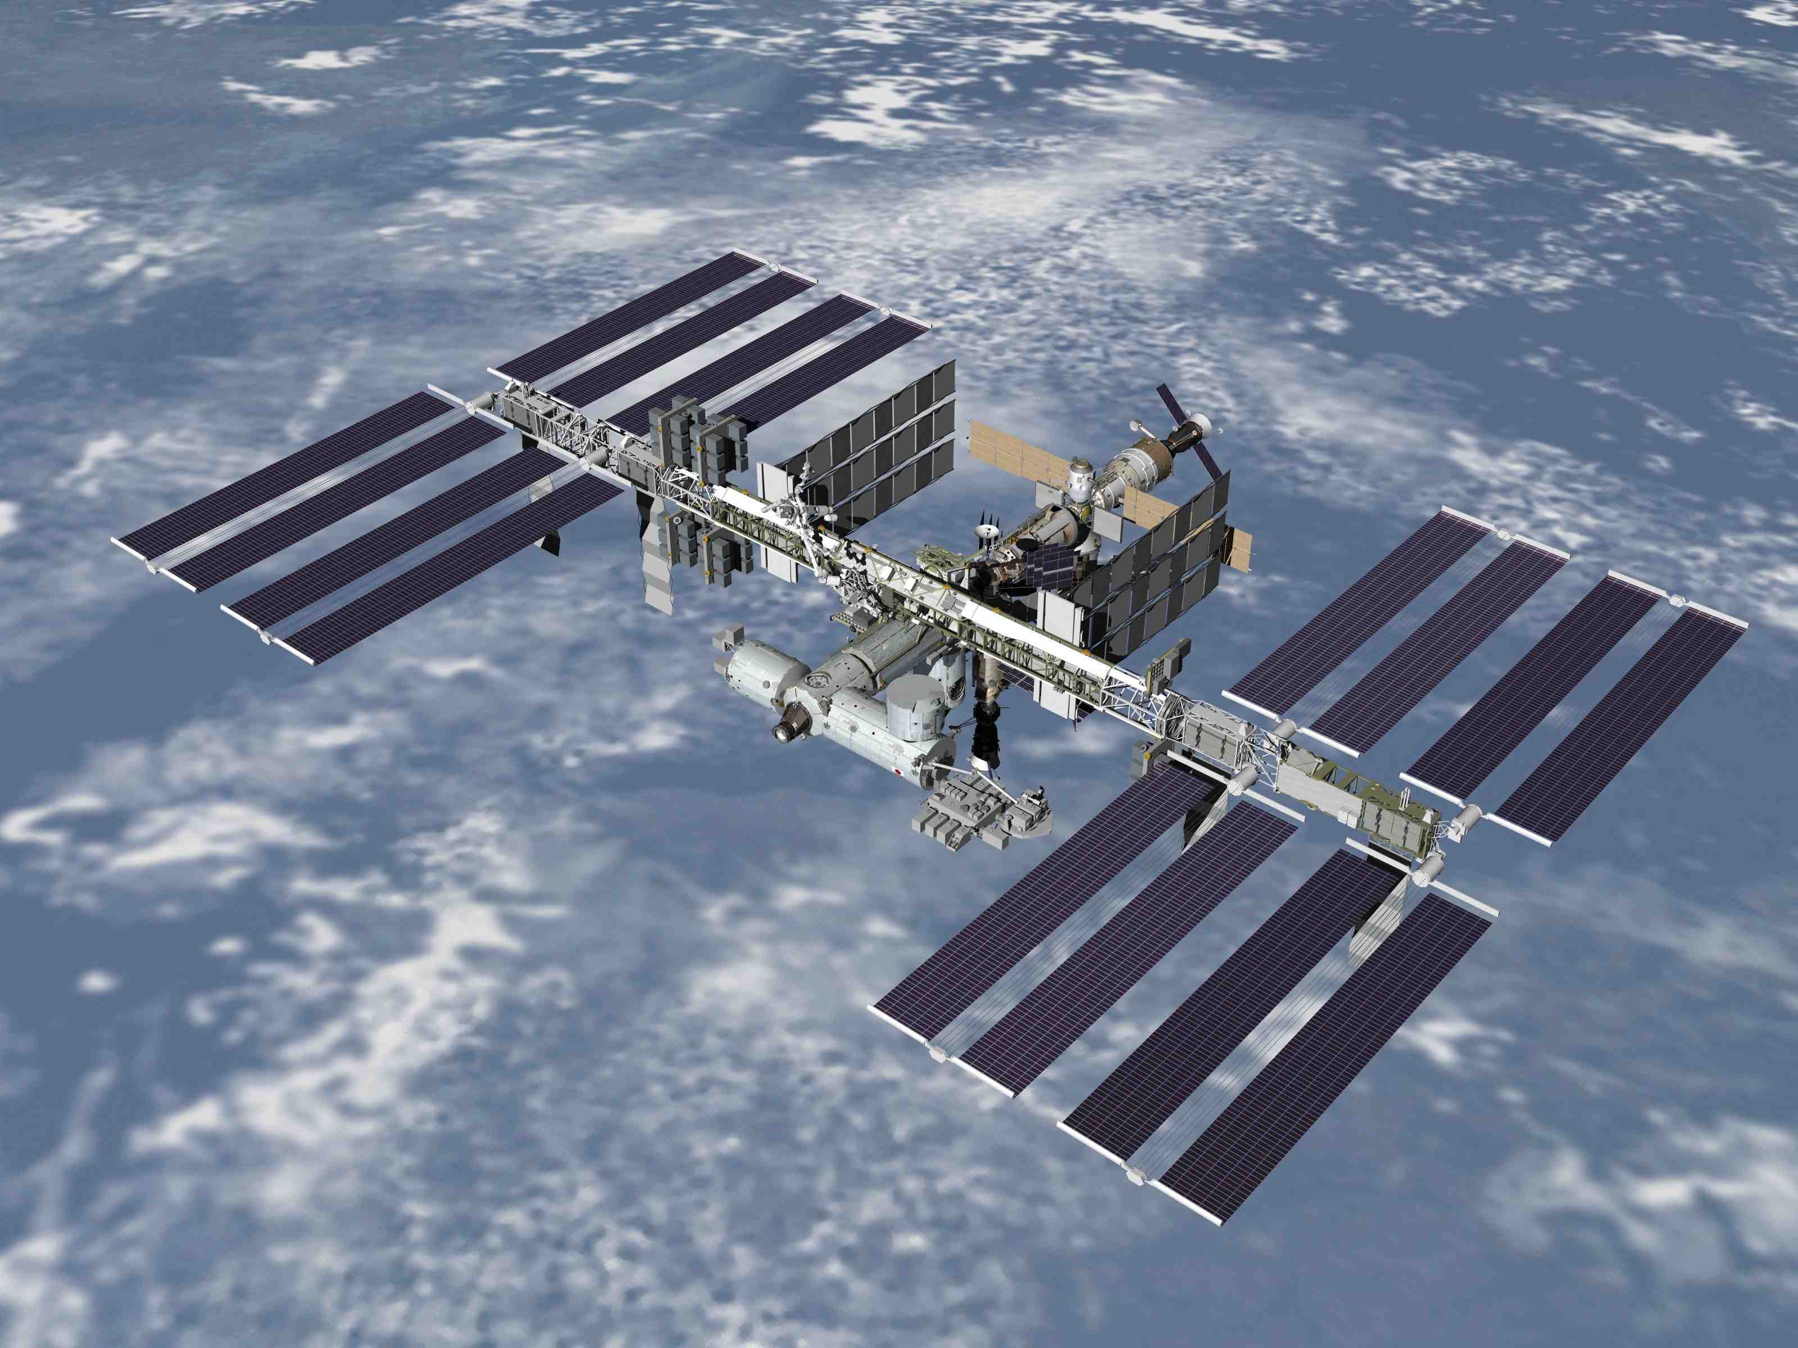
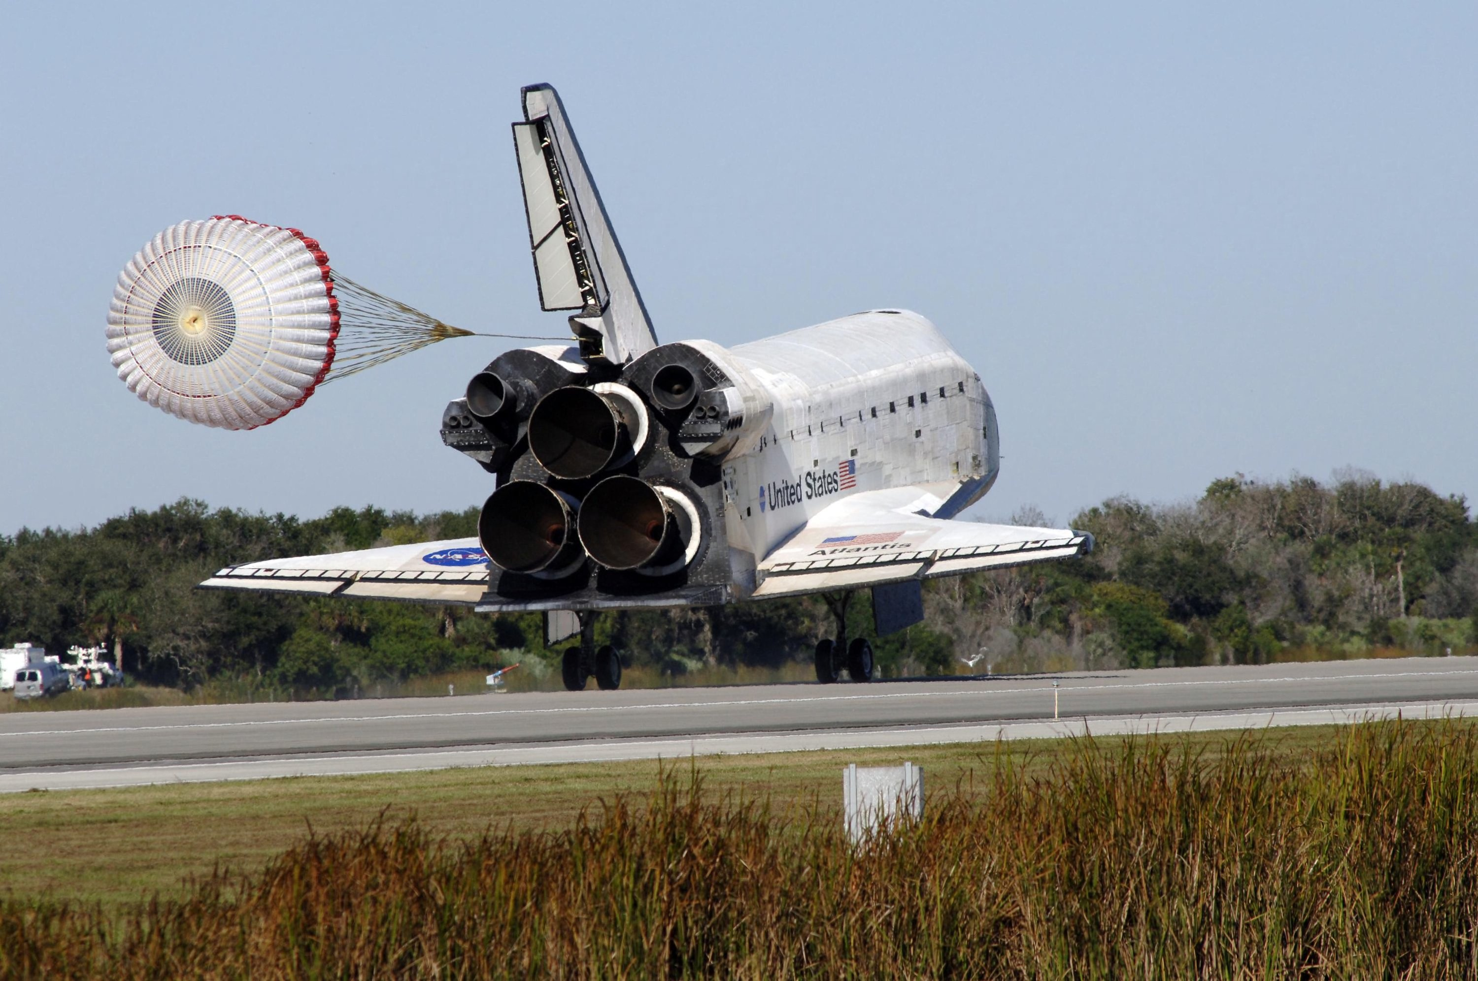
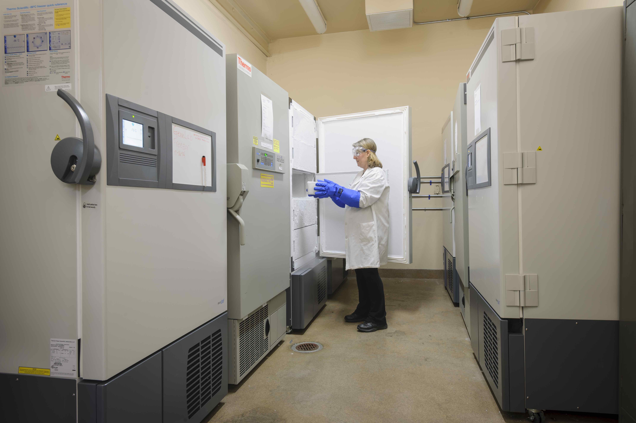
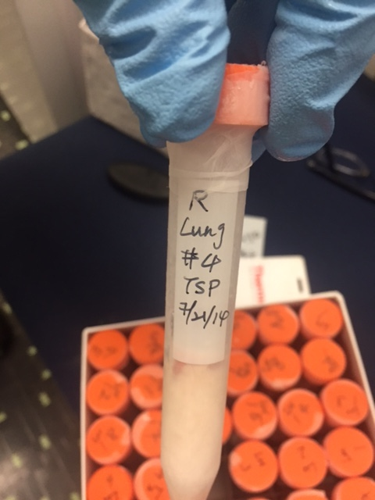
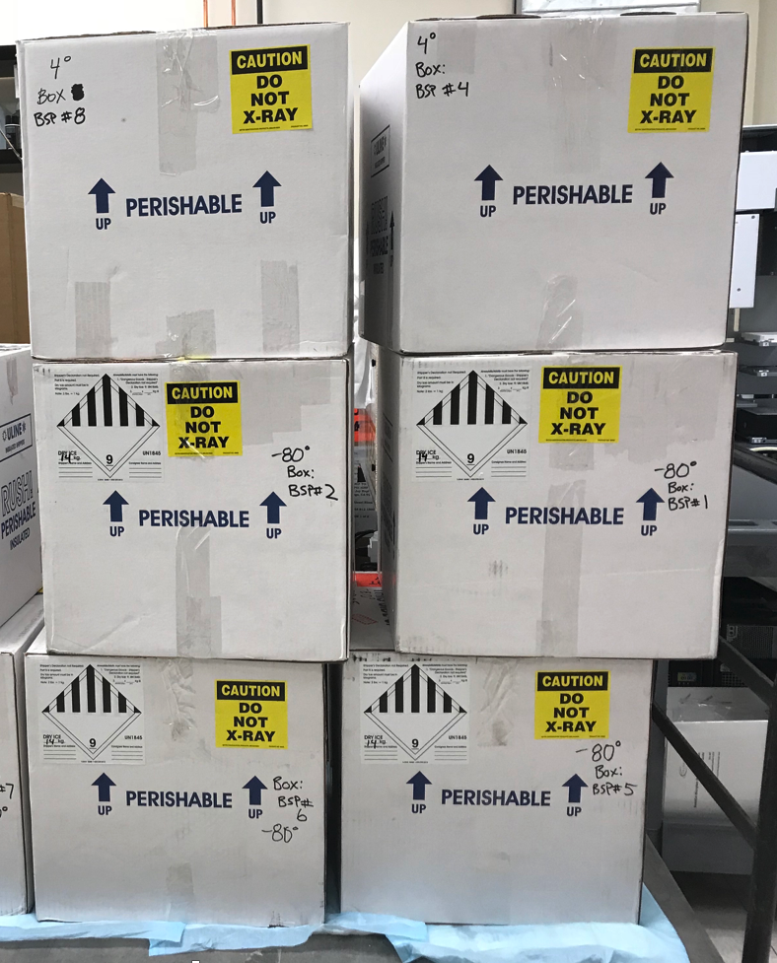
Ames Life Sciences Data Archive (ALSDA)
ARC Biobank and Institutional Scientific Collection (ISC)
Background
The ARC biobank includes more than 27,000 preserved biological specimens from experiments dating from 1975 to the present. These biological specimens were derived from spaceflight investigations conducted during space shuttle missions and aboard the International Space Station, and from related ground studies.
Services
Specimen collection, receipt into the repository, inventory, cataloging, chain-of-custody tracking, long term storage, listing on the public LSDA website, processing of specimen requests and distribution
Inventory management
Secure inventory management system
Metadata includes: tissue type, species, fixation method, treatment, storage temperature, chain-of-custody and other pertinent information
Requests
Submitted through Space Biology NRA (ROSBio) or LSDA request page https://lsda.jsc.nasa.gov/Request/dataRequest
LSDA requests are peer reviewed in accordance with Ames protocols
Biospecimen Storage Facility (BSF)
Located in a secure building
Seven -86ºC Freezers, ~0.6 m³ each, one maintained as back-up
One -20ºC Freezer
One +4C Refrigerator
Independent temperature monitoring system (FY’19)
Approved for storage of tissues with radioactive isotopes
Fail-safe power backup; connected to emergency generator; all units alarmed and monitored 24/7
Emergency procedure and trained personnel on call 24/7
Meets NPD 7100.10F Curation of Institutional Scientific Collections and National and International Standards for Biobanking in alignment with ISBER
Notes:
Do not plan to do a detailed read of this slide but here to provide info in the package.

Slide 10
Ames Life Sciences Data Archive (ALSDA)
Managed Grants
HRP and Space Biology Funded Investigations
804 experiments records, 1975 to 2017
698 legacy experiments, 1975 to 2015
- no further information expected
110 of those 800 experiments are active, 2010 to 2017
200 experiments linked to BSP investigations, 1996 to 2017
Biospecimens
~25,000 Frozen Samples (~10,000 are HRP)
~2,500 Ambient Samples
Complete- indicates data and/or results have been collected and archived. No further information is needed.
Investigations in Progress- DSA’s signed and awaiting completion of the investigation or archivist attempting to collect data from the PI

