Slide 1
Biospecimen Culling Plan
Jon Rask
Kaushik Chakravarty

Slide 2
Outline
Objectives of the Biospecimen Culling Plan
Biospecimen Culling Plan Approach
Biospecimen Culling List Summary
• RNA Analysis Candidates
• Histology Candidates
Scientific Opportunities
Summary

Slide 3
  Objectives
Increase available space for future samples in the BSF.
Identify candidate biospecimens for RNA integrity analysis.
Identify biospecimens that should be discarded.
Further characterize select biospecimens in the BSF.
Perform extraction and purification of RNA from selected biospecimens.
Collect RNA integrity data from the select biospecimens.
Determine if tissues frozen at -70˚C are viable for omics analyses and the GeneLab data repository.
Prepare a NASA white paper and/or a manuscript.
Provide disposition recommendations for biospecimens in the culling list.
Support and guide NASA policy on best practices for curation of biological collections (NPD 7100.xx Scientific Collections Directive), addressing stowage duration and temperature, sample testing cycle and frequency.

Slide 4
Biospecimen Culling Approach
Phase 1: Electronic Sorting of Biospecimens Culling list
- Sort information on mission, launch date, payload, kind of organism, tissue type, number of tissue samples, radioactive tracers, storage temperature, and fixative use (if any).
- To Identify candidates for RNA analysis, histology, disposal, RFP
Phase 2: Laboratory Activities
- Sample analyses to determine RNA Integrity Number (RIN)
Phase 3: Additional Testing, RFPs, and Omics Analyses

Slide 5
Assumptions for RIN Data
8 or above: Viable for future omics analysis
5 to 7.9: Viable for qPCR.
Samples may still have viable DNA and could be used for genomics, histology, or immunohistochemistry.
Less than 5: Considered non-viable for RNA analysis.
The samples may still have viable DNA and could be used for genomics, histology, or immunochemistry.
RIN data can be made available to the science community via an RFP.

Slide 6
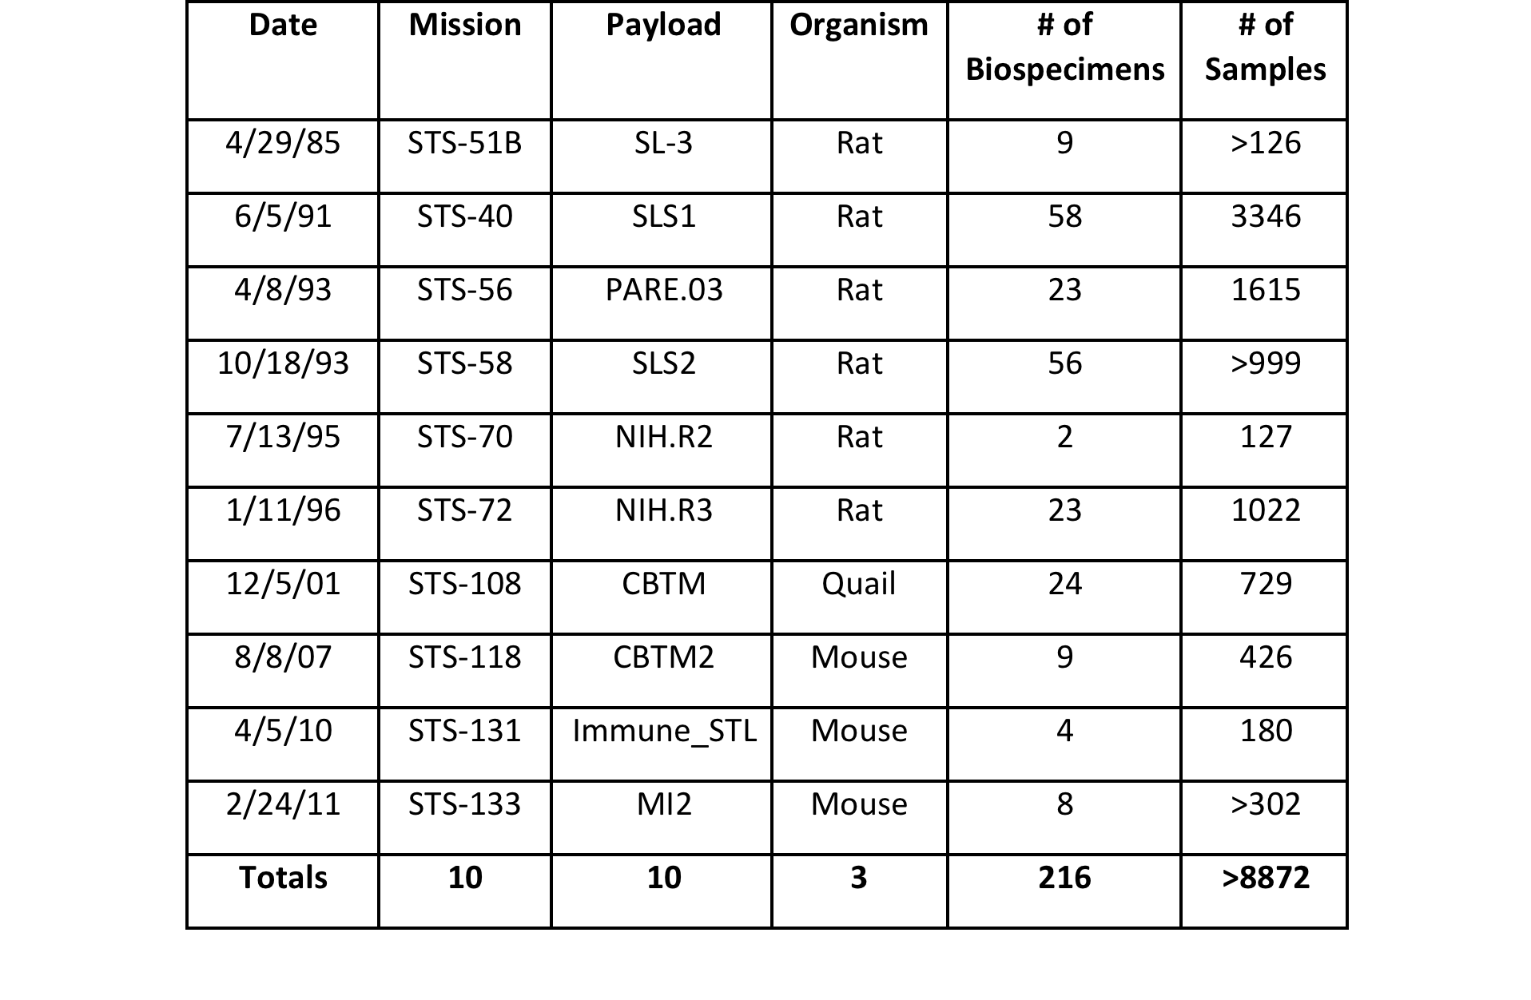
Biospecimen Culling List Summary

Slide 7
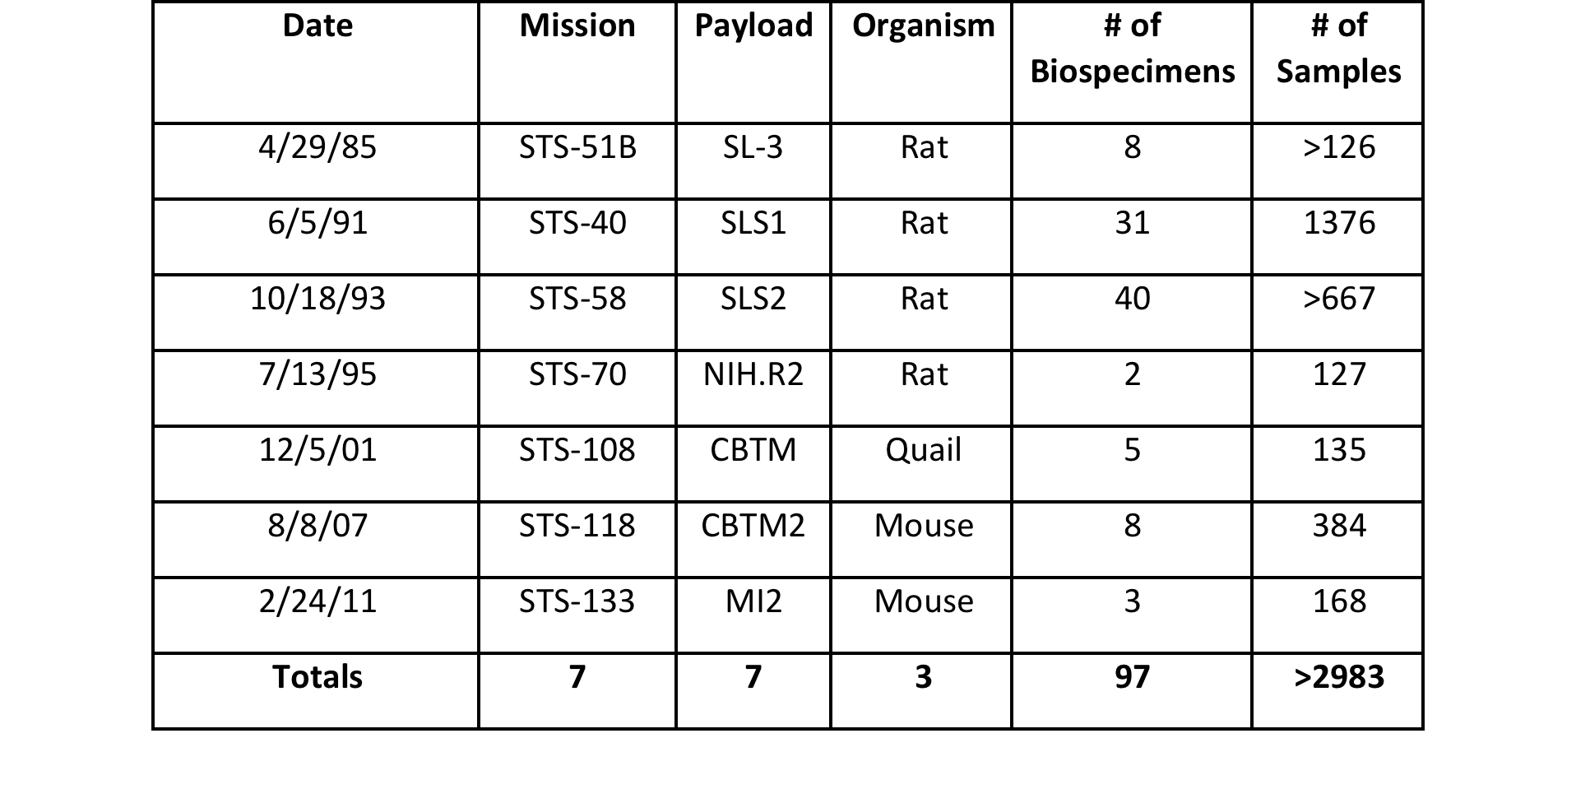
RNA Analysis Candidates

Slide 8
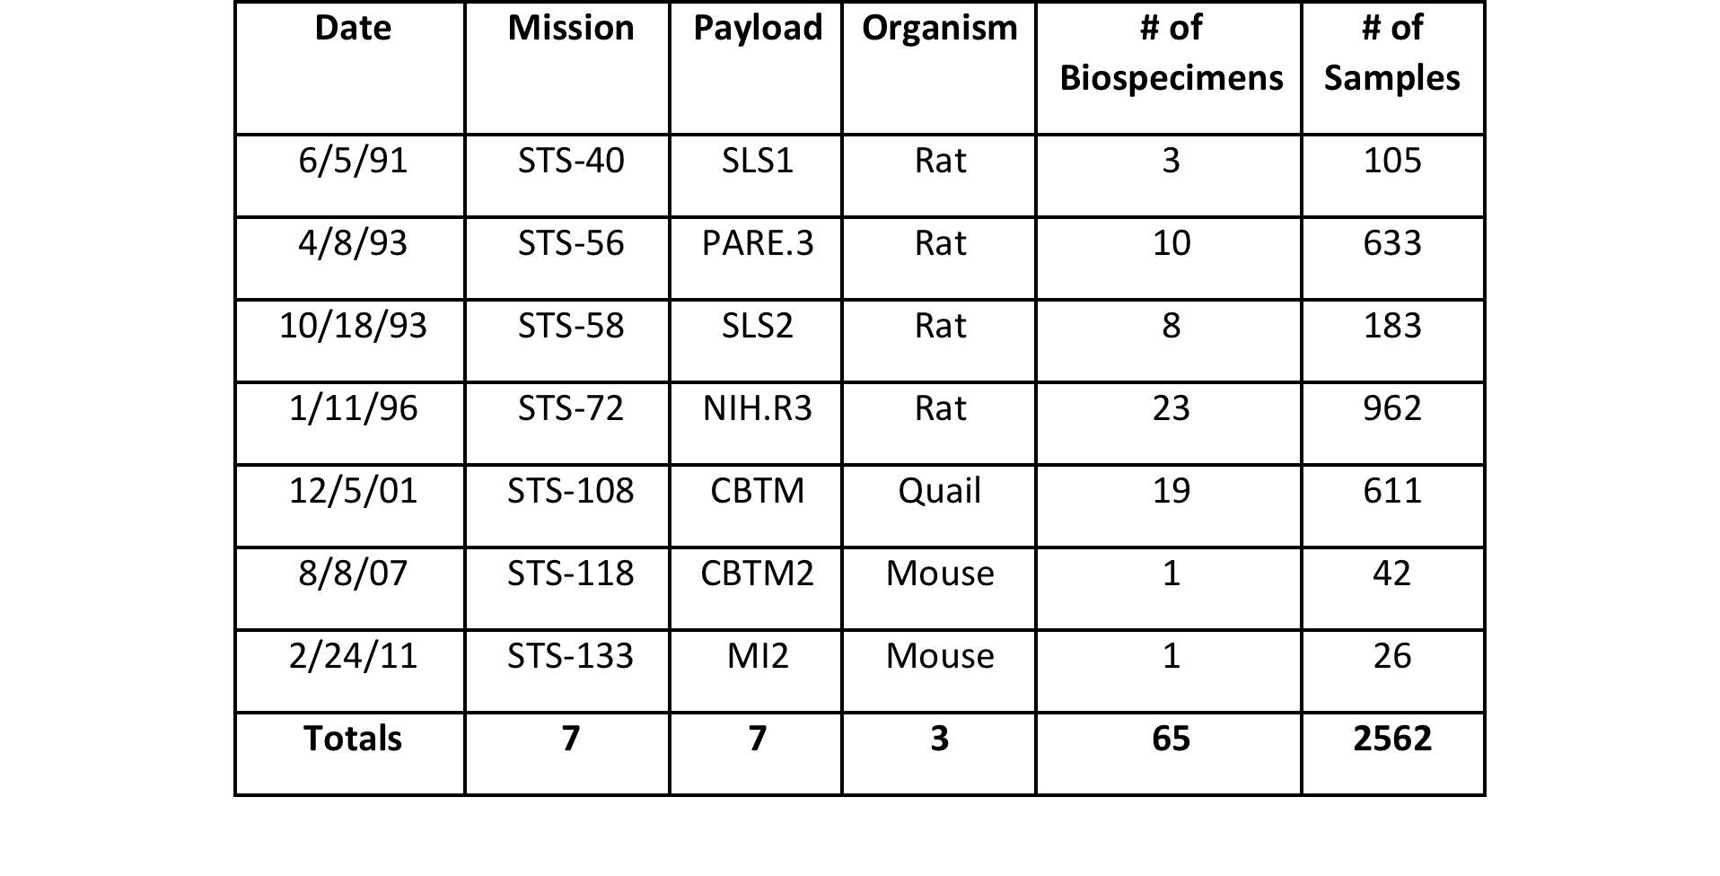
Histology Candidates

Slide 9
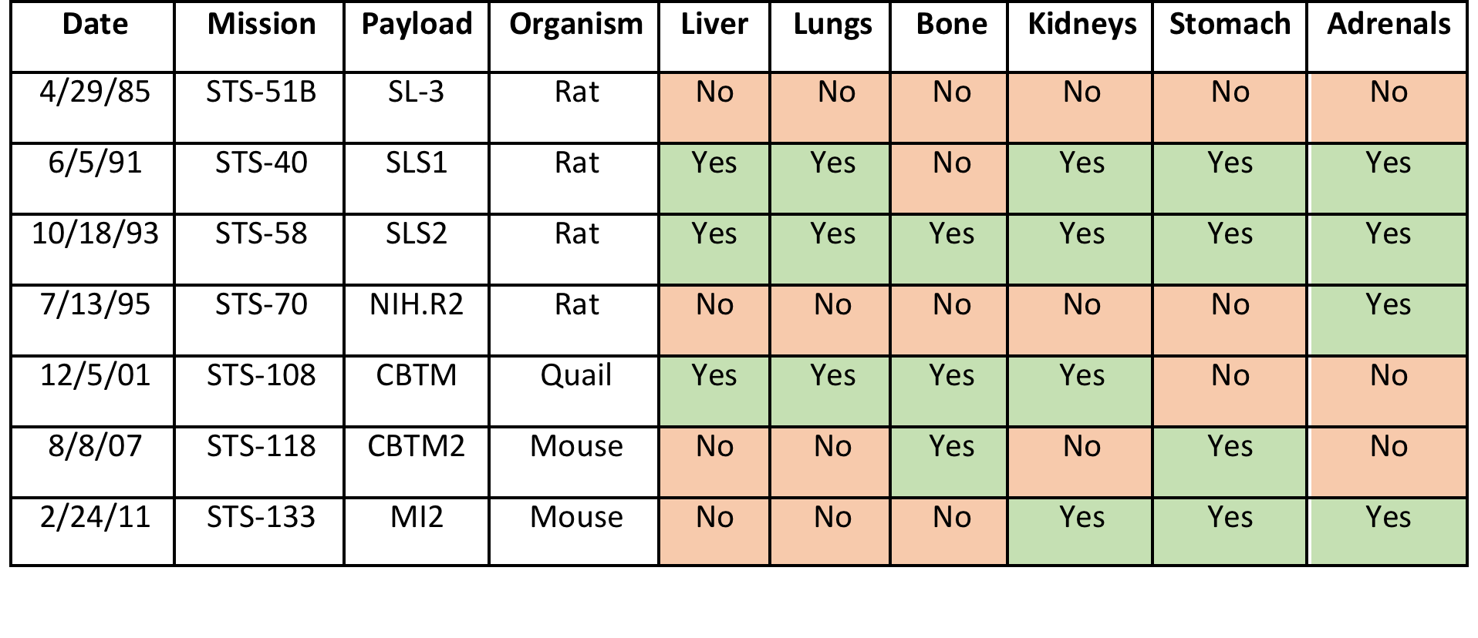
Common Tissue Types in the RNA Analysis Candidates

Slide 10
  Scientific Investigation Opportunities
Omics Analysis: Transcriptomic and Epigenomic
Temporal assessment of tissue and RNA viability from spaceflight samples
rRNA evolutionary studies across different species
Functional analysis of housekeeping genes from the purified RNA, as support to the RFP

Slide 11
  Summary
Developed a RIN-focused methodology for culling of biospecimens stored at -70˚C.
  Established criteria for science viability using RIN scores
Completed electronic sorting of biospecimen culling list
Identified ~89 RNA analysis candidate biospecimens
The most common tissues types found across all six missions stored in the BSF were liver (3 missions), lungs (3 missions), bone (4 missions), stomach (4 missions), kidneys (4 missions), and adrenals (4 missions).
Results from the culling process will support and guide NASA policy on best practices for curation of biological collections, (NPD 7100.xx Scientific Collections Directive) by addressing stowage duration and temperature, sample testing cycle and frequency.
  Complete preparations for lab activities
  Collect RIN data from biospecimens
  Analyze RIN data
  Draft disposition recommendations
  Draft report/manuscript of results

Slide 12
  Next Steps
• Upon completion of Phase 2 RIN analyses, we will better understand the scientific viability of samples stored at -70˚C in the BSF.
• If many samples are found to have high RIN scores, additional RNA analyses may be warranted.
• Upon agreement of biospecimen dispositions, Request for Proposals (RFPs) can be drafted to make samples available based on our most current understanding of the sample viability per the biospecimen culling list and plan.
• Send samples with RIN scores of ≥8 to Omics facilities for analyses and submit data to GeneLab.

Slide 13
Acknowledgements
Helen Stewart
Jeff Smith
Michael Skidmore
Alison French
Frances Donovan
Oana Marcu
San-Huei Lai
Sungshin Choi
Rick Chen
Alan Wood

Slide 14
Questions?

Slide 15
  Stakeholders
Biospecimen/data archive facilities
Bioscience research and development programs and projects
Scientific Community

