Slide 1
Rectangular Supercritical Wing
Thorsten Hansen ANSYS Germany GmbH

Slide 2
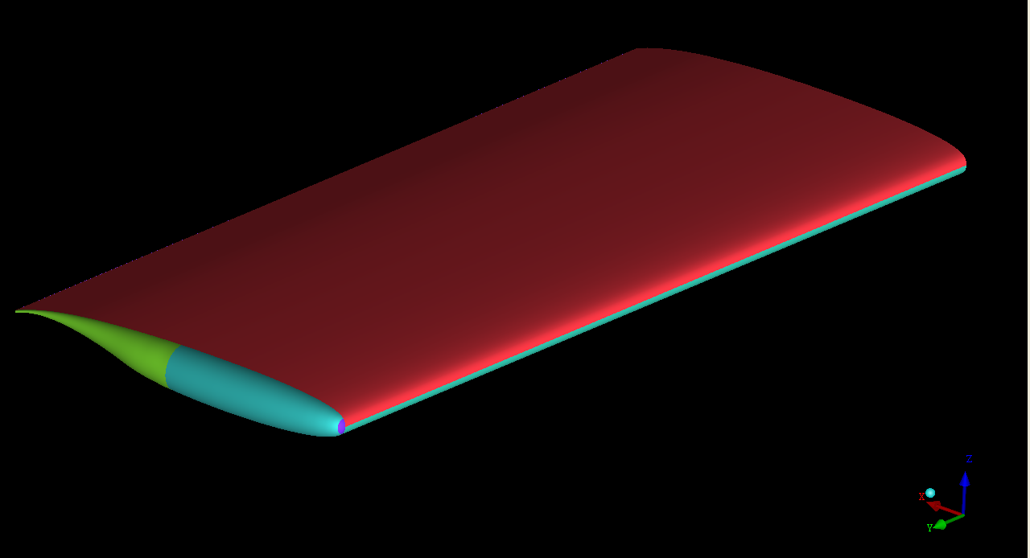
Aeroelastic Prediction Workshop
All data and information downloaded from
https://c3.nasa.gov/dashlink/static/media/other/RSW_base.htm
Geometry in IGES data format

Slide 3
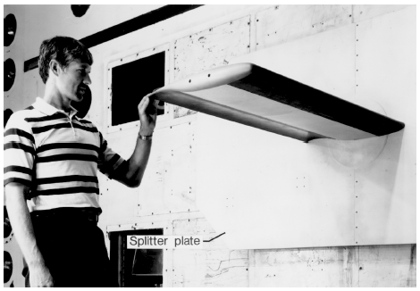
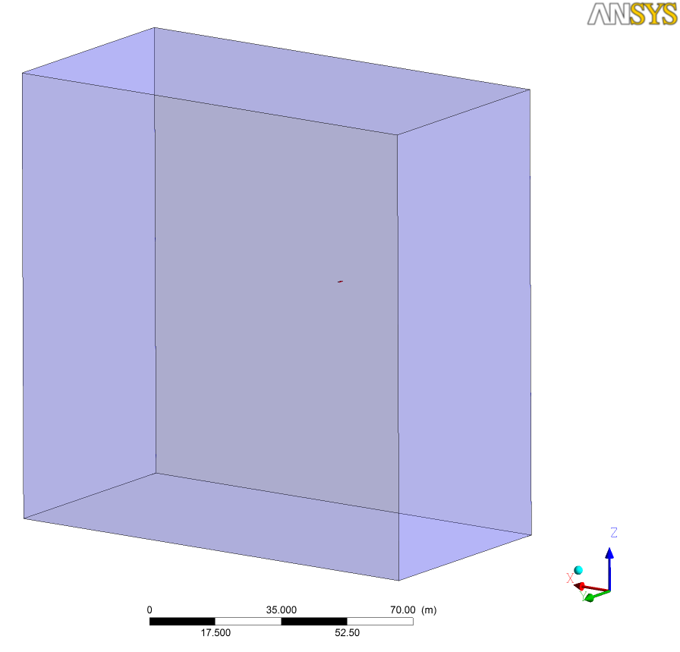
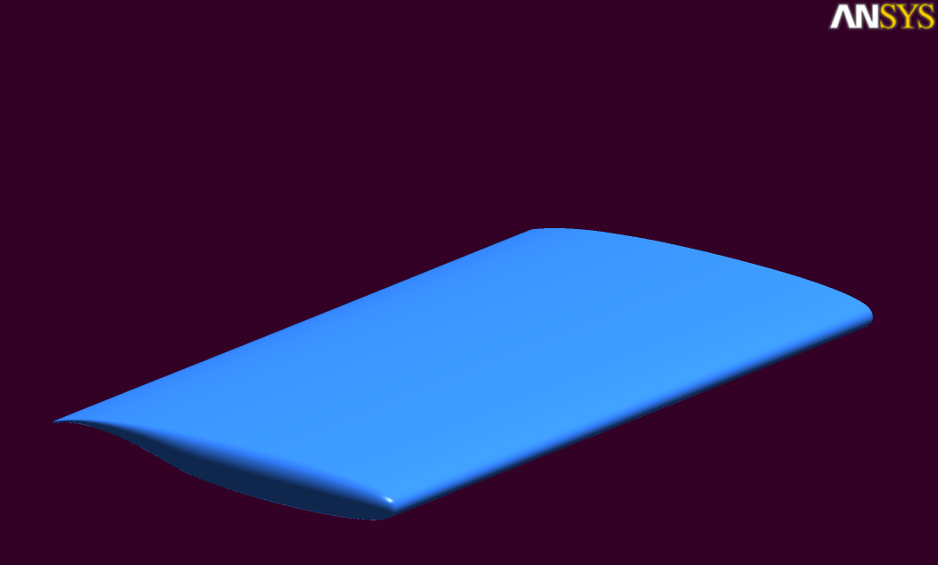
Computational Domain
Cref = 24.0 inches (609.6 mm)
100 * Cref in all directions

Slide 4
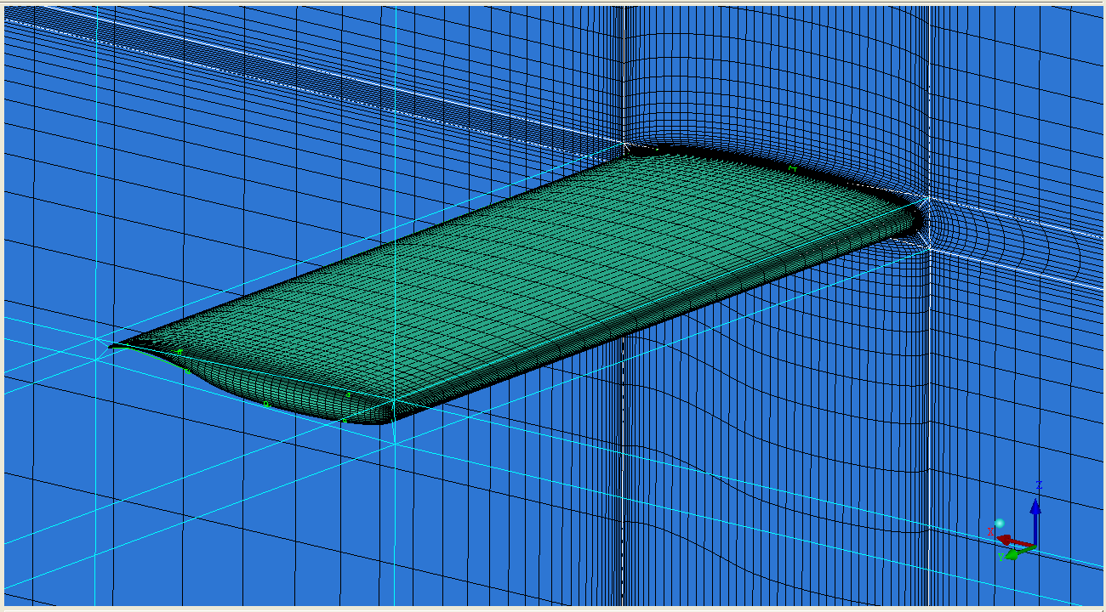
Grid Information
ANSYS ICEM CFD
Hexahedral elements
Scalable grids
Consistent mesh quality upon grid refinement

Slide 5
Grid Information
 | Grid 1 | Grid 2 | Grid 3
Number of nodes | 1,940,280 | 5,925,100 | 17,549,020
Number of elements | 1,891,954 | 5,823,120 | 17,338,244
Minimum grid angle | 33.45° | 32.75° | 32.29°
Maximum aspect ratio | 1,360,440 | 796,946 | 529,113
First grid node @ Wall, mm | 0.000158” (y⁺~1) | 0.000105” (y⁺~2/3) | 0.000070” (y⁺~4/9)

Slide 6
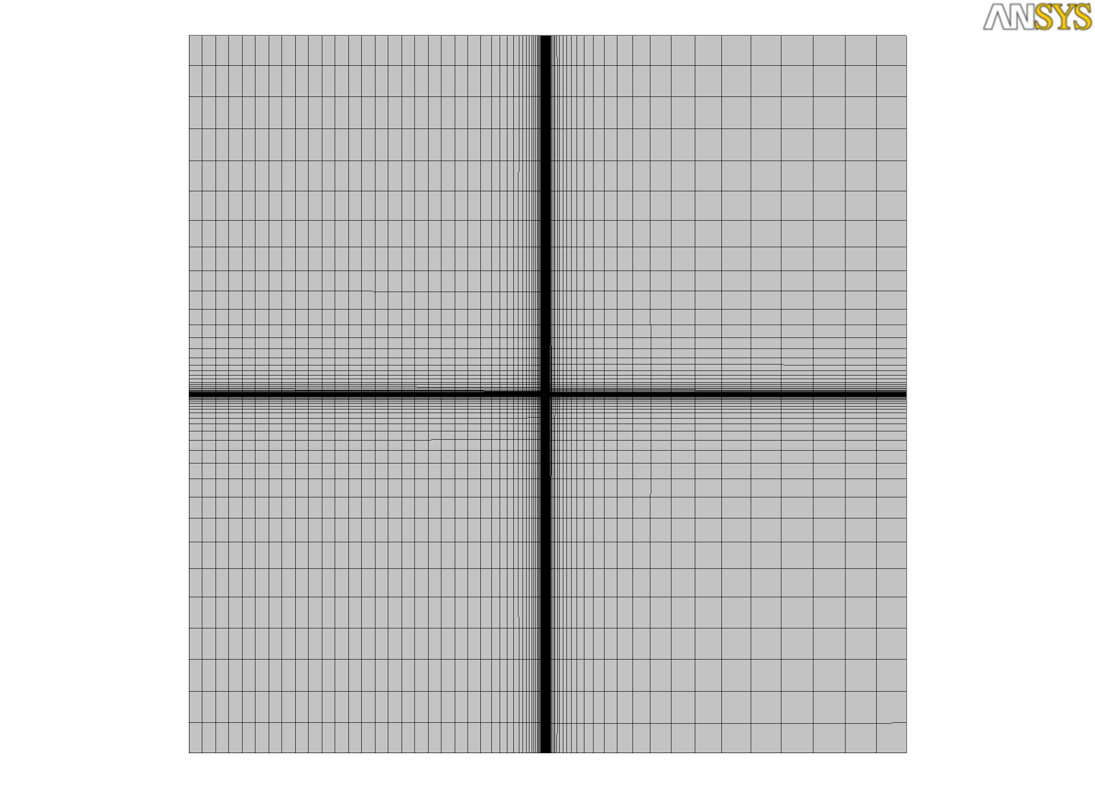
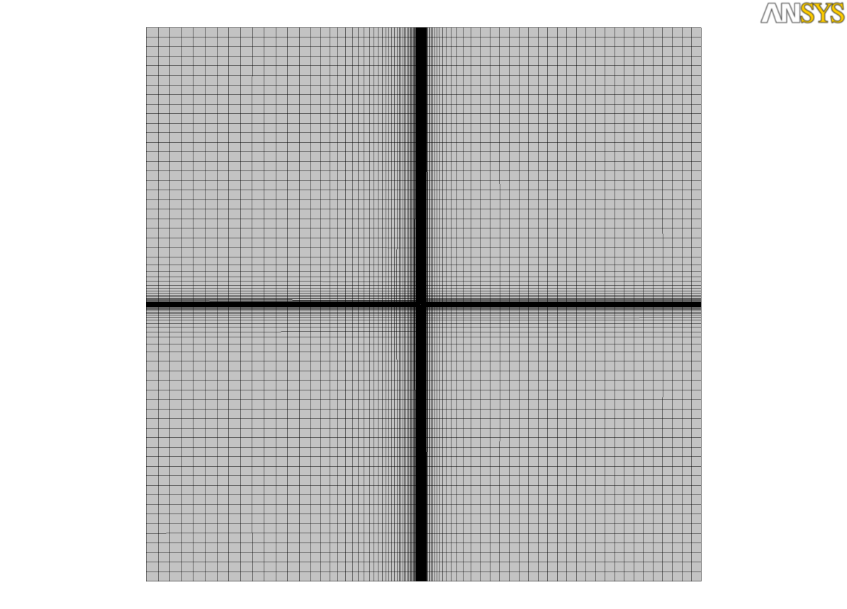
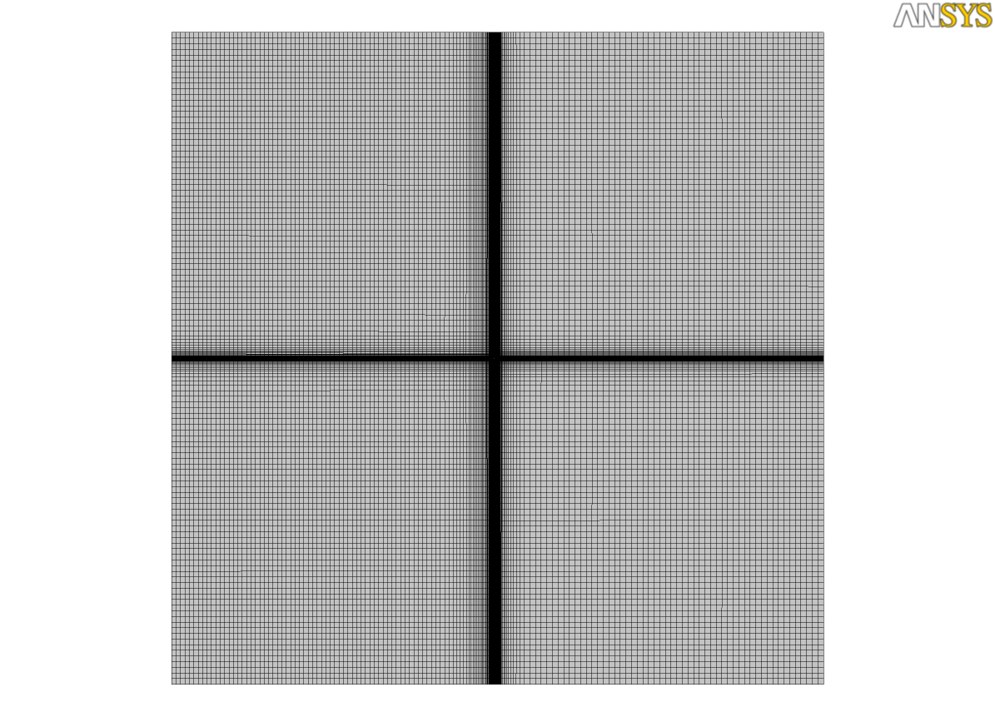
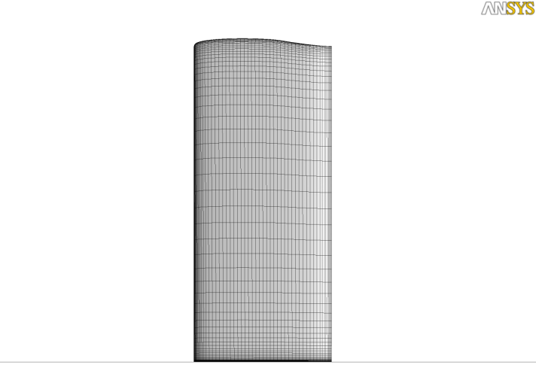
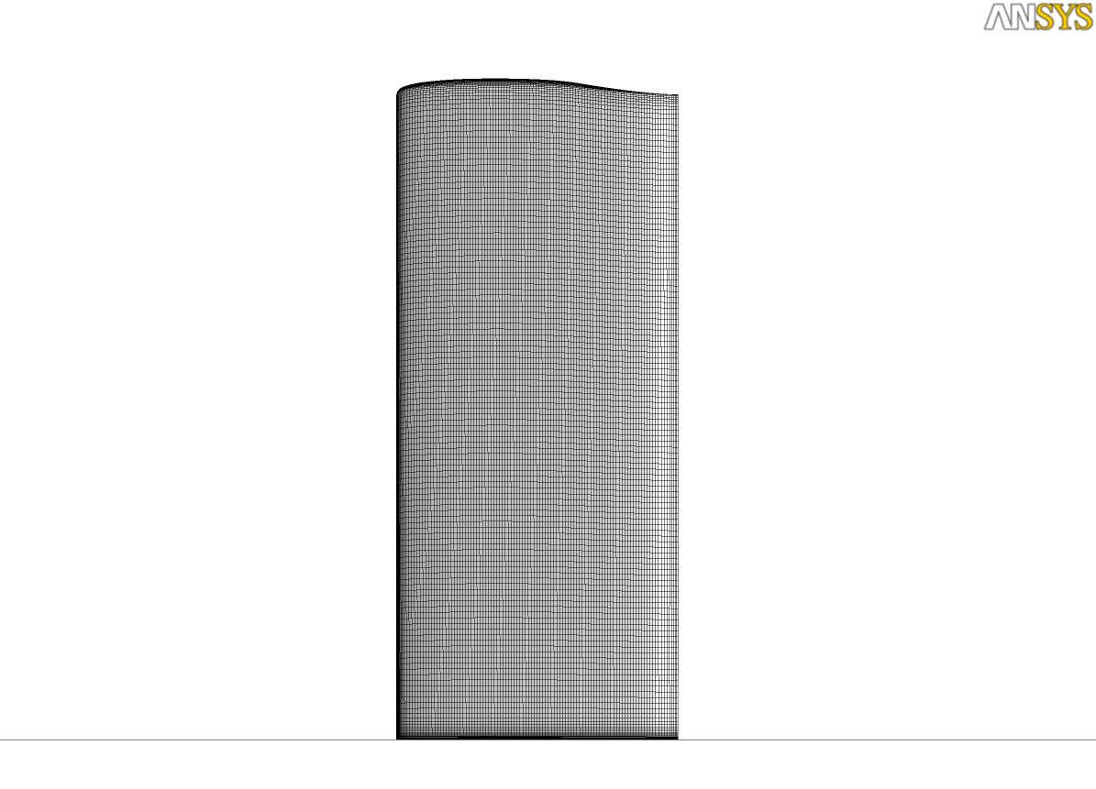
Grid Information
Grid 1
Grid 2
Grid 3

Slide 7
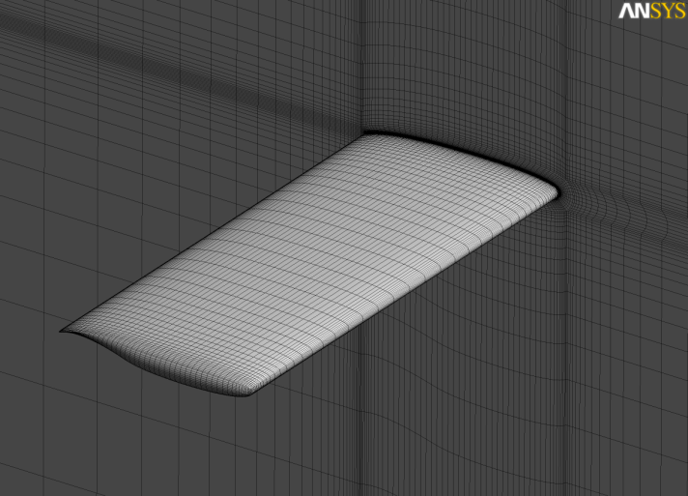
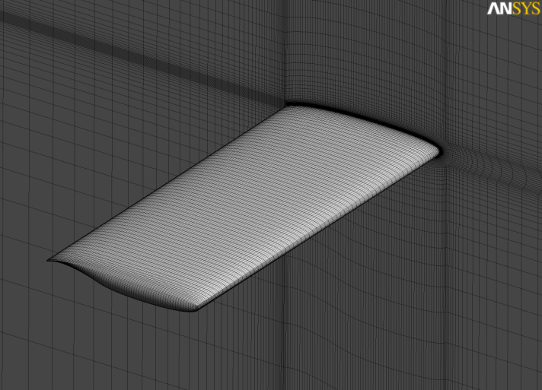
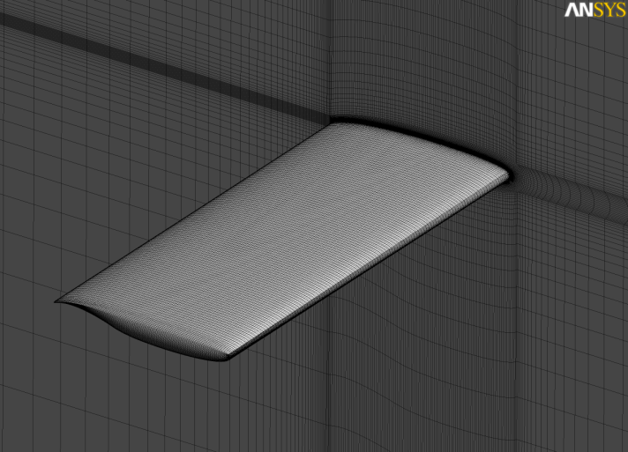
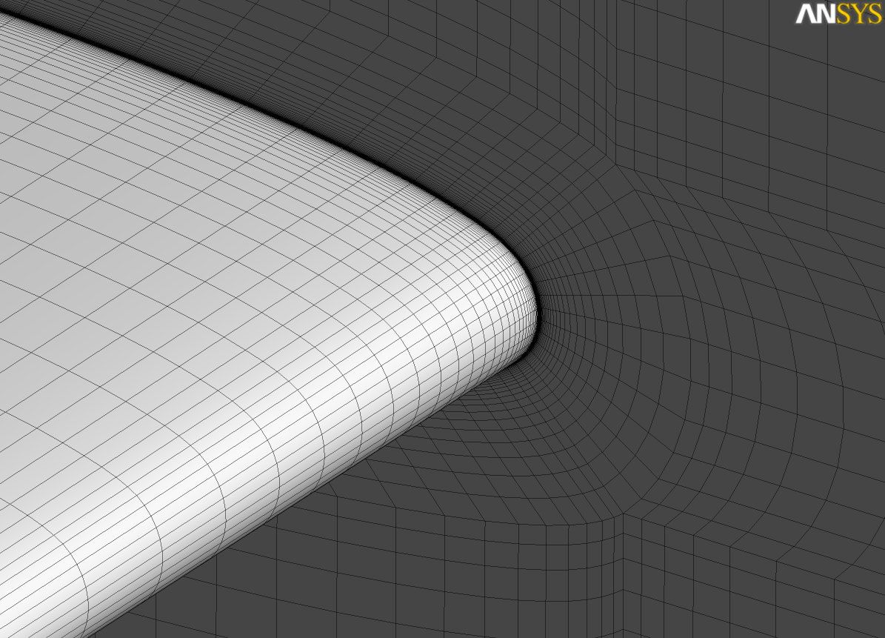
Grid Information
Grid 1
Grid 2
Grid 3

Slide 8
Grid Information
Grid 1
Grid 2
Grid 3

Slide 9
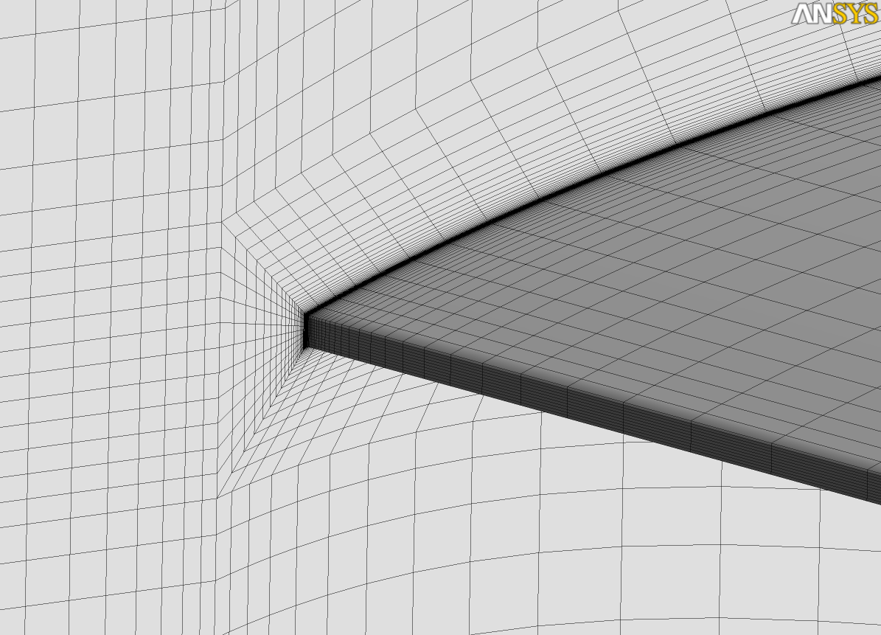
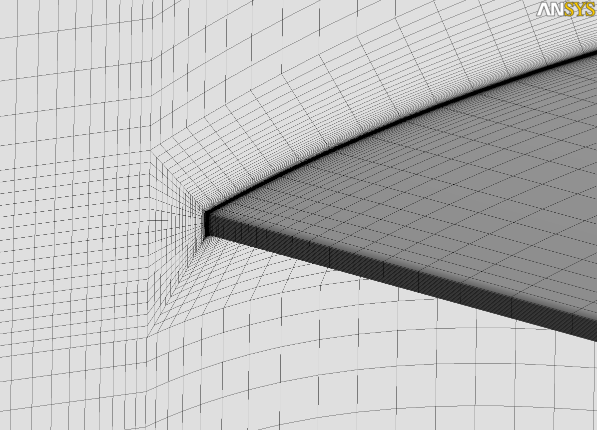
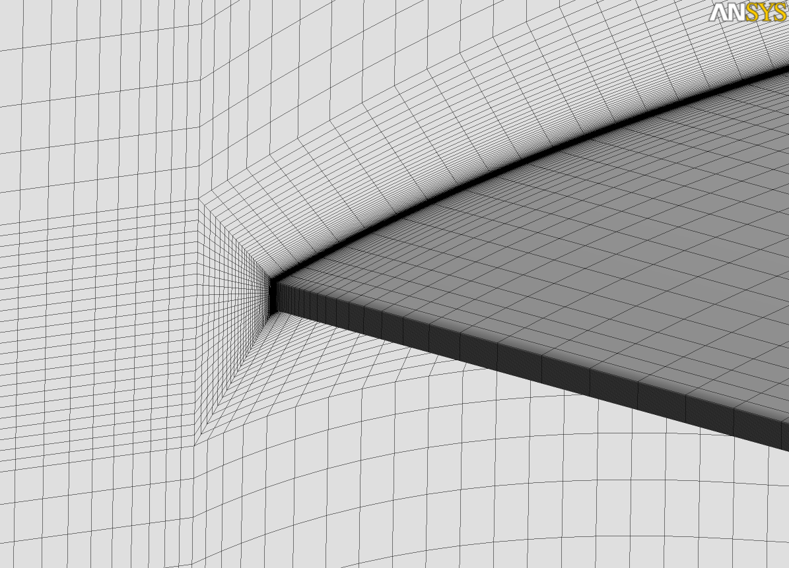
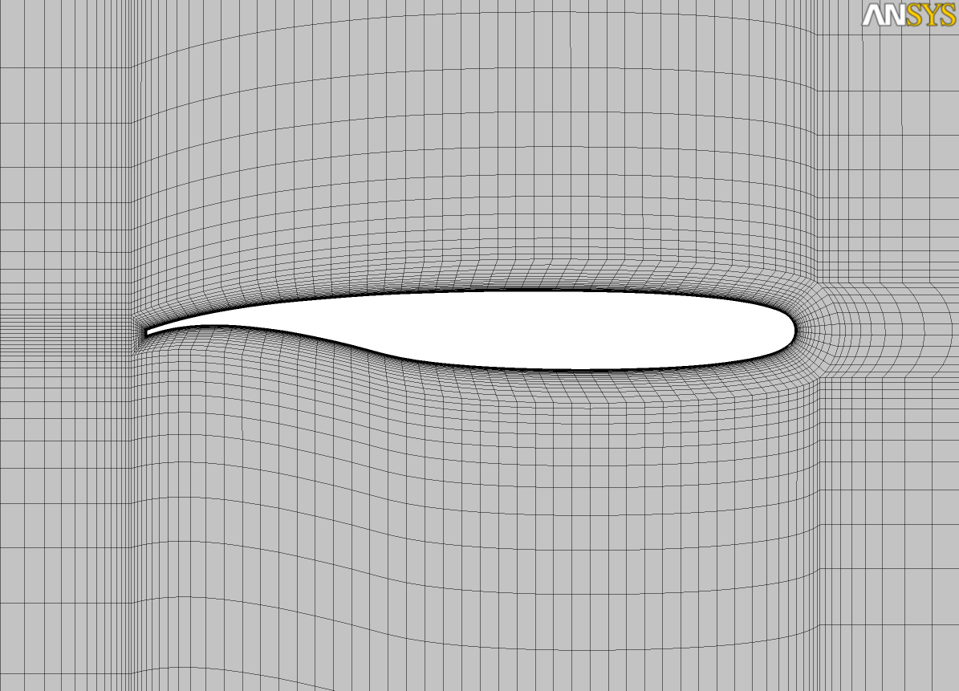
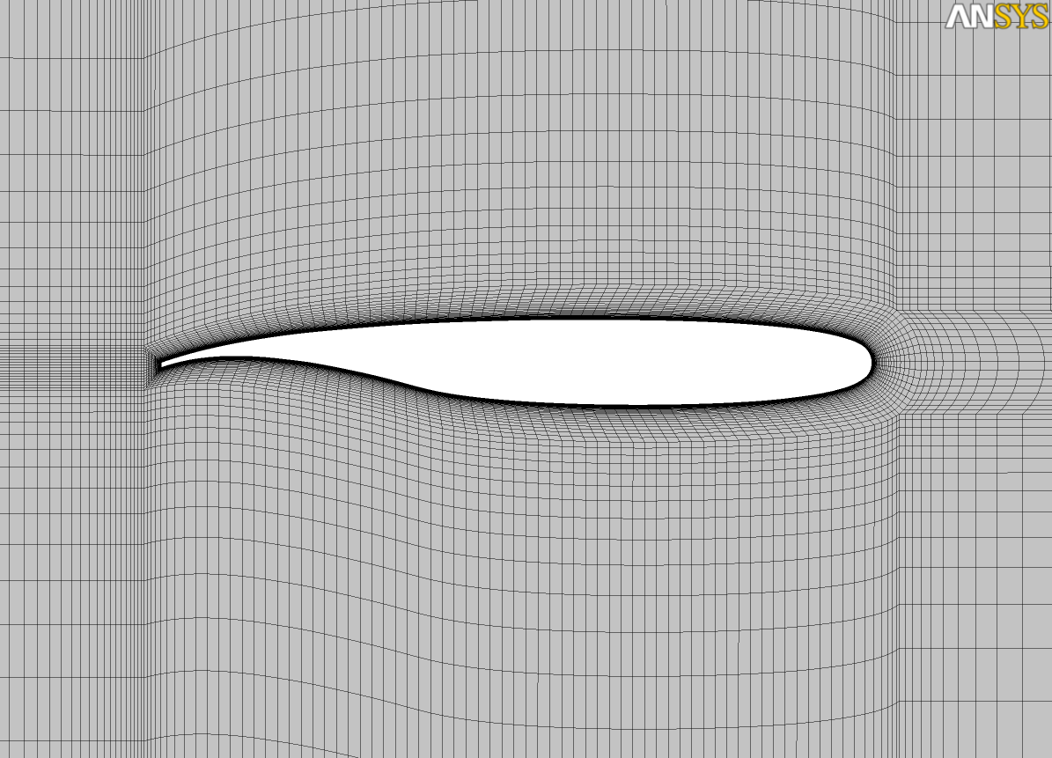
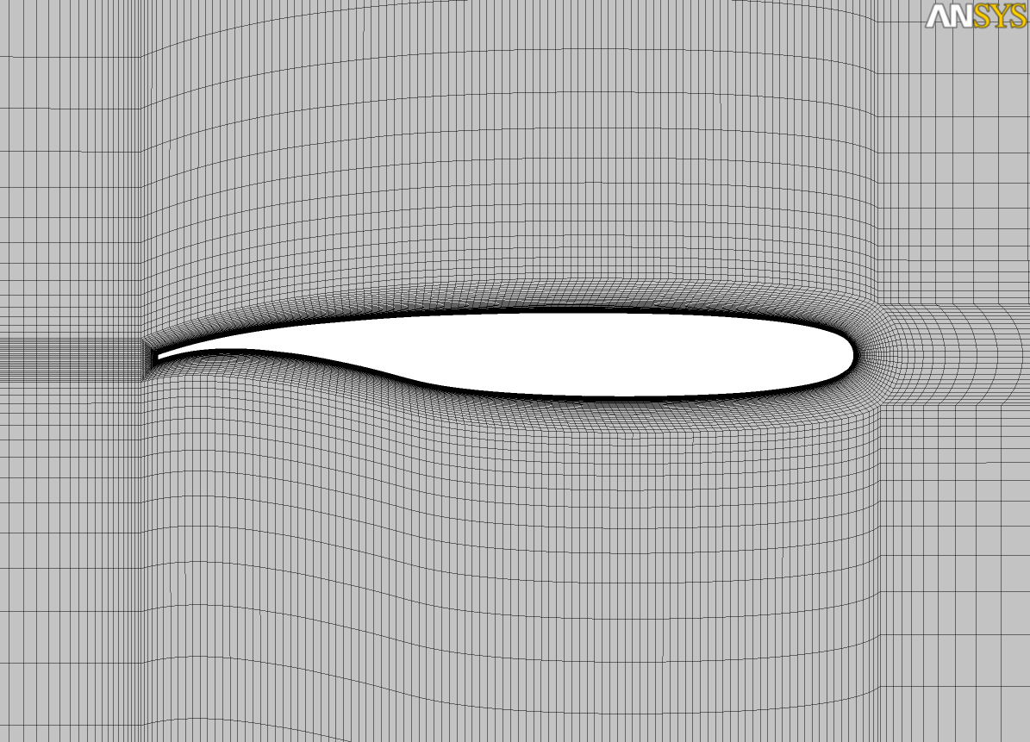
Grid Information
Grid 1
Grid 2
Grid 3

Slide 10
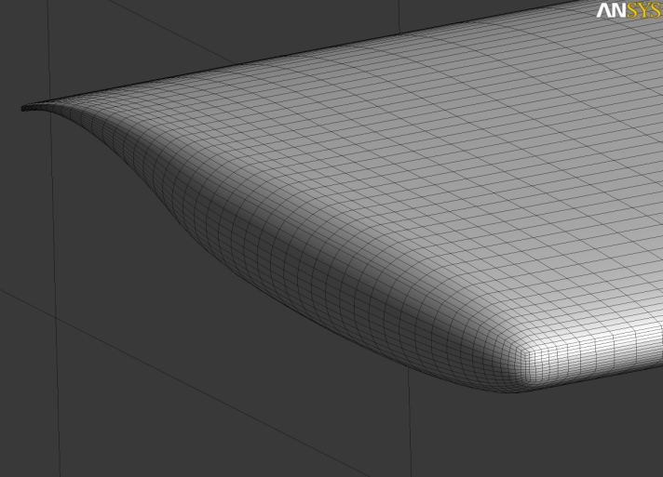
Grid Information
Grid 1
Grid 2
Grid 3

Slide 11
Summary
RSW hexahedral grid created with ANSYS ICEM CFD Hexa
Export to the following grid format (Unit = inch)
CGNS (Unstructured)
Plot3d (Structured)
….

