Slide 1
Dynamic Flight Simulation (DFS) for MAD/MUTT
Erich Ritz and P. C. Chen
ZONA TECHNOLOGY INC
Presented at ASE Workshop, NASA Langley, VA on April 18-19, 2012
9489 E. Ironwood Square Drive, Scottsdale, AZ 85258, Tel. (480) 945-9988, Fax (480) 945-6588, E-mail: info@zonatech.com

Slide 2
Why DFS?
Flight dynamics model solves the nonlinear 6 DoF equations of motion with an aerodynamic database to assess the stability, performance and handling quality of the aircraft.
  The aerodynamic database is usually generated by wind tunnel testing on a rigid aircraft.
  At best, the nonlinear aerodynamic database can be “flexiblized” using a quasi-static correction factor to account for the static aeroelastic effects.
  Inclusion of dynamic aeroelastic effects are difficult and, thereby, usually ignored.
Dynamic aeroelastic model combines the structural dynamics and unsteady aerodynamics to predict the static and dynamic aeroelastic response.
  The equations of motion, at least for the structural dynamics, are usually linear.
  The predicted rigid body aerodynamics by the unsteady aerodynamic methods may not agree with the wind tunnel data.
Flight control law based in the 6 DoF rigid aircraft model is inadequate to handle the slender, more flexible and/or sizable aircraft. Therefore, aeroelastic effects must be considered during the flying quality evaluation of aircraft.
  Helios mishap in June 2003 possibly due to an interaction between aeroelastic deformation and longitudinal stability.
  A sensor-craft wind tunnel model encountered unexpected fore-aft oscillation in the TDT.

Slide 3
Objectives
Develop a linear Dynamic Flight Simulation (DFS) tool for MAD/MUTT
  Combining the flight dynamics and aeroelastic models in a Simulink environment.
  Capable of simulating the key aeroelastic coupling mechanisms between structural and unsteady aerodynamic effects with classical rigid-body dynamics.
DFS should be formulated in principle by using commonly agreed terms from flight dynamics and aeroelasticity.
  Leave the flight dynamic model with least change so that DFS remains in the framework of 6 DoF simulation.
  When the aeroelastic effects are removed, DFS reduces to the flight dynamic model.
DFS can be used for:
  Control law development.
  Maneuvering flight simulation.
  Handling quality assessment.

Slide 4
The Approach
Incorporates the add-on incremental forces and moments, and , due to aeroelastic effects in the nonlinear flight simulation model.
Adds the structural oscillation, X_{s}, at the sensor locations to the sensor reading of rigid body motion.
Modifies the linear aeroelastic equations of motion as an aeroelastic solver to provide
, , and X_{s} at each time step in the nonlinear flight simulation model.
Flight Dynamic
Model
Airframe state, control
surface deflection,
Aeroelastic Solver

Slide 5
Time-Domain Aeroservoelastic
Equations of Motion (I)
The frequency-domain (k) Generalized Aerodynamics Forces (GAF) are transformed to the time domain via the Rational Function Approximation (RFA).
where is the aerodynamic lag states.
Two methods for RFA are available in the ZAERO ASE module
  The Minimum State Method
  The Roger’s Method
Combining the time-domain RFA with the structural equation yields:

Slide 6
Time-Domain Aeroservoelastic
Equations of Motion (II)
Defining an aeroelastic state vector as
The ASE state-space equations are formulated:
where
and
The number of states is if the Minimum State Method is used and is if the Roger's Method is used.

Slide 7
Technical Issues Involved in the Development
of Aeroelastic Solver
Rigid body modes of the linear aeroelastic equations of motion are usually computed by the finite element analysis and defined in the principle axis.
    To be consistent with the flight dynamic model, they must be transformed to the airframe states such as …etc.
    The generalized mass matrix of the rigid body modes, usually a diagonal matrix, needs to be converted to the rigid body mass matrix that involves the inertial cross products such as I_{xz} , I_{yz}, …, etc.
The rigid-body aerodynamics computed by the unsteady aerodynamic methods should be replaced by the wind tunnel data.
Gravity should be in the aeroelastic solver.
    The linear aeroelastic equations of motion lacks the gravity term.
    Without the gravity term, phugoid mode can not be accurately recovered by the aeroelastic solver.
If the flight dynamic model is already incorporated with static aeroelastic effects, these effects must be excluded from aeroelastic solver.

Slide 8
Transformation of Rigid-Body Modes
to Airframe States
Based on the work by Baldelli, Chen, and Panza (Baldelli, Chen, Panza, Journal of Aircraft, Vol. 43, No. 3, May-June 2006) a transformation matrix [T_{A}] can be formulated that transforms the rigid-body modes in the principle axis to airframe status .
(a)
Generalized Coordinates
of Rigid Body d.o.f. in FEM
Analysis (Principal Axis)
(b)
Rigid Body d.o.f. in Body Axis:
(c)
Airframe States:
For Symmetric Maneuvers [T_{A}] is defined as:
For Anti-Symmetric Maneuvers [T_{A}] is defined as:

Slide 9
Conversion of Generalized Mass Matrix to
Rigid-Body Mass Matrix
The transformation matrix from principle axis to body axis can convert the rigid-body sub-matrix in the generalized mass matrix to rigid-body mass matrix and leave the elastic generalized mass matrix unchanged.
where matrices [M_{rb}] and [M_{ee}] are defined as,
m is the total mass of the aircraft. I_{xx}, I_{xy}, and I_{zz}, are the mass moment of inertial of the aircraft.

Slide 10
Replacement of the Rigid Body Aerodynamics by Wing Tunnel Data (I)
The rigid body sub-matrices in the rational function approximation matrices can be replaced by the wind-tunnel measured aerodynamic stability derivatives.
A gravity term mg is added into the [A0] matrix.

Slide 11
Replacement of the Rigid Body Aerodynamics by Wing Tunnel Data (II)
Good match with the Flight Dynamic results.

Slide 12
Validation of the ASE State-Space Equation for MAD/MUTT at Empty Fuel Condition
The Minimum State Method with six aerodynamic lag states are used.
6 rigid bodies and 24 elastic modes are included.
Flexible Empty Flutter Mode | ASE |  | g-method
 | V_{f} (KEAS) | ω_{f} (Hz) | V_{f} (KEAS) | ω_{f} (Hz)
BFF | 104.4 | 2.58 | 103.8 | 2.56
AWBT | 116.9 | 4.70 | 116.0 | 4.73
SWBT | 118.7 | 6.66 | 116.3 | 6.82

Slide 13
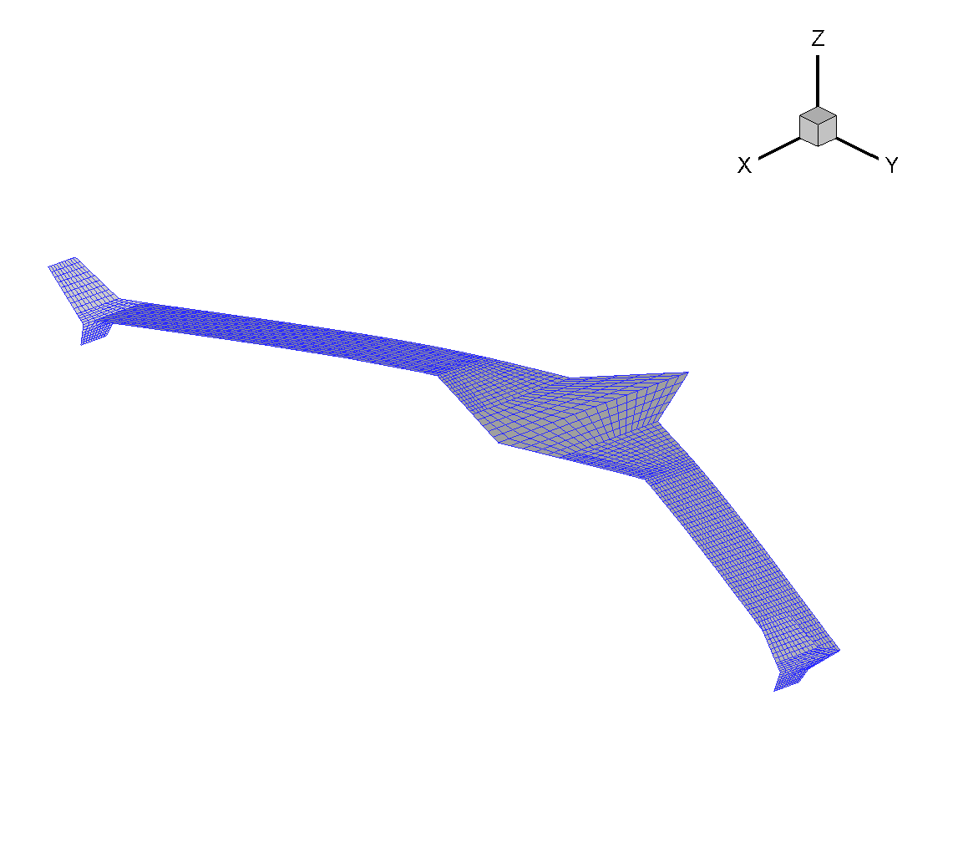
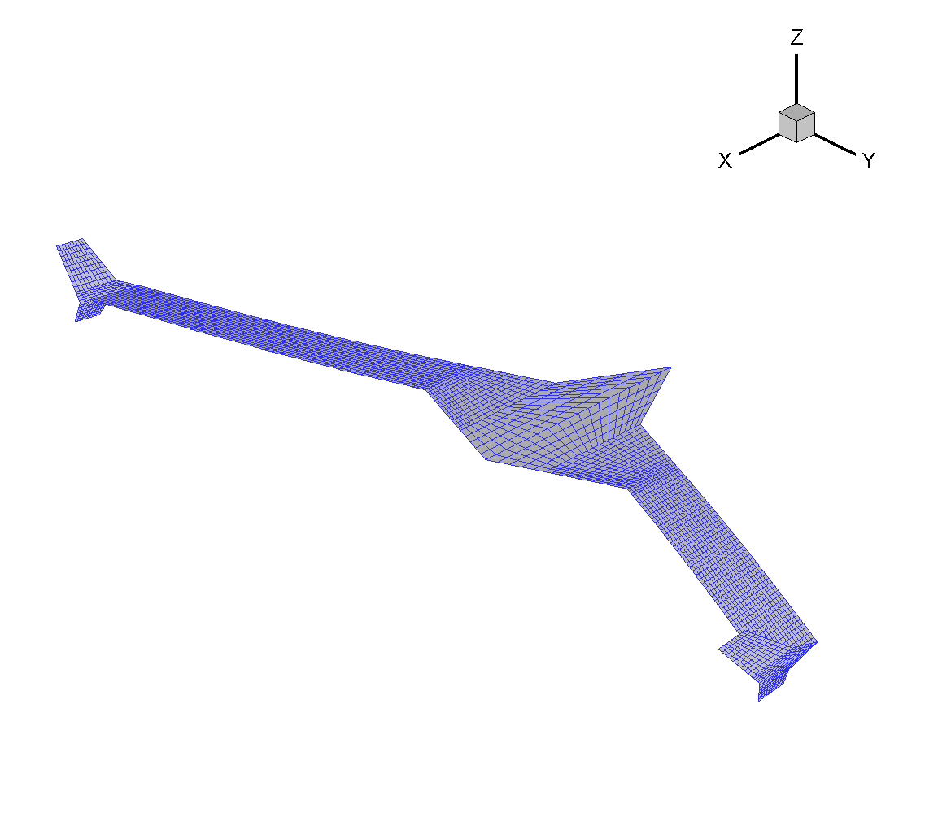
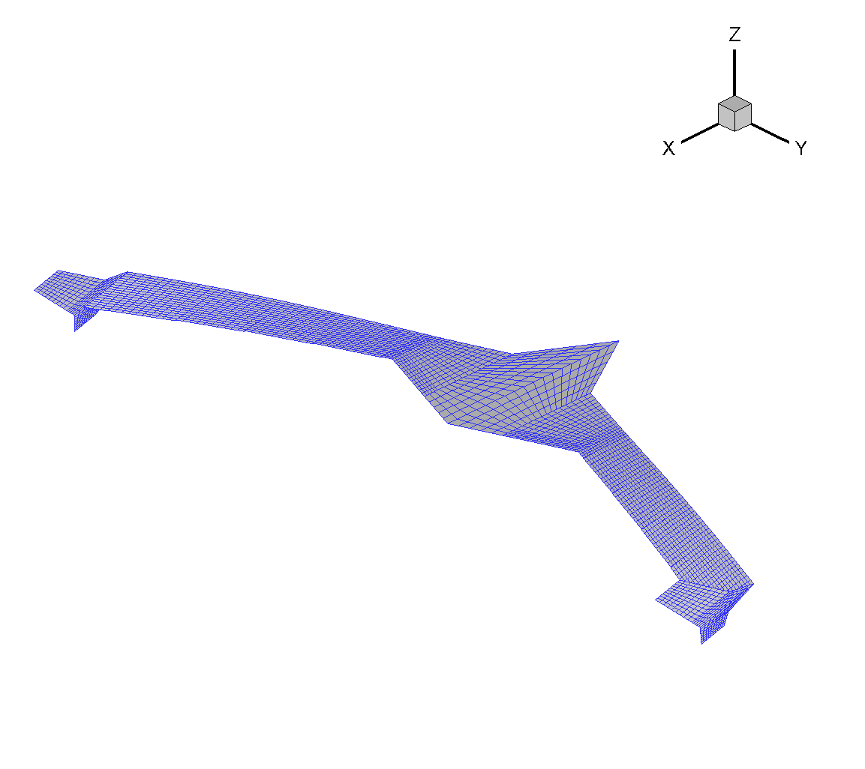
Flutter Modes of the Empty Fuel Condition
BFF Mode
AWBT Mode
SWBT Mode

Slide 14
Validation of the ASE State-Space Equations for MAD/MUTT at Full Fuel Condition
Flexible Full Flutter Mode | ASE |  | g-method
 | V_{f} (KEAS) | ω_{f} (Hz) | V_{f} (KEAS) | ω_{f} (Hz)
BFF | 102.1 | 1.80 | 102.0 | 1.78
SWBT | 121.1 | 6.24 | 120.1 | 6.32
AWBT | 141.7 | 6.48 | 140.1 | 6.61

Slide 15

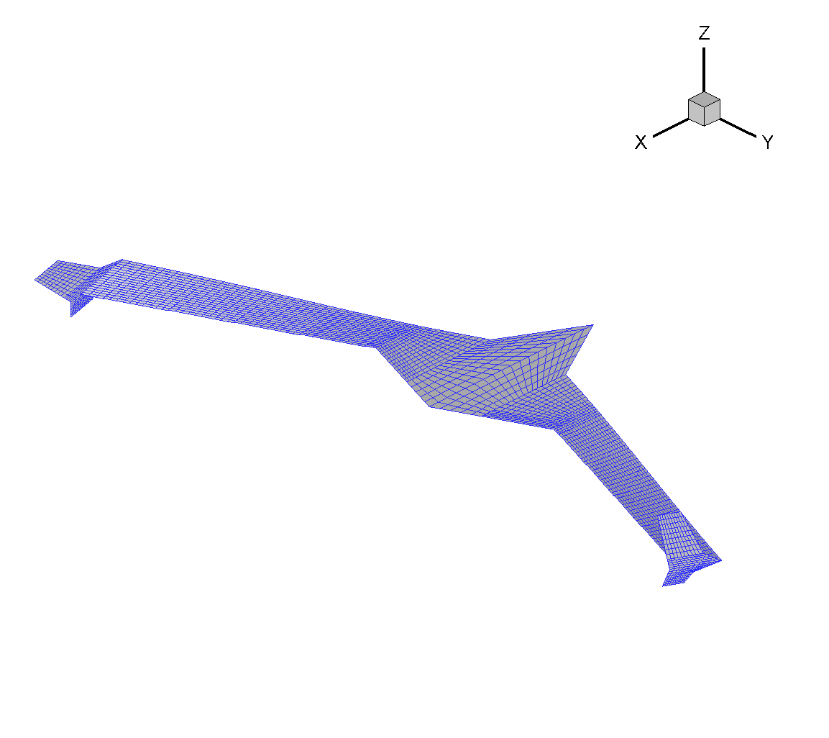
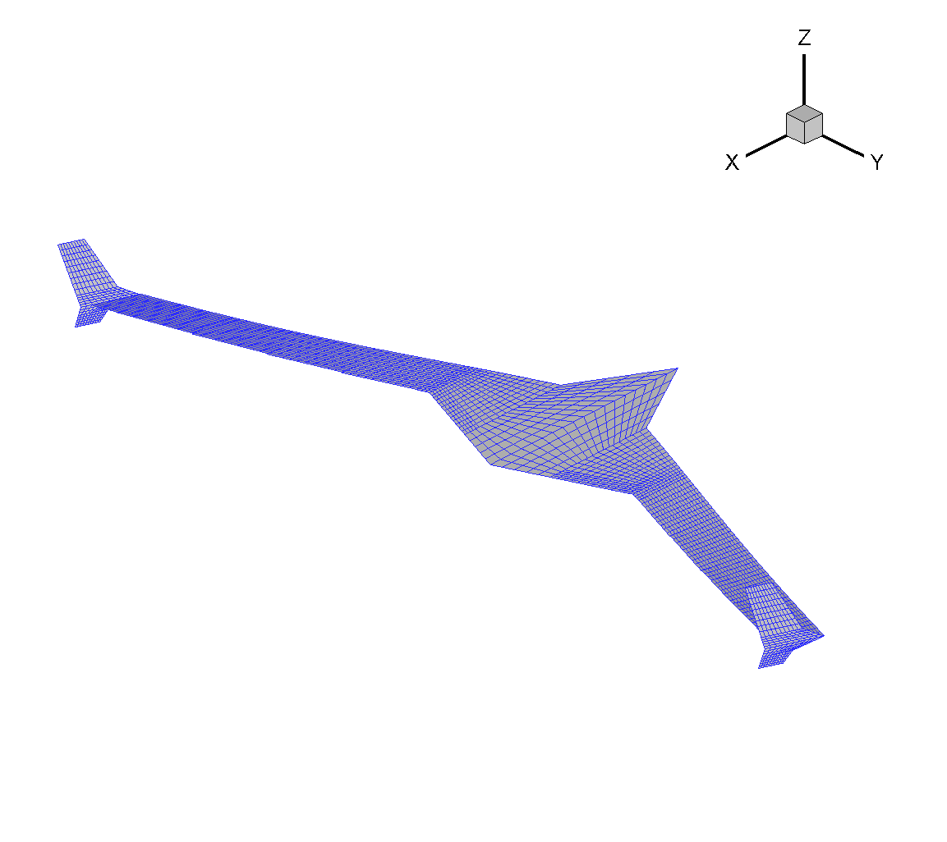
Flutter Modes of the Full Fuel Condition
BFF Mode
AWBT Mode
SWBT Mode

Slide 16
The Original DFS Approach
Partitioning the state-space equations into the airframe states and elastic states.
The aeroelastic solver solves only the elastic states.
and are provided by the flight dynamic modes.
Flight Dynamic
Model
Airframe state, control
surface deflection,
Aeroelastic Solver
and are obtained from the rigid body sub-matrices of RFA:

Slide 17
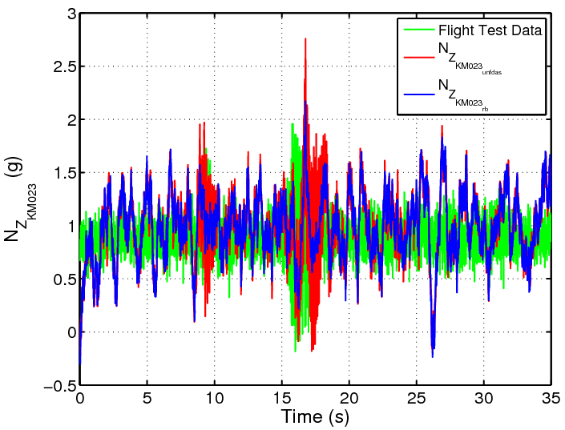
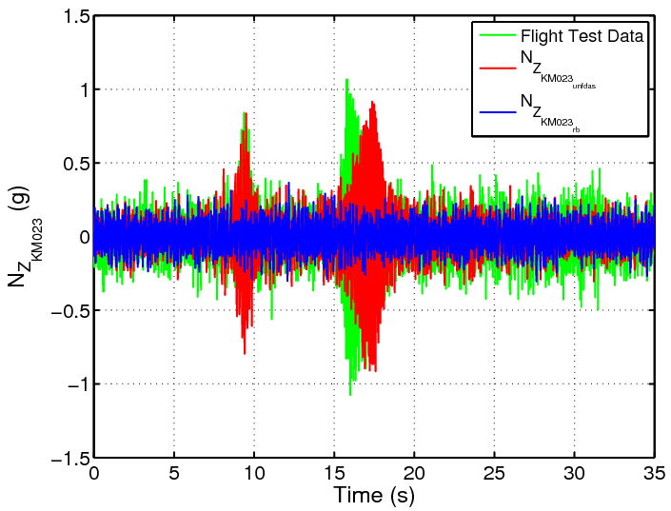
The Original DFS has been Validated with
AAW Flight Test Data at M=0.9 and H=15kft
Input: Collective Aileron (Frequency Sweep, 5-35 Hz, Δ_{t} = 35 sec)
Output: acceleration at wing fold

Slide 18
Failure of Original DFS on MAD/MUTT
The original DFS approach ignores the term [A_{re}] in the aeroelastic solver.
  Because of the weak coupling between the rigid body and elastic modes of AAW, the original DFS results match with the AAW flight test data.
  Because of the Body Freedom Flutter (BFF) mode, the original DFS fails to predict BFF of MAD/MUTT.
This suggests that all coupling terms between rigid body and elastic states must be included in the DFS.

Slide 19
The New DFS Approach for MAD/MUTT
The ASE state-space equation including airframe states, elastic states and aerodynamic lag states are solved at each time step.
Flight Dynamic
The input of DFS is
The output of DFS is
are pre-computed at i = 1, 2, …n and j = 1, 2, …m
  Rigid body aerodynamic stability derivatives at are obtained from the aerodynamic database in the flight dynamic model to account for nonlinear rigid body aerodynamic effects.
  During simulation, are interpolated through

Slide 20
The and recovery in the original DFS approach does not work for MAD/MUTT.
  If [D] matrix in RFA is partitioned into [D_{rr} , D_{er}], the effect of D_{rr} is ignored.
  Without D_{rr}, the BFF mode can not be predicted.
Instead of computing and from RFA, they can be computed from the structural matrices.
  pre-multiplying by yields
0
0
0

Slide 21
Comparison of Approaches
Original Approach | New Approach
Solves elastic states only | Solves rigid body and elastic states simultaneously
Input: and from flight dynamic model | Input: only from flight dynamic model
Output: computed from aerodynamic matrices | Output: computed from structural matrices
Cannot predict BFF | Can predict BFF

Slide 22
Flexible Full Fuel Simulation
ZAERO flutter prediction is 2043 ft, 1.78 Hz
ASE flutter prediction is 1934 ft, 1.80 Hz
DFS altitude is set to 0, 2000, and 10000 ft

Slide 23
Pitch Rate, q, Command and Sensor (deg/s)
No DFS
10,000 ft
2000 ft
0 ft

Slide 24
Sym and Antisym Control Command (deg)
No DFS
10,000 ft
2000 ft
0 ft

Slide 25
Alpha and Beta Sensor (deg)
No DFS
10,000 ft
2000 ft
0 ft

Slide 26
Incremental Forces, ΔF_{x}, ΔF_{y}, ΔF_{z} (lb)
No DFS
10,000 ft
2000 ft
0 ft

Slide 27
Incremental Moments, ΔM_{x}, ΔM_{y}, ΔM_{z} (ft lb)
No DFS
10,000 ft
2000 ft
0 ft

Slide 28
Flexible Empty Fuel Simulation
ZAERO flutter prediction is 1044 ft, 2.56 Hz
ASE flutter prediction is 728 ft, 2.58 Hz
DFS altitude is set to -1000, 1000, and 10000 ft

Slide 29
Pitch Rate, q, Command and Sensor (deg/s)
No DFS
10,000 ft
1000 ft
-1000 ft

Slide 30
Sym and Antisym Control Command (deg)
No DFS
10,000 ft
1000 ft
-1000 ft

Slide 31
Alpha and Beta Sensor (deg)
No DFS
10,000 ft
1000 ft
-1000 ft

Slide 32
Incremental Forces, ΔF_{x}, ΔF_{y}, ΔF_{z} (lb)
No DFS
10,000 ft
1000 ft
-1000 ft

Slide 33
Incremental Moments, ΔM_{x}, ΔM_{y}, ΔM_{z} (ft lb)
No DFS
10,000 ft
1000 ft
-1000 ft

Slide 34
Future Work
DFS can be used to evaluate the performance of flutter suppression and gust loads alleviation controllers for MAD/MUTT.
So far, the state-space equation in DFS is constructed by the natural modes of each fuel condition.
  DFS is defined in different modal coordinates at different fuel conditions.
  This allows DFS to perform simulation only one point in the sky at one time.
If the state-space equations at all fuel conditions are constructed by one set of natural modes, for instance of the full fuel condition, DFS can perform a continuous simulation at all flight conditions by a multi-dimensional interpolation.
  Through Mach number and altitudes
  Through angles of attack and side slip angles
  Through fuel conditions
Because of the real-time computational capability of DFS, DFS can be plugged into a real-time simulator to train the pilot under aeroelastic effects.

