Slide 1
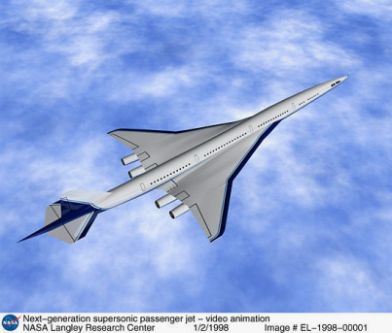
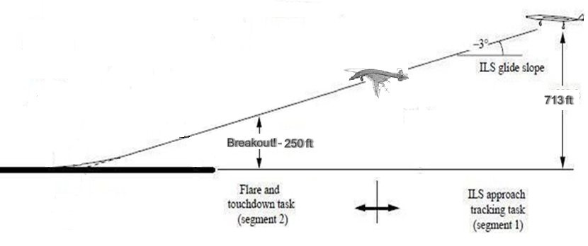



Structural Modes and Aircraft Handling Qualities
Simulation Development for Supersonic Studies (SDSS)
Brandon Cowen
  Adaptive Aerospace Group
  757-447-7221
Notes:
Hello Everyone,
Hello everyone. I’m Brandon Cowen. Today I’m going to give an overview of a ongoing study using simplified structural modeling in real-time piloted simulation.
The name of the is “Simulation Development for Supersonic Studies” or SDSS for short.
NASA is the study’s sponsors and I’m representing Adaptive Aerospace Group also located in this building.
NASA sponsored the effort, and the NIA is making our workshop possible today.

Slide 2
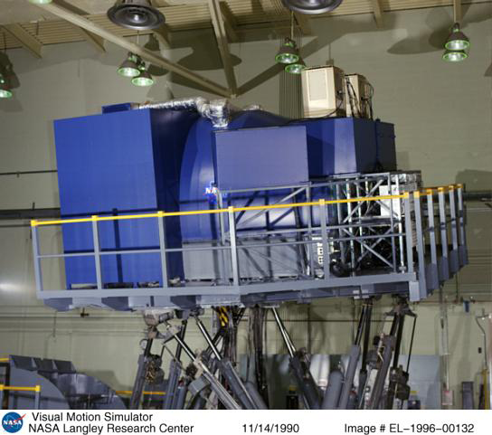
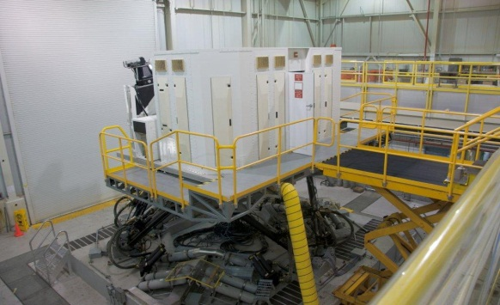
Study Comparison
1990s HSCT Handling Qualities Study using Visual Motion Simulator (VMS)
Current SDSS Study using Cockpit Motion Facility (CMF)
Assess impact of broad range of Dynamic Aeroservoelastic (DASE) characteristics on supersonic aircraft handling qualities
SPARC6 (Scalable Prototyping Aircraft for Rapidly Configured 6 DoF Models) generic scalable rigid body aircraft simulation
Newer CMF with expanded motion capability
Assess handling qualities of Ref H. Cycle 4 version of High-Speed Civil Transport:
Baseline model
Parametric variations of stiffness and control-augmented damping from baseline model
Notes:
Mr. Raney before me went over the previous handling qualities study in the 1990s in the Visual Motion Simulator. During the study they evaluated a detailed supersonic transport model. With a portion of the study evaluating parametric variations of stiffness and damping from their baseline aircraft model. (6DoF motion-based simulator)
The SDSS effort is a follow-on study with the objective of trying to ascertain a broader assessment of the impact of structural accelerations, or Dynamic Aeroservoelastic accelerations, on supersonic aircraft handling qualities. The study is being performed with a different aircraft simulation in the newer Cockpit Motion Facility.
CMF was built for SDSS
Talk a little bit more about sparc6, struc model…… (‘specific vs. broad’)

Slide 3
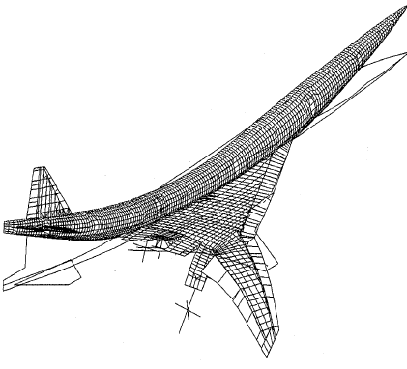
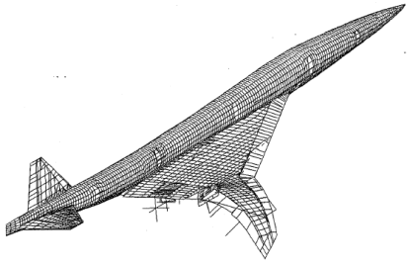
Approach
Development of simplified rigid body aerodynamic models allowing parametric variations of aircraft rigid body characteristics.
Vary:
  Geometric & inertial characteristics
  Aero performance
  Handling qualities
Pilot
Station
F_{elevator}
Required control surface forces and moments excite structural modes
Notes:
Part of the intial effort was the development of the simplified aircraft simulation allowing for easier specification of the aircraft’s basic characteristics: Including the ++++++
These parametric variations change your typical forces on the control surfaces of the aircraft – and that’s what ultimately deforms the aircraft structure. It is important to point out here that the simplified modeling of the structural accelerations do NOT feed back into the aerodynamics.
For the initial study, the baseline aircraft configuration has been modeled after the HSCT.
The control laws were further modified to meet level 1 handling qualities for class 3 aircraft and category C flight phases.

Slide 4

Approach (Continued)
Development of simplified rigid body aerodynamic models allowing parametric variations of aircraft rigid body characteristics.
Development of simplified structural models to leverage expanded motion capability of newer (LaRC) Cockpit Motion Facility.
Notes:
Read bullet 2 +++++++
In addition to the simplified DASE modeling, a simplified DASE models were developed to simulate the modal frequencies and damping. The model was then ported to the newer CMF, with higher motion capability than the older VMS.
I’m going to blow these two charts up so you can see them.

Slide 5
CMF vs. VMS – Commanded to Measured Sway Accelerations
Notes:
The design specs of the newer CMF were in part driven by the needs for higher motion bandwidth for simulating these aeroelastic accelerations.
I’m not going to go into to much detail: Emphasize ‘lateral’
Go over the title.++++++
1st subplot slowly+++++
2nd subplot slowly+++++

Slide 6
Approach (Concluded)
Development of simplified rigid body aerodynamic models allowing parametric variations of aircraft rigid body characteristics.
Implementation of real-time, generic structural model to leverage expanded motion capability of newer (LaRC) Cockpit Motion Facility.
This approach enables piloted assessment of isolated variations of structural characteristics and aircraft performance.
Notes:
To conclude the approach: We are developing simulation that allows us to quickly isolate the impact of specific variations of structural characteristics and aircraft performance on handling qualities.

Slide 7
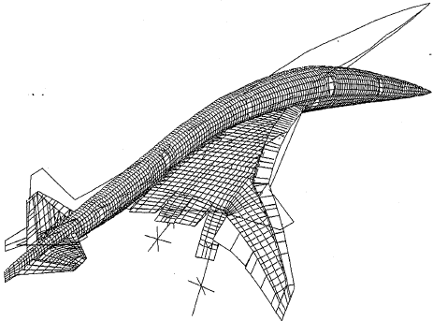
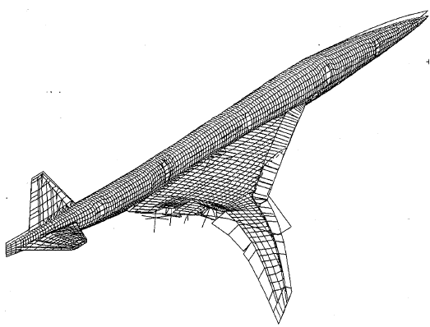
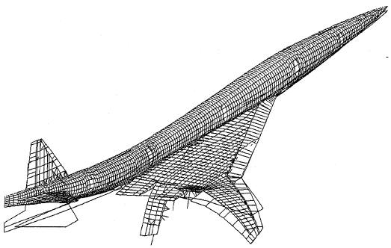
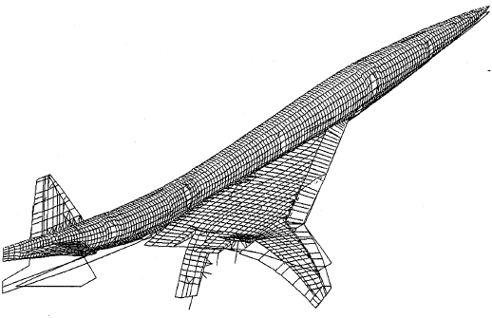
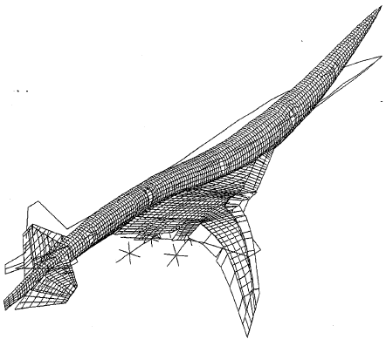
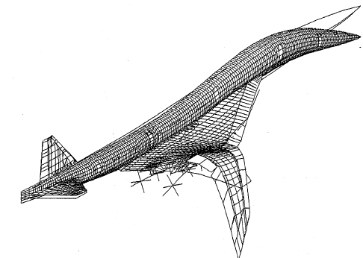
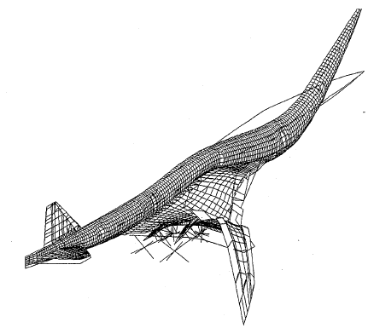
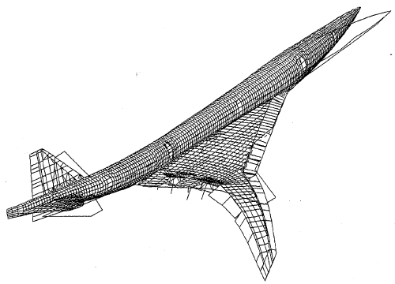
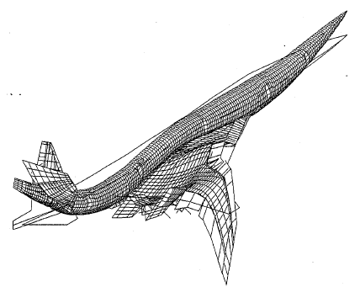
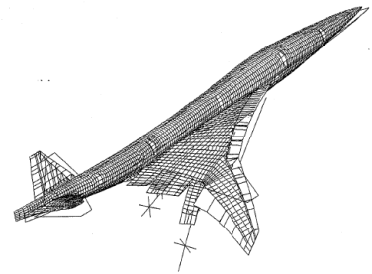
Dense Modal Space
Symmetric Modes
Antisymmetric Modes (First 2)
1.33 Hz
1.49 Hz
1.89Hz
1.94 Hz
2.69 Hz
2.77 Hz
3.88Hz
2.66 Hz
4.30 Hz
4.89 Hz
1.41 Hz
1.86 Hz
Notes:
The next slides gives you an idea of the tightly packed modal space from a similar variant of the supersonic transport.
Don’t get lost in the numbers – just note that there are ten modes below 5 Hz
These are exaggerated illustrations of course, with primarily the symmetric (or vertical modes shown) and just the first to antisymmetric modes – as I ran out of space on my slide. What you can’t really see here is that some of these modes are more prevalent than others – by an order of magnitude in some cases.
But what’s important to point out here, is that, although these are exaggerated, the pilot station deflection, at the end of this long, slender aircraft, is typically more severe than at other stations.
Our current approach for the our intial study is looking at 1 freq at a time, we will also look at the impact of multiple modes (per configuration)

Slide 8
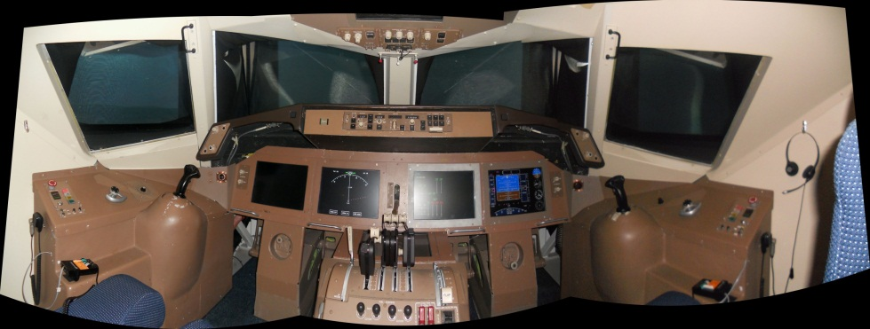

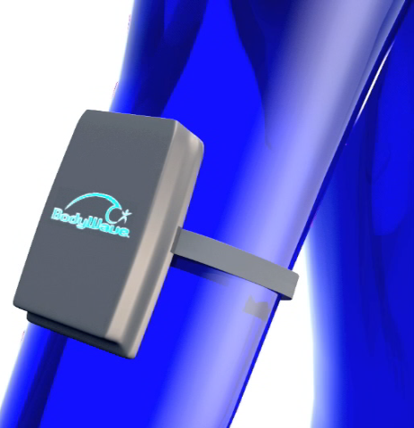
Experiment
Piloted simulation study using NASA and industry test pilots to assess handling qualities of various aircraft/structural model combinations
Use NASA LaRC’s Generic Flight Deck in the CMF
Perform lateral offset landing task similar to HSCT study
Record pilot’s aircraft handling qualities ratings via Cooper-Harper (CHR) Scale
Record pilot inputs, simulation and
motion base states, and brain wave measurements
udy
Notes:
With all of the pilots being test pilots familiar with the Coorper-Harper Scale.
Note non-intrusive body wave monitor

Slide 9
Data Analysis Methodology
Evaluate pilot workload based on pilot performance, recorded stick inputs, and bio-measurements
Define relationship between structural characteristics and aircraft handling qualities
Develop DASE-related design guidelines
Uncontrollable
H y p o t h e t I c a l
Good
Notes:
Ex – general characteristics describle level 1 chr, and maybe faa will mandate acceptance for a/c achieves level 2 chr sans control augmentation…….
Mention good and bad chr

Slide 10
Initial SDSS Study
Test Matrix
SST
DASE Characteristics
A/C Category
Isolated Variations
Modal Frequency
Stiffness
Configurations
Rigid Body Dynamics (CHR Level 1)
(Per Axis)
Notes:
Break down what’s happening slowly.
Isolated Variations = Independent Variables

Slide 11
Follow-On SDSS Study
Test Matrix
SST
SSBJ
Rigid Body Dynamics (CHR Level 1)
DASE Characteristics
A/C Category
Isolated Variations
Modal Frequency
Stiffness
Aircraft Geometries & Inertias
Configurations
A/C Dynamic Stability
Damping
Notes:
Break down what’s happening slowly
SSBJ – Supersonic business jet

Slide 12
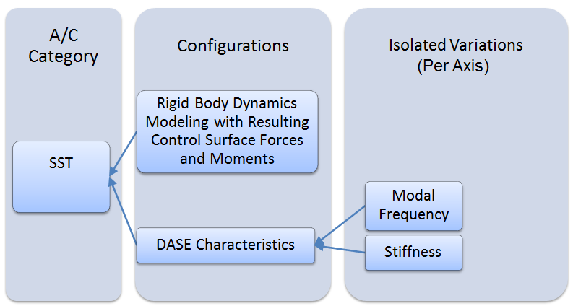
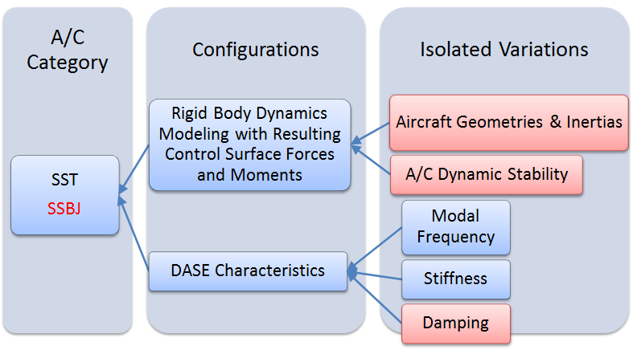
Roadmap
NASA ASE Workshop
Initial Study
Follow On Study
Detailed Model Development
Innovative Controls Research
Scalable Supersonic Transports and Business Jets
Innovative Control Strategies for Commercially Viable Transports
Q3 2012
Q4 2012? .
2013?
2013?
Notes:
The first two studies are to help bound the problem. The final is to help build towards a solution.
What is the current state of the art?
What do we need to move forward to develop the capability to quickly construct higher fidelity DASE models for the control phase

Slide 13
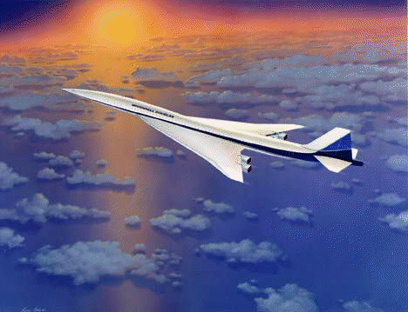
Questions?

Slide 14
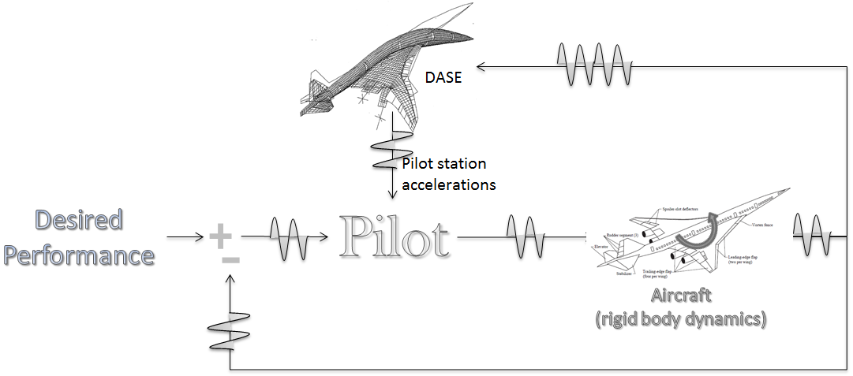

Simulation Development for Supersonic Studies
Piloted simulation study using NASA’s Generic Flight Deck (GFD) simulator to address the impact of Dynamic AeroServoElastic (DASE) accelerations on the flying qualities of a generic supersonic transport.

Slide 15
Objectives
Development of simplified rigid body aerodynamics model allowing for parametric variations of aircraft rigid body characteristics.
Geometry
Inertias
Thrust
Varying A/C performance and required control surface forces and moments
Varying resulting structural modes

Slide 16
Rigid Body Model
Control power limitations from table lookup
Angular rates from linear model
Total moments required by linear model
Long. stick
Stick shaping and linear model
Gains
Total forces
and moments
Lat. stick
Pedal
Aero
Throttle
Engine
Equations of motion
States to be controlled from previous frame

Slide 17



SPARC6 Longitudinal Modeling
Pilot
Inputs
Control Shaping
Inner Loop Control
Short Period Mode
Pitch Rate
Command
Linear Model
Pitch Rate
α
n_{z}
α
$${c_{N}}_{α}$$
Control Limiter
Logic
Control Power Limitations
Linear Model
Pitch Rate
Pitch
Acceleration
Pitching Moment
Pitch Rate
Previous Frame
Aircraft Moment
Of Inertia

Slide 18
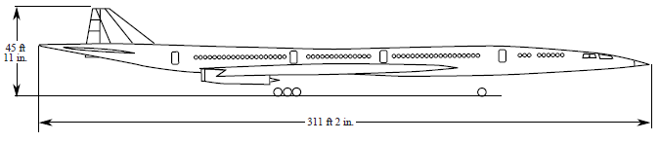
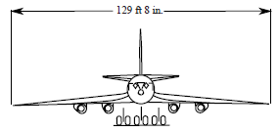
Generic Airplane Model
Based on High Speed Research Vehicle
Conventional tail
Cranked-arrow wing
4 mixed-flow turbofan engines, 2 throttles
Landing weight of 384,862 lb
300 passengers
311 ft long
130 ft
wingspan
SPARC6
Dynamic properties similar to HSR
Pitch-rate command
Stability axis roll-rate command
Pedal commands direct sideslip
  Track angle corrections made with lateral stick

Slide 19
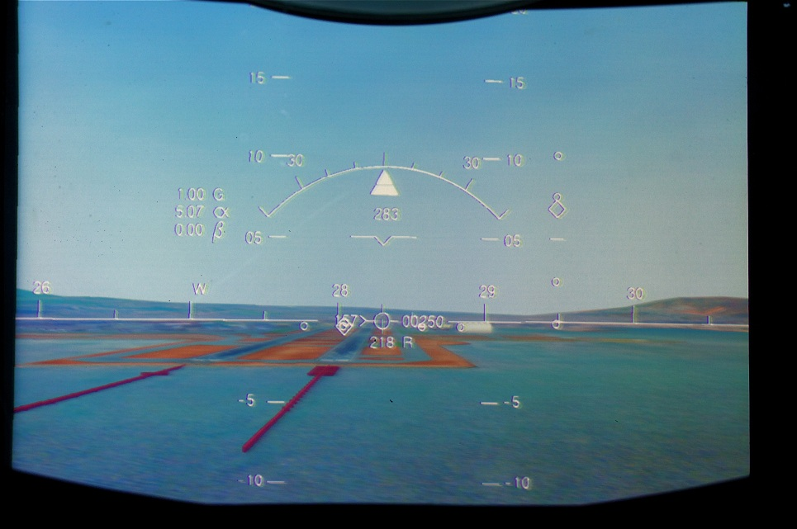
Lateral Offset Precision Landing
Initial Conditions
  Flying straight & level
  Initial Heading (283 deg)
  Autothrottle active 157 kts
  High-lift landing configuration
  Overcast (not shown below)
  No winds or gusts
Mission
  Capture localizer (283.00 deg) and fly the glide slope (-3 deg) until breakout at 250 ft.
  200 ft. offset laterally from localizer

Slide 20
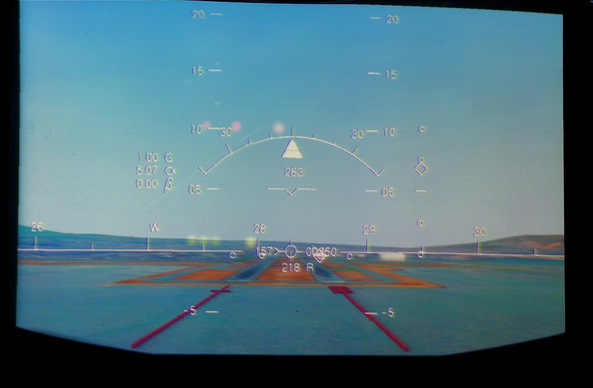
Lateral Offset Precision Landing
Task Description – After Breakout at 250 feet)
  3 Scenarios
    ILS offset 300 ft laterally left or right from runway centerline
    ILS aligned with runway centerline
  No winds

Slide 21
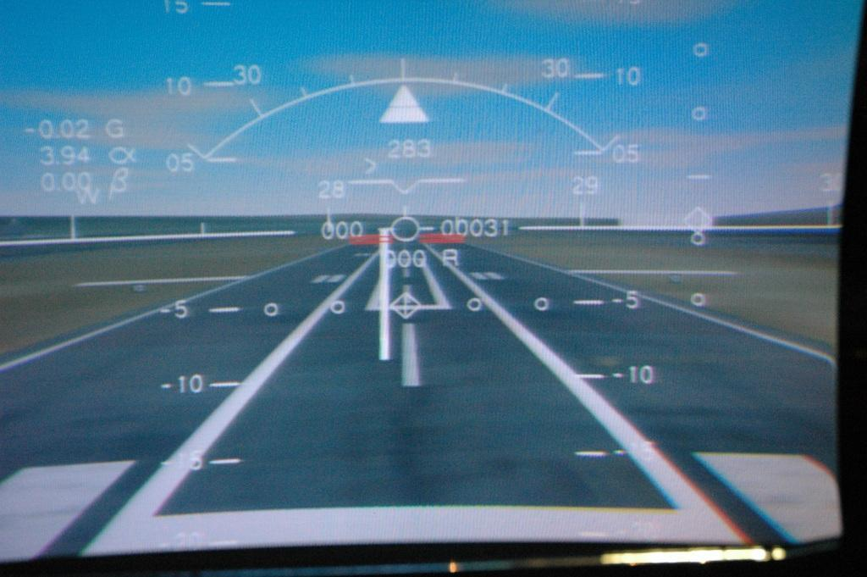
Performance Criteria
Parameter | Target | Desired | Adequate
Airspeed deviation at 50 ft (kts) | 0 | +/- 5 | +/- 10
Maximum bank angle less than 50 ft (°) | 0 | +/- 5 | +/- 7
X distance of c.g. from runway threshold (ft) | 1250 | +/- 250 | -500, +1000
Y distance of c.g. from runway centerline (ft) | 0 | +/- 10 | +/- 27
Landing hdot (ft/s) | 0 | >= -4 | >= -7
Landing heading error (°) | 0 | +/- 3 | +/- 6
Localizer deviation descending from 325 ft through 275 ft msl | 0 | ½ diamond | 1 diamond
Glideslope deviation descending from 325 ft through 275 ft msl | 0 | ½ diamond | 1 diamond

Slide 22
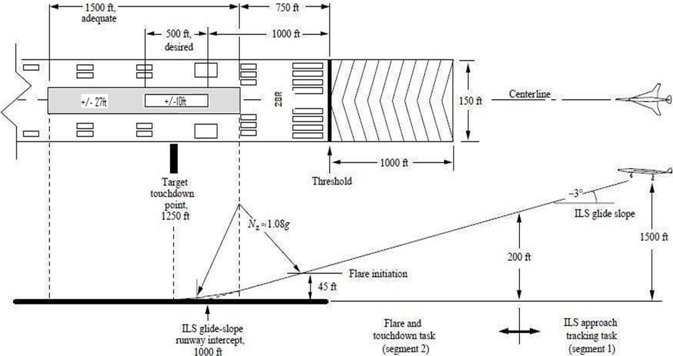
Lateral Offset Precision Landing
713 ft
Breakout! - 250 ft

Slide 23
Body Wave Monitor
BodyWave™ monitors the brain’s physiologic signal through the body via sensors that attach to the arm or wrist.
Will be used to measure pilot focus and task workload.

Slide 24
Rating Scales
Cooper-Harper Rating Scale
  ILS Tracking
  Lateral Offset Maneuver
Control Influence Rating Scale
Ride Quality Rating Scale

Slide 25
Cooper-Harper Handling Qualities Rating Scale
Adequacy for Selected Task or Required Operation
Aircraft Characteristics
Demands on the Pilot in Selected Task
or Required Operation
Pilot Rating
Yes
Excellent Highly Desirable | Pilot compensation not a factor for desired performance
Good Negligible deficiencies | Pilot compensation not a factor for desired performance
Fair – Some mildly unpleasant deficiencies | Minimal pilot compensation required for desired performance
1
Is it satisfactory without improvement?
2
No
Deficiencies warrant improvement
3
Desired Performance attained
Minor but annoying deficiencies | Desired performance requires moderate pilot compensation
Moderately objectionable deficiencies | Adequate performance requires considerable plot compensation
Very objectionable but tolerable deficiencies | Adequate performance requires extensive pilot compensation
4
Yes
Is adequate performance attainable with a tolerable pilot workload?
5
No
Deficiencies require improvement
6
Adequate Performance attained
Major deficiencies | Adequate performance not attainable with maximum tolerable pilot compensation. Controllability not in question
Major deficiencies | Considerable pilot compensation is required for control
Major deficiencies | Intense pilot compensation is required to retain control
7
Yes
Is it controllable?
8
No
Improvement mandatory
9
Major deficiencies | Control will be lost during some portion of required operation
10
Pilot Decisions
Notes:
Technically, to rate 4 or higher, you need all desireds on your performance for each parameter for all 3 runs. However, you can use a little bit of judgement here also – You will fly 3 runs per task – frequently there will be some learning between your 1st and 3rd runs. We want you to rate the task based on what performance you could CONSISTENTLY achieve after the 3rd run. Maybe if you had a 1000 practice runs you could fly the task and structural model with minimal compensation BUT we are concerned with what you can fan fly consistently after 3 runs.
Level 1 Flying qualities clearly adequate for the mission Flight Phase
Level 2 Flying qualities adequate to accomplish the mission Flight Phase, but some
increase in pilot workload or degradation in mission effectiveness, or both, exists
Level 3 Flying qualities such that the airplane can be controlled safely, but pilot workload
is excessive or mission effectiveness is inadequate, or both. Category A Flight
Phases can be terminated safely, and Category B and C Flight Phases can be
completed.

Slide 26
Dynamic Aeroservoelastic (DASE) influence on pilot’s control inputs
CIR
Pilot does not alter control inputs as a result of aircraft flexibility.
Pilot intentionally modifies control inputs to avoid excitation of flexible modes.
Cockpit vibrations impact precision of voluntary control inputs.
Cockpit vibrations cause occasional involuntary control inputs.
Cockpit vibrations cause frequent involuntary control inputs.
Cockpit vibrations cause sustained involuntary control inputs or loss of control.
1
2
3
4
5
6

Slide 27
DASE Influence on Ride Quality
RQR
Cockpit vibrations do not impact ride quality.
Cockpit vibrations are perceptible but not objectionable: no improvement necessary.
Cockpit vibrations are mildly objectionable: improvement desired.
Cockpit vibrations are moderately objectionable: improvement warranted.
Cockpit vibrations are highly objectionable: improvement required.
Cockpit vibrations cause abandonment of task: improvement required.
1
2
3
4
5
6

Slide 28
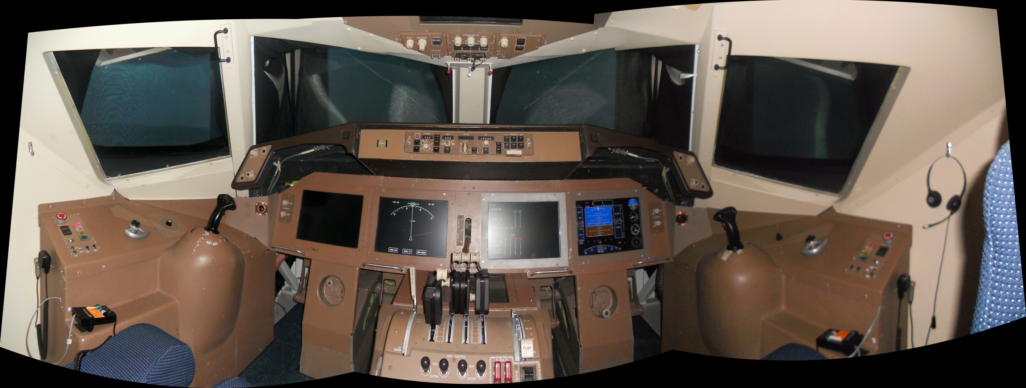
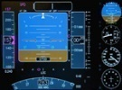
GFD Interior
Notes:
HUD displays aren’t really important
Point out location of FMC

