Slide 1
Rectangular Supercritical Wing (RSW)
Thorsten Hansen ANSYS Germany GmbH

Slide 2
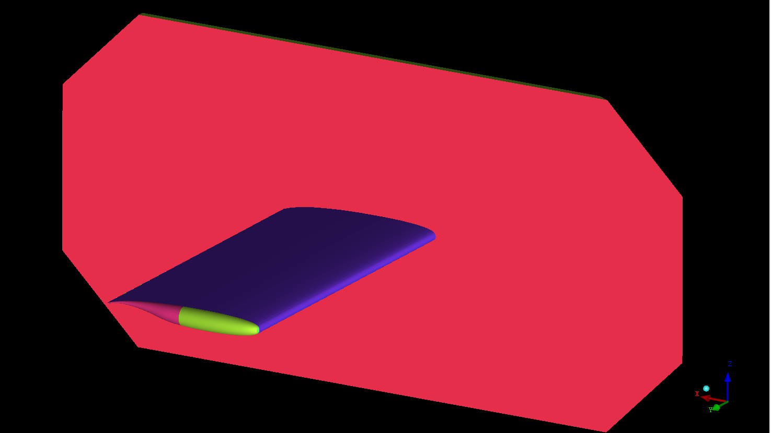
Aeroelastic Prediction Workshop
All data and information downloaded from
https://c3.nasa.gov/dashlink/static/media/dataset/RSW_WITHsplitterplate.igs
Geometry in IGES data format

Slide 3
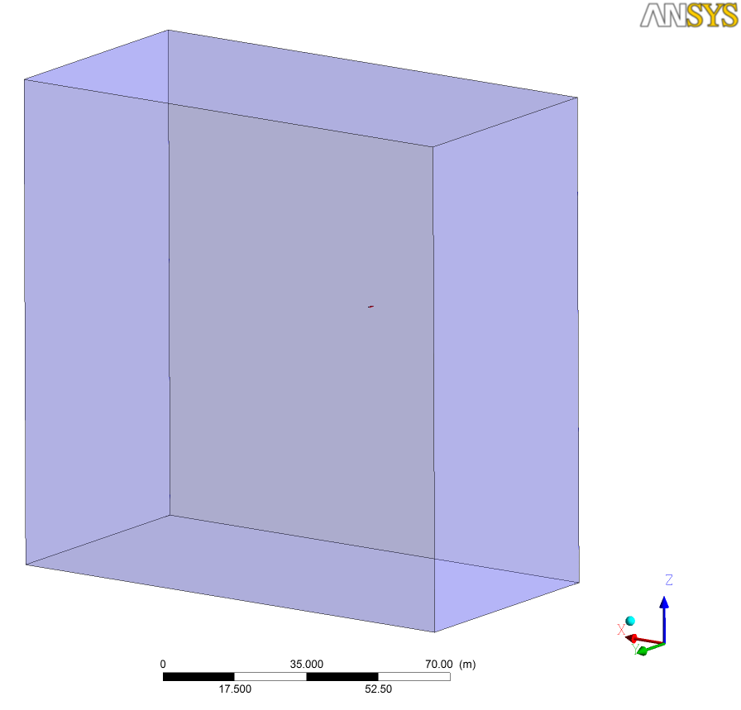
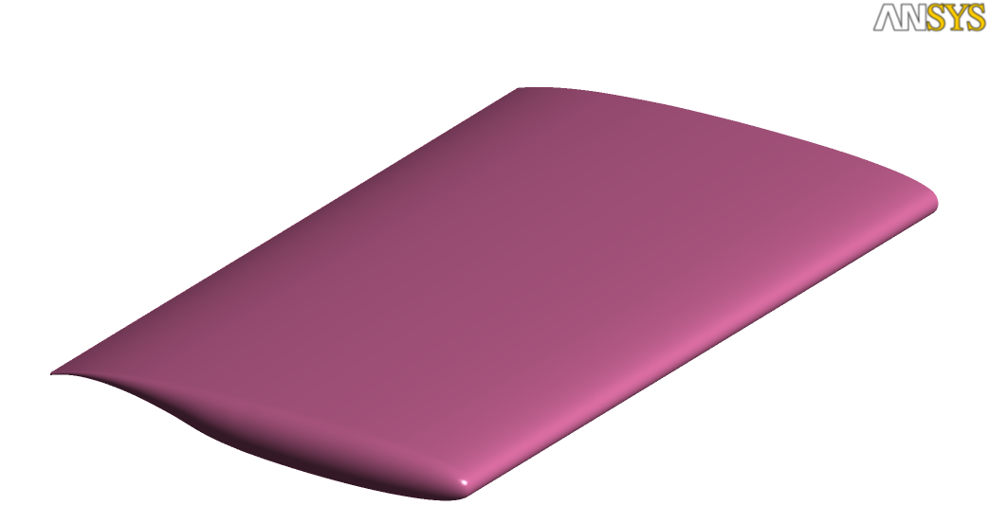
Computational Domain
Cref = 24.0 inches (609.6 mm)
Span = 48 inch
100 * Cref in all directions

Slide 4
Gridding Guidelines for AePW
Adapted from DPW and HiLift Workshops

Slide 5
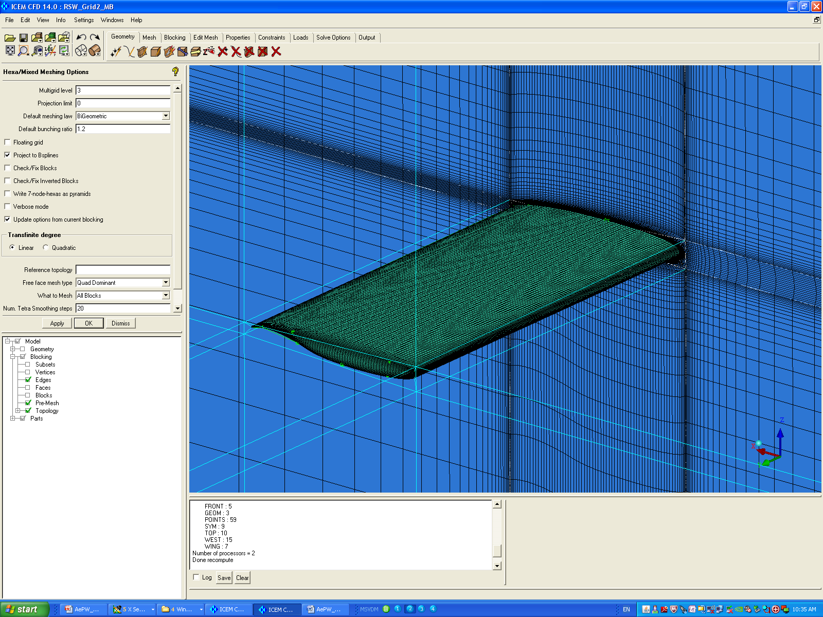
Grid Information
ANSYS ICEM CFD 13
Hexahedral elements
Scalable grids
Consistent mesh quality upon grid refinement
Multigrid
levels = 3

Slide 6
Grid Information
 | Grid 1 | Grid 2 | Grid 3
Number of nodes | 1,911,235 | 5,892,737 | 15,427,625
Number of elements | 1,863,680 | 5,792,768 | 15,238,656
Minimum grid angle | 32.66° | 32.37° | 28.71°
Maximum aspect ratio | 12,931 | 13,123 | 12,945
First grid node @ Wall, inch | 0.000158” (y⁺~1) | 0.000105” (y⁺~2/3) | 0.000070” (y⁺~4/9)

Slide 7
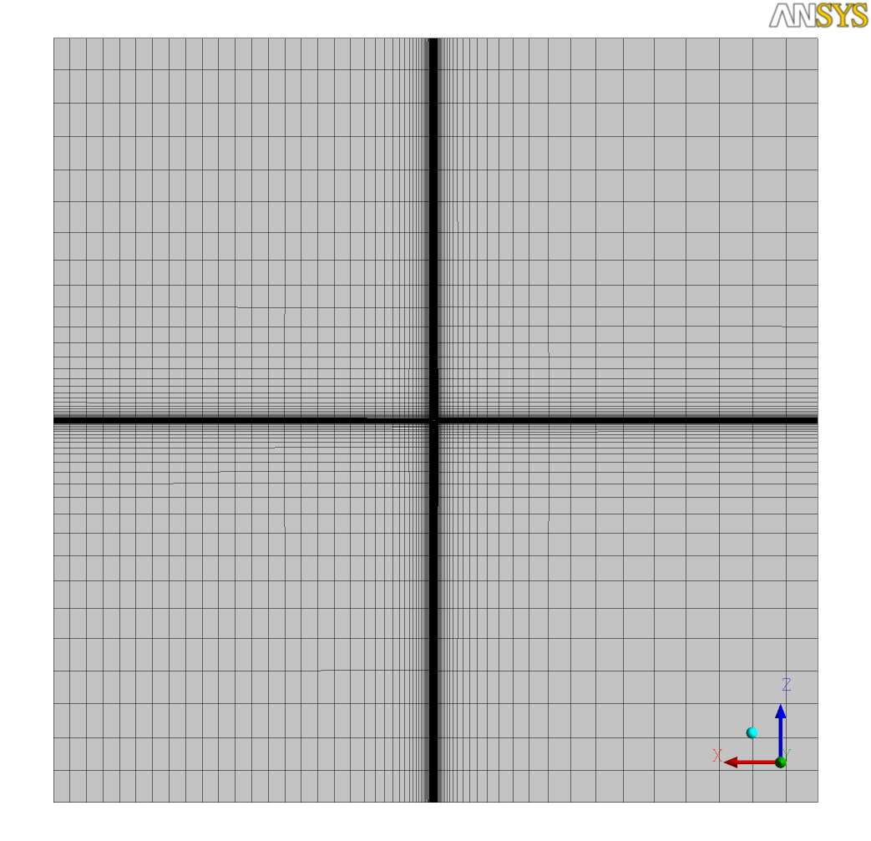
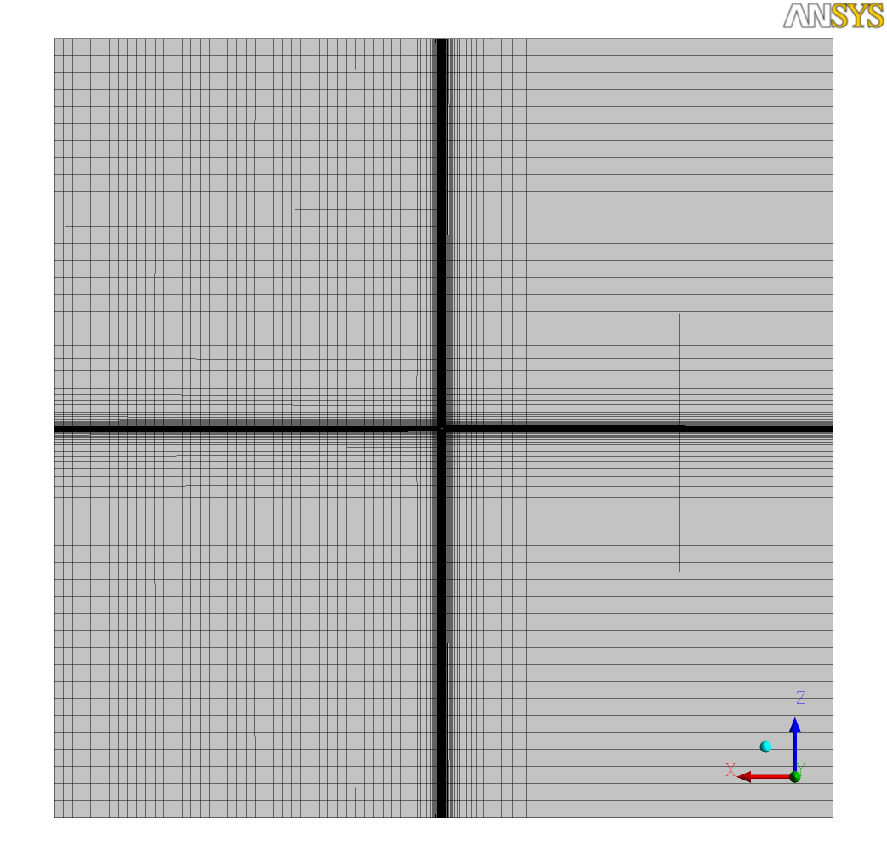
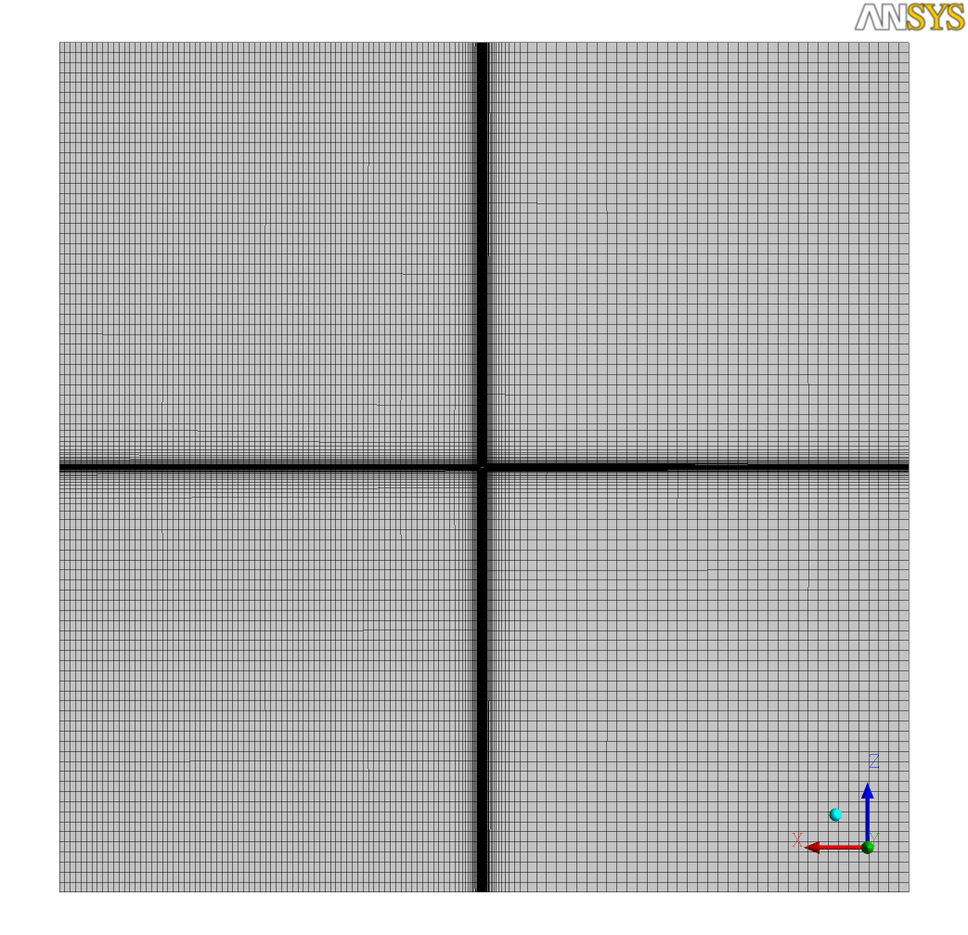
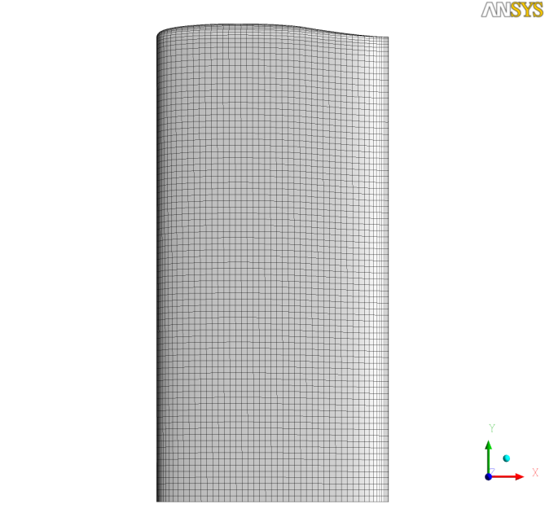
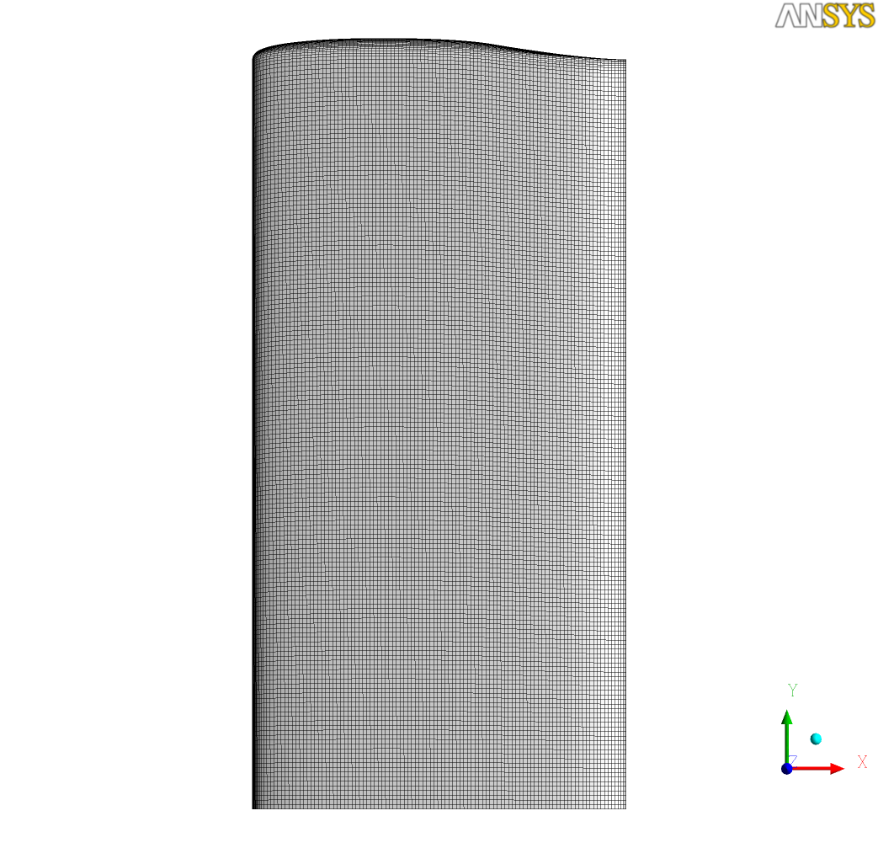
Grid Information
Grid 1
Grid 2
Grid 3

Slide 8
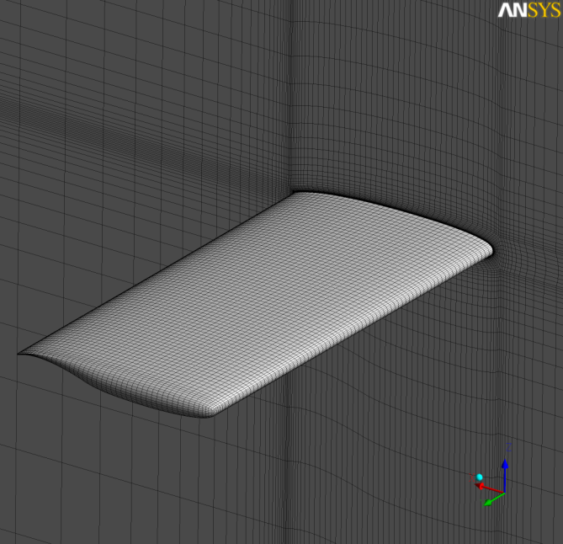
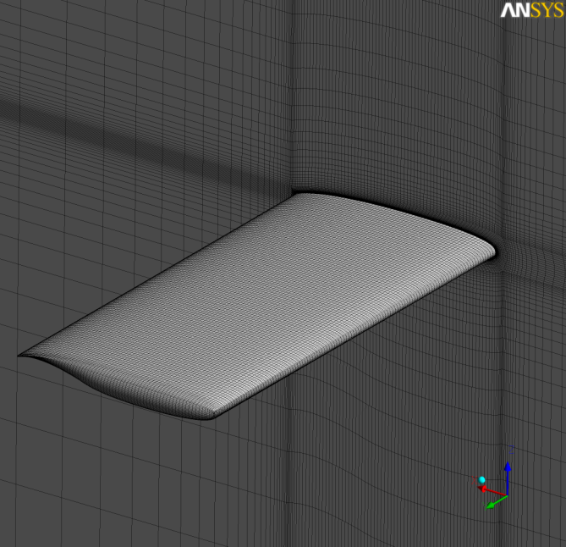
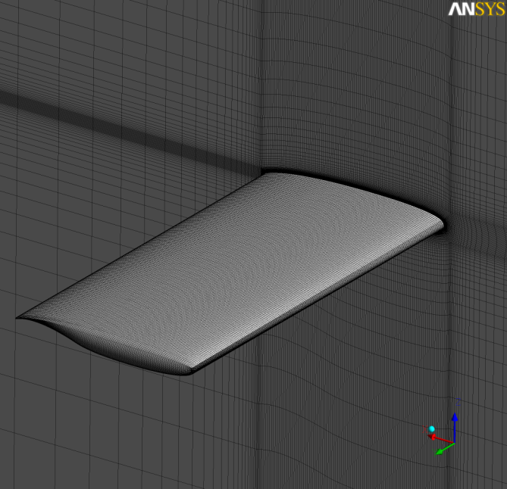
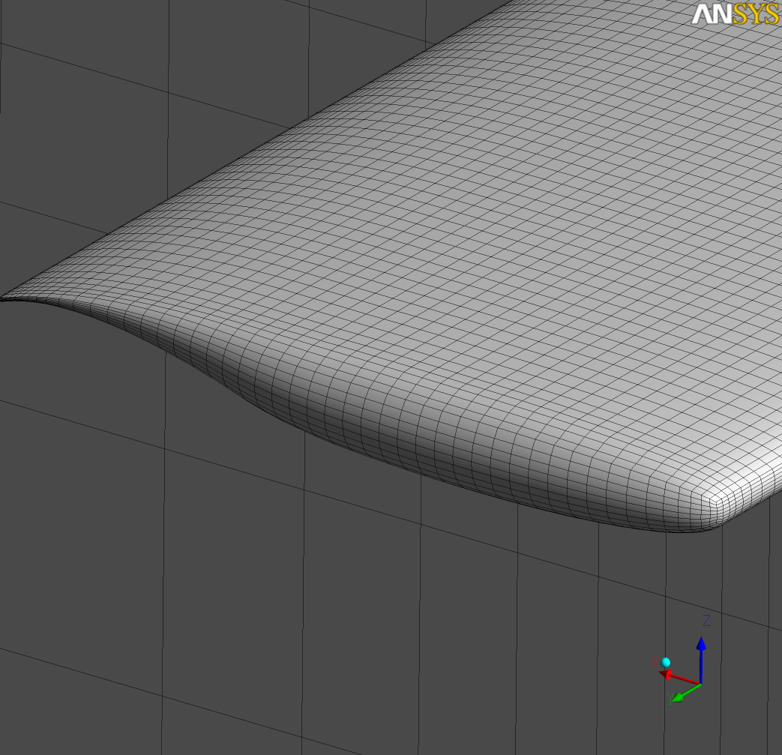
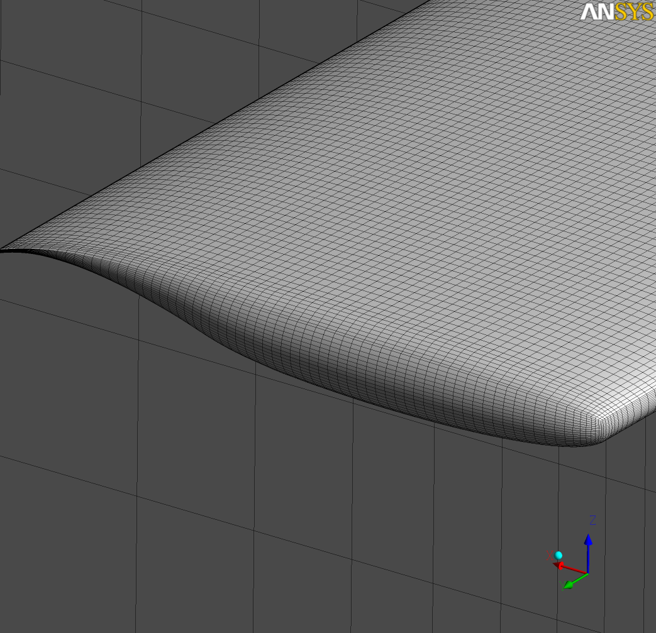
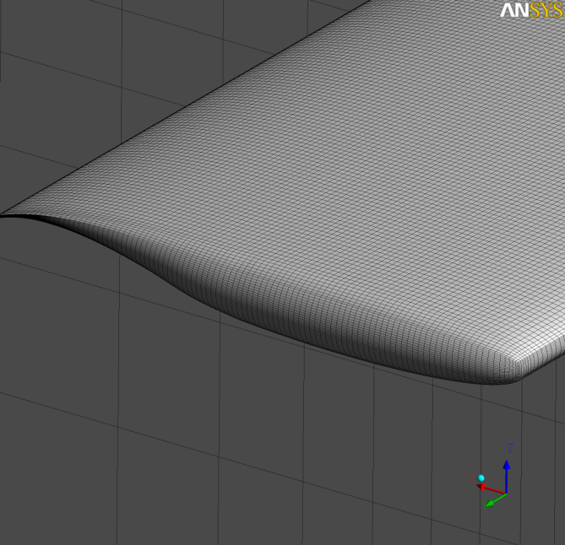
Grid Information
Grid 1
Grid 2
Grid 3

Slide 9
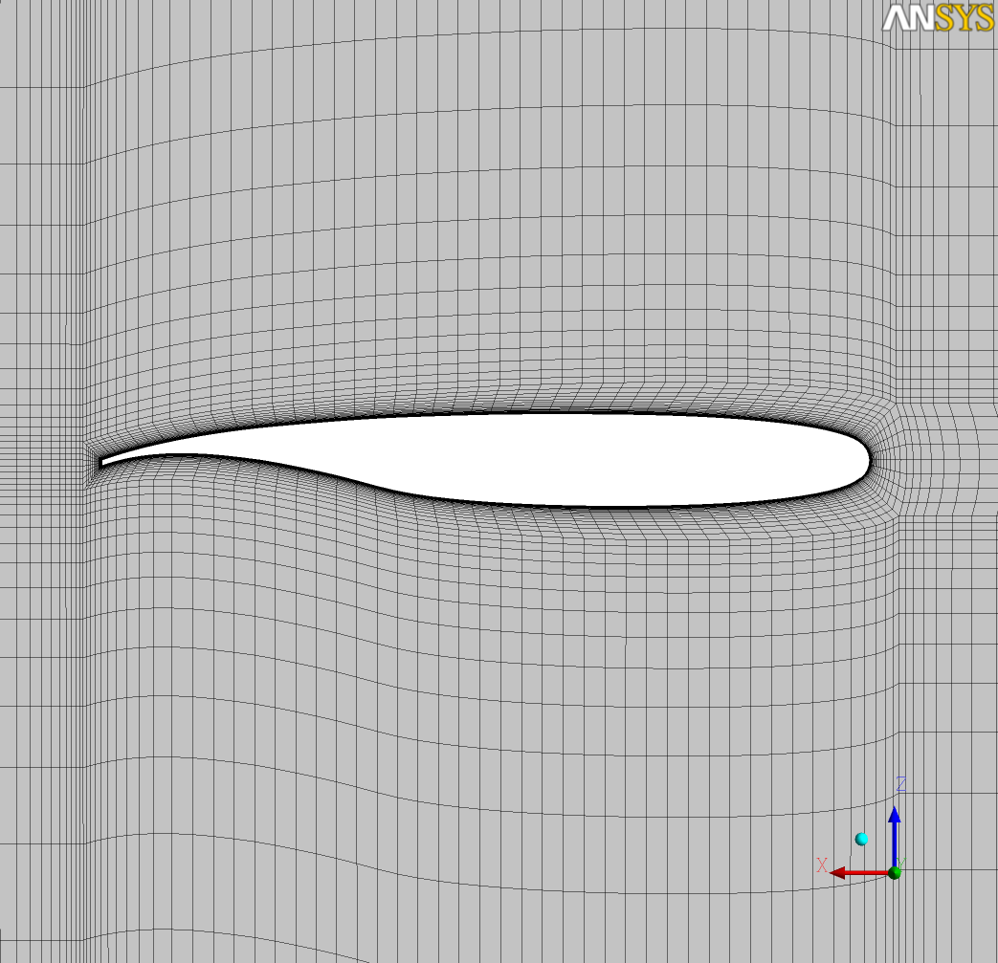
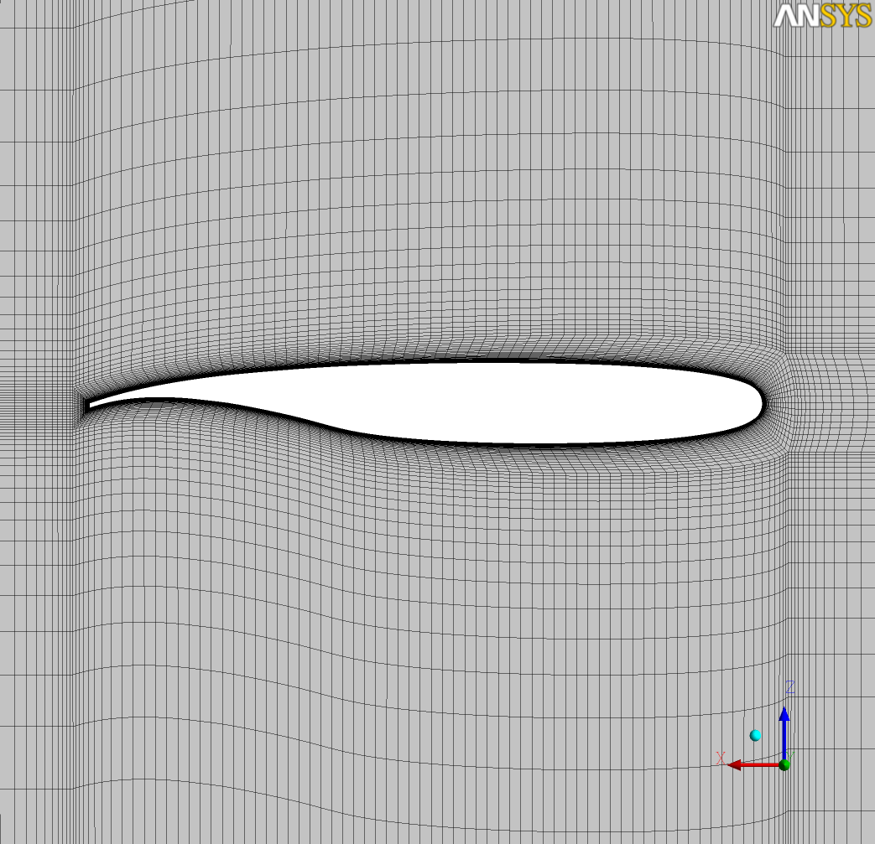
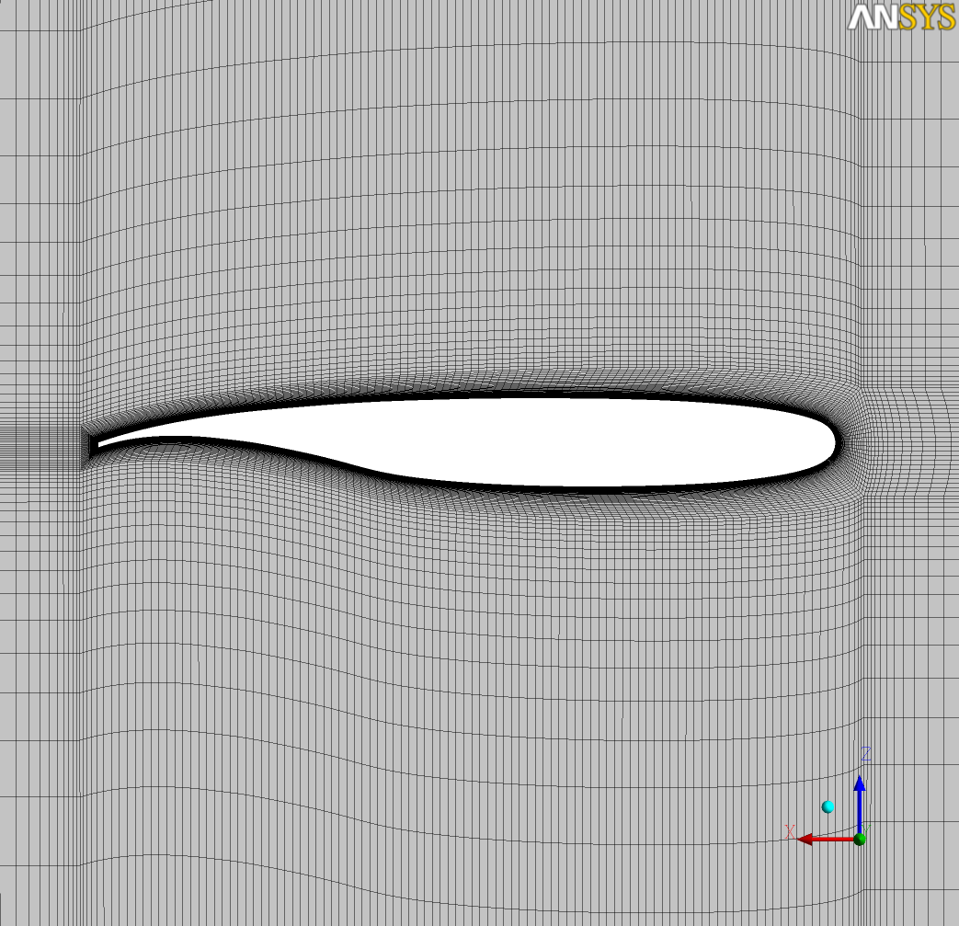
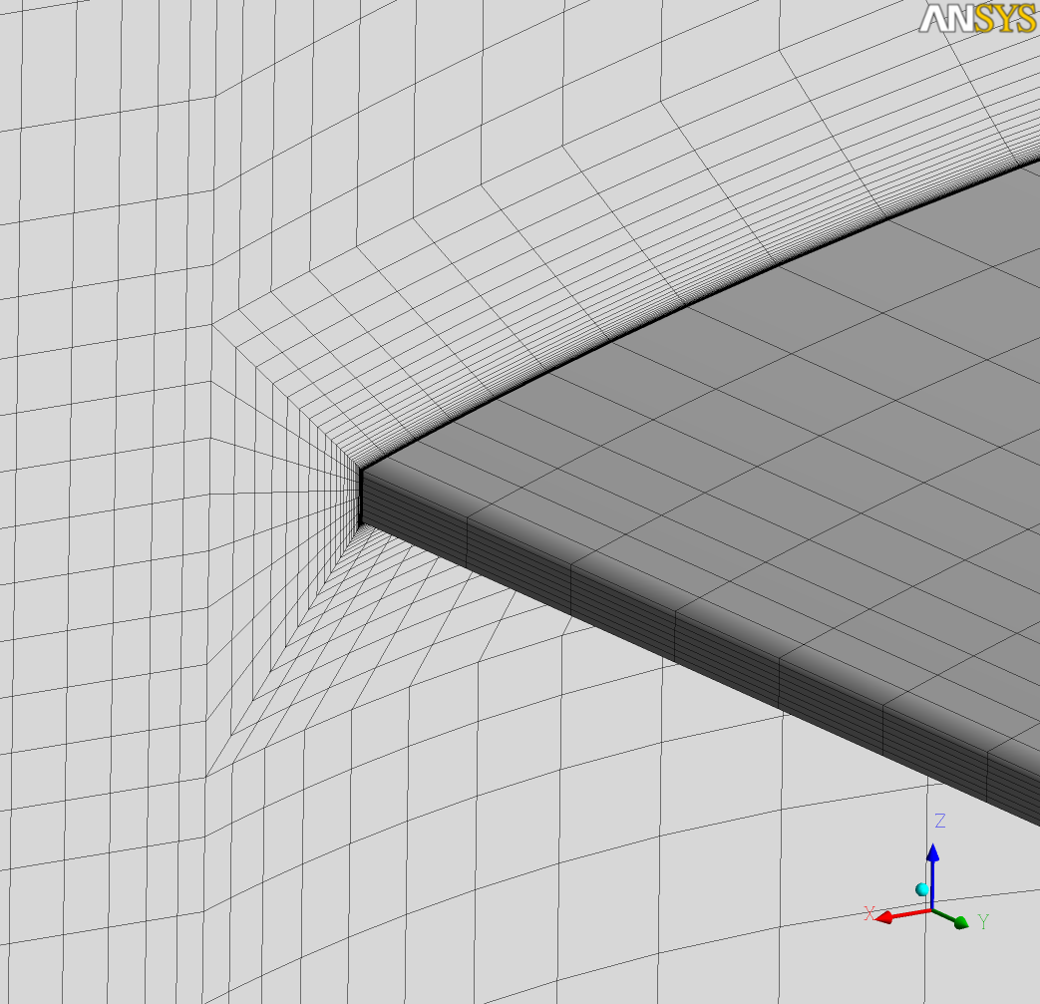
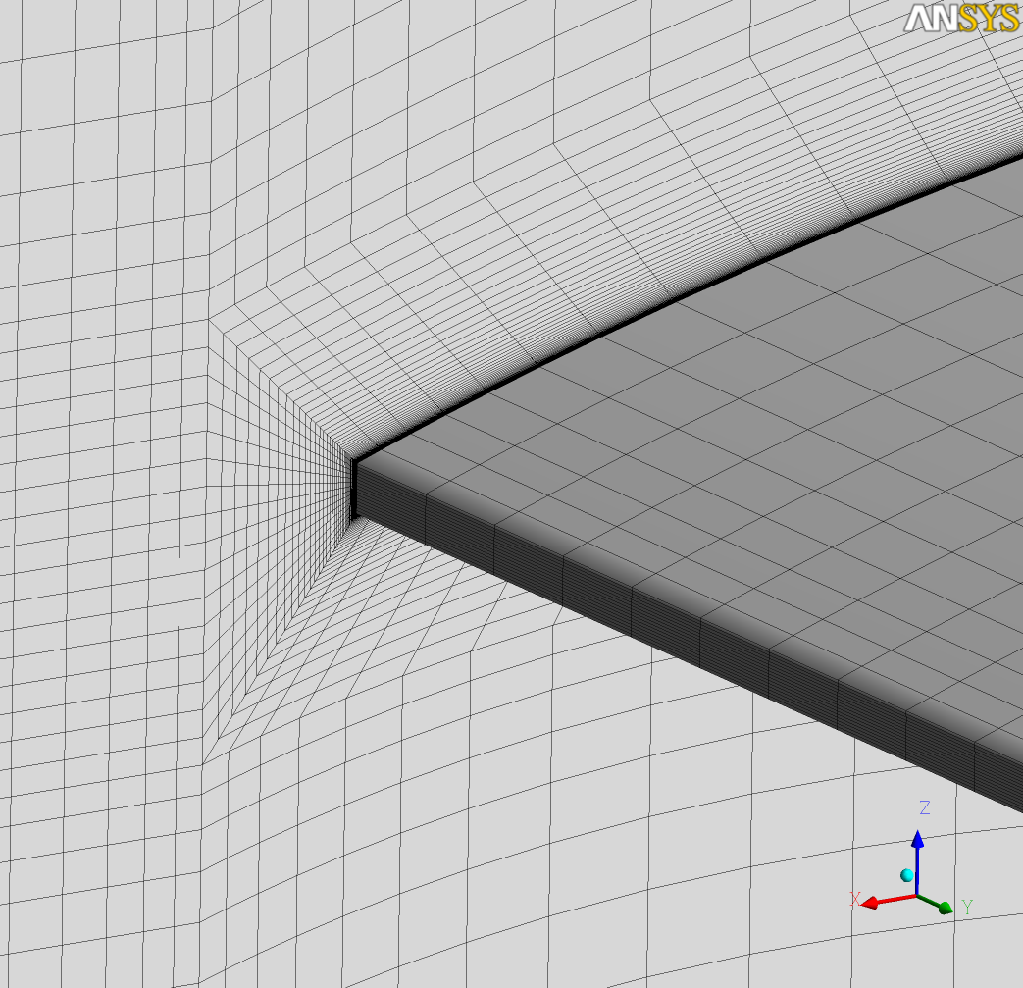
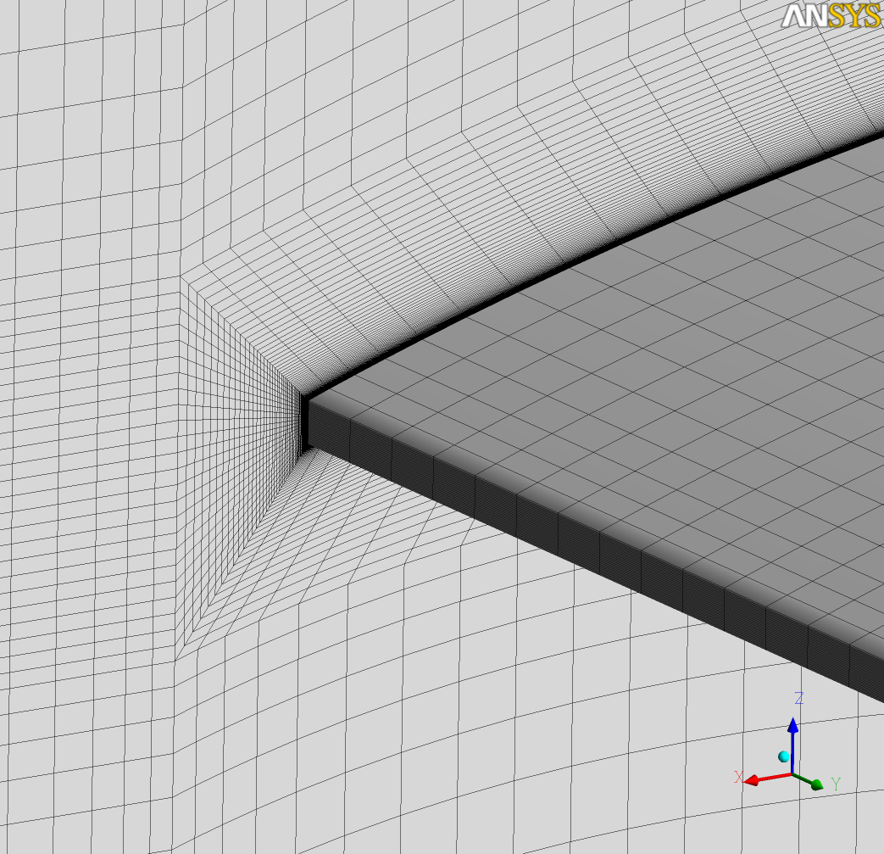
Grid Information
Grid 1
Grid 2
Grid 3

