Slide 1
HIRENASD
Thorsten Hansen ANSYS Germany GmbH

Slide 2
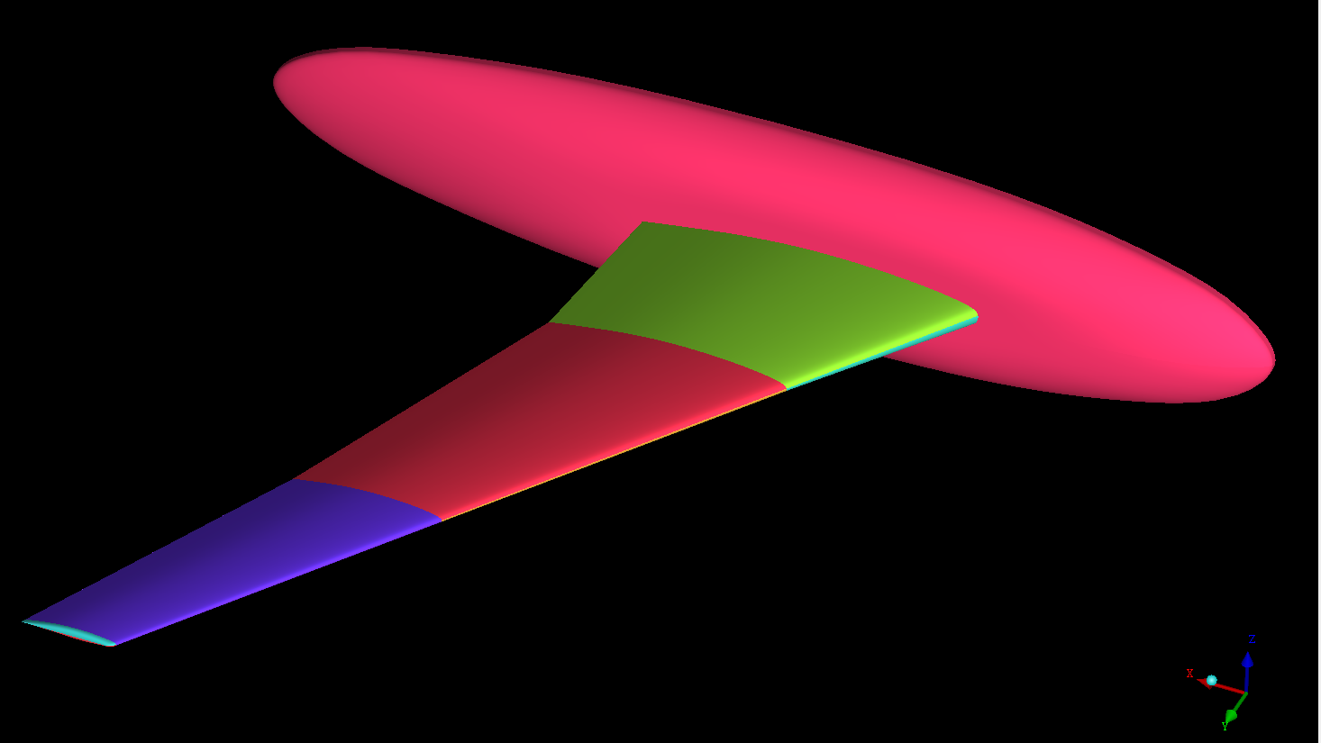
Aeroelastic Prediction Workshop
All data and information downloaded from
https://c3.nasa.gov/dashlink/static/media/other/hirenasd_AePW_DLR.igs.gz
Geometry in IGES data format

Slide 3
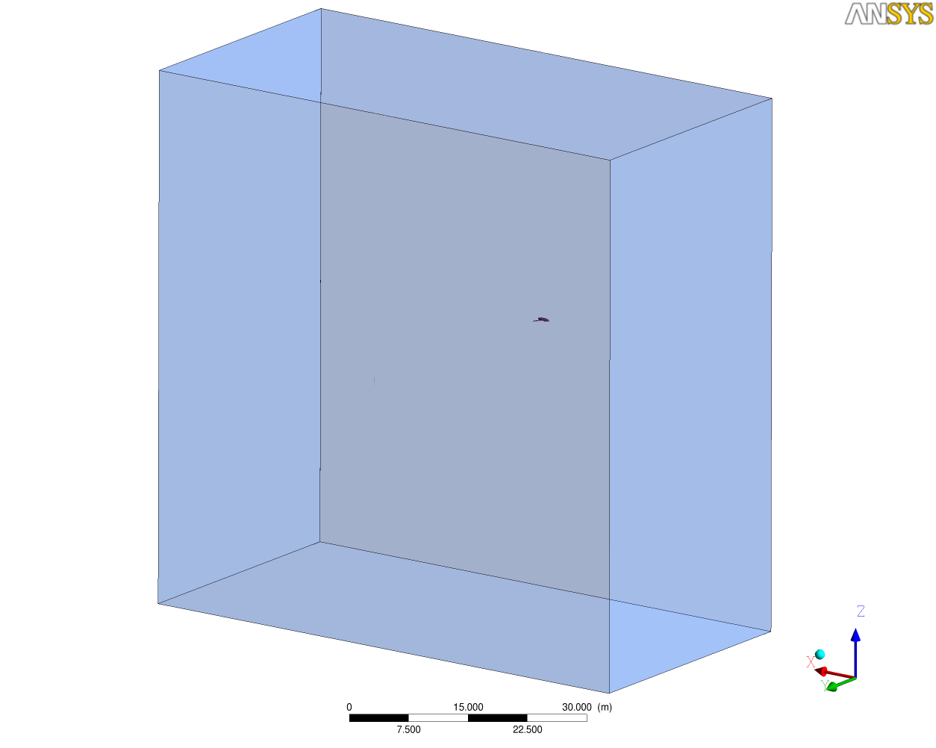
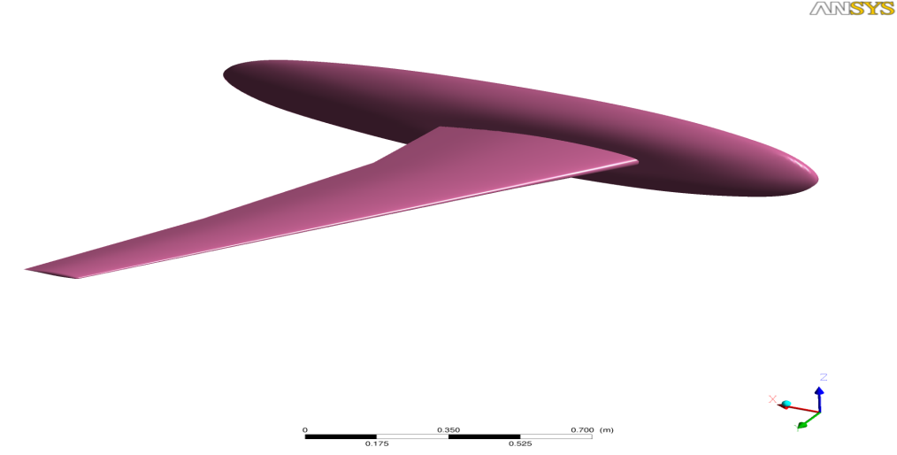
Computational Domain
Cref_{mean} = 0.3445 m
100 * Cref in all directions

Slide 4
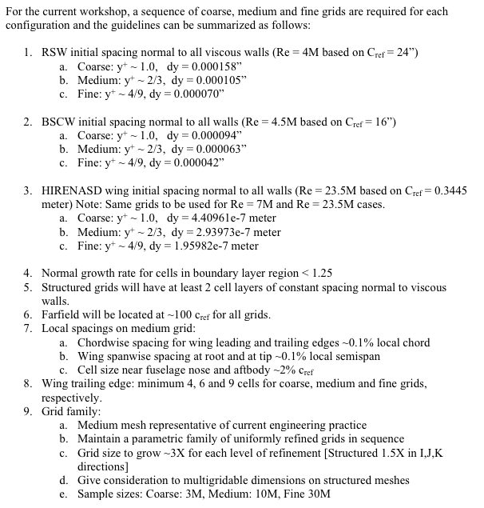
Gridding Guidelines for AePW
Adapted from DPW and HiLift Workshops

Slide 5
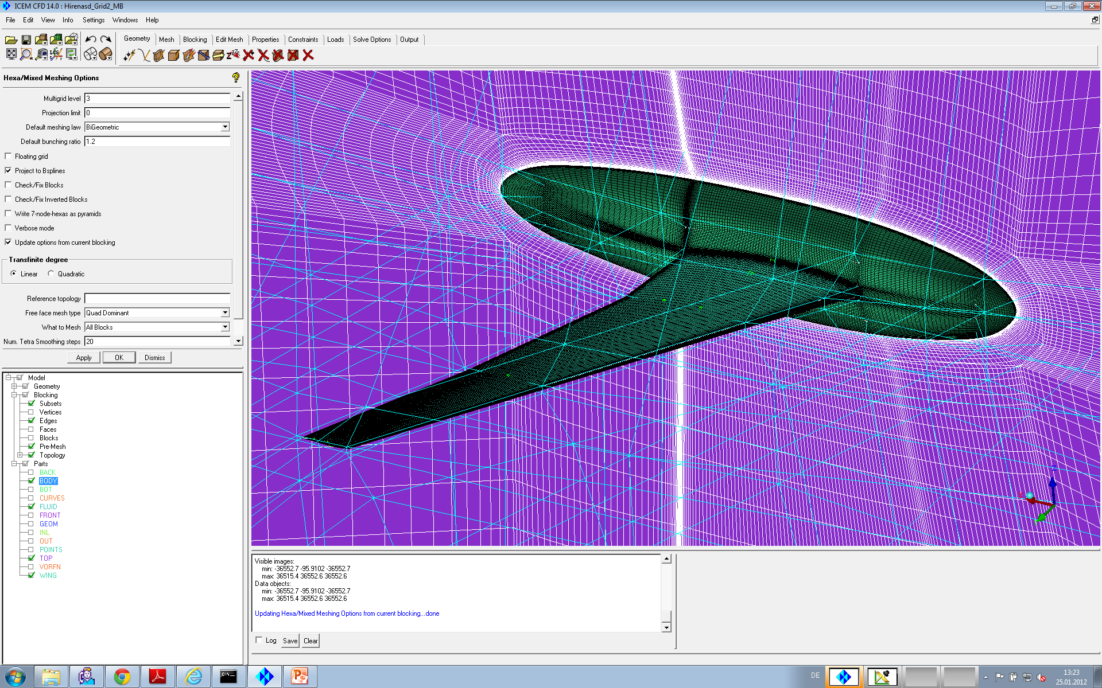
Grid Information
ANSYS ICEM CFD 14
Hexahedral elements
Scalable grids
Consistent mesh quality upon grid refinement
Multigrid
levels = 3

Slide 6
Grid Information
 | Grid 1 | Grid 2 | Grid 3
Number of nodes | 3,158,849 | 10,025,769 | 28,458,329
Number of elements | 3,088,384 | 9,872,384 | 28,149,248
Minimum grid angle | 23.3° | 24.17° | 24.33°
Maximum aspect ratio | 149,529 | 125,250 | 134,515
First grid node @ Wall, m | 4.4e-07” (y⁺~1) | 2.94e-07” (y⁺~2/3) | 2.0e-07” (y⁺~4/9)

Slide 7
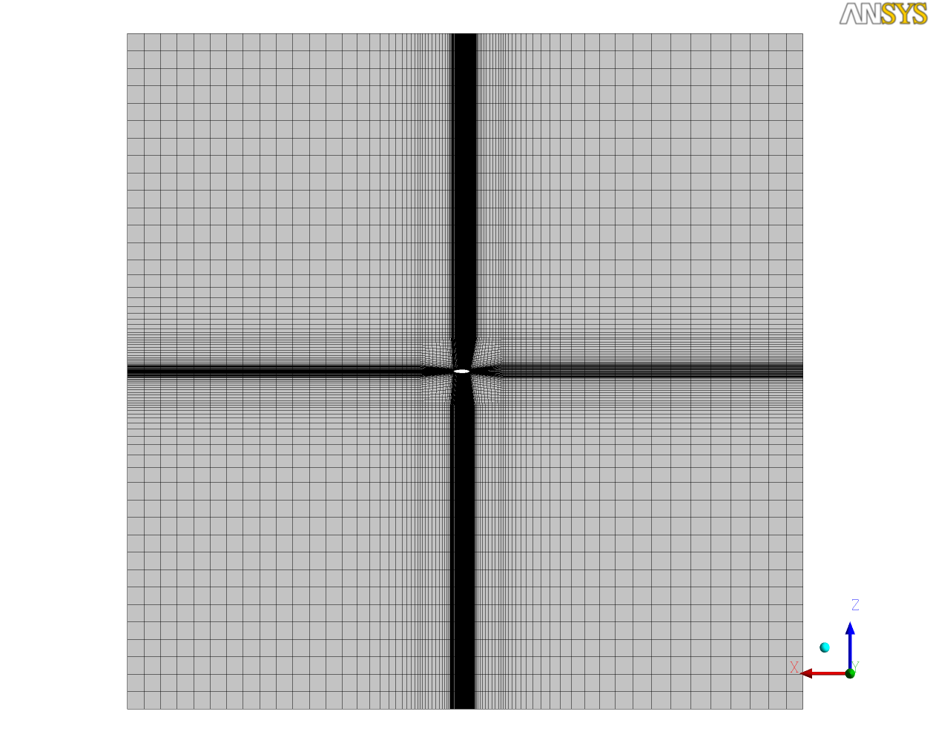
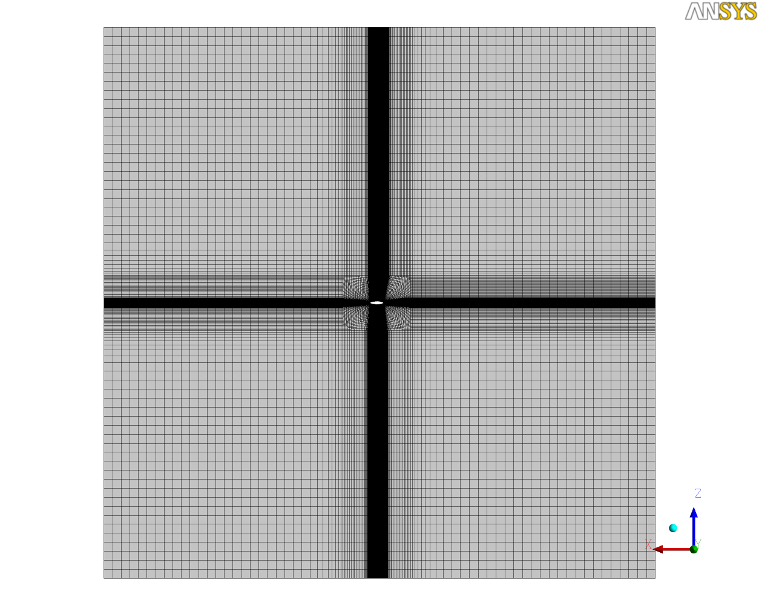
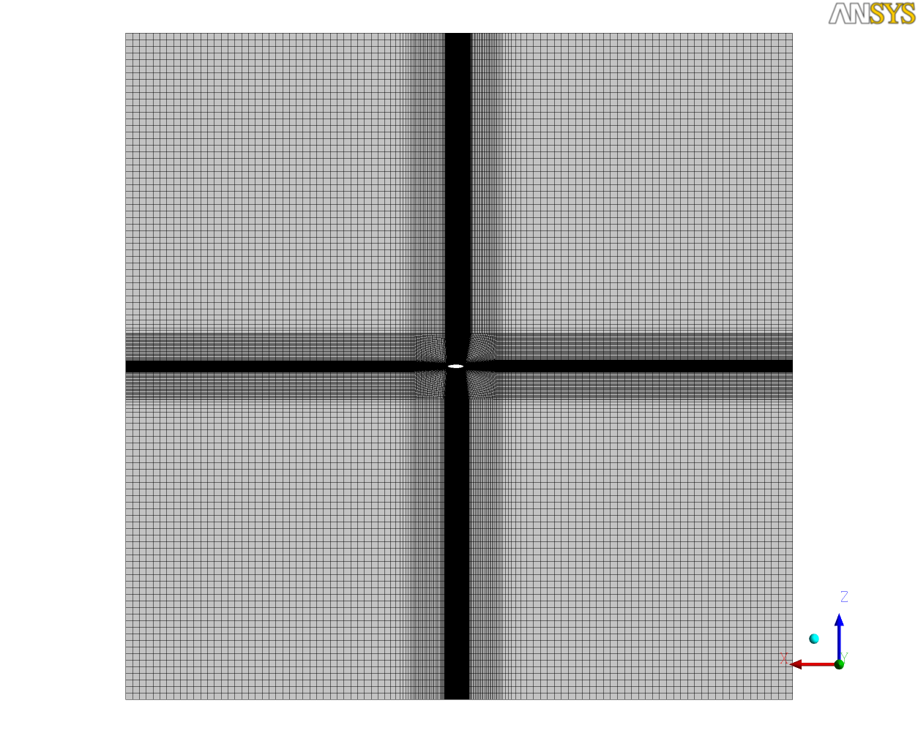
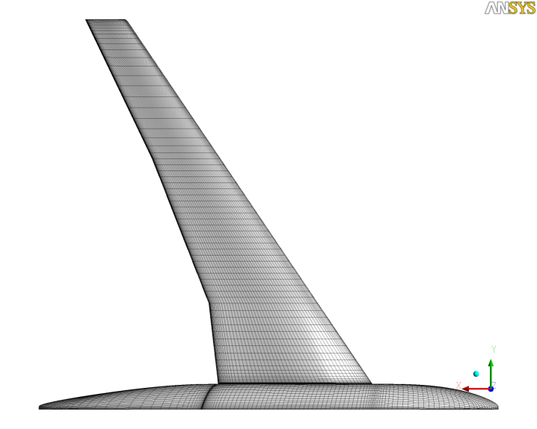
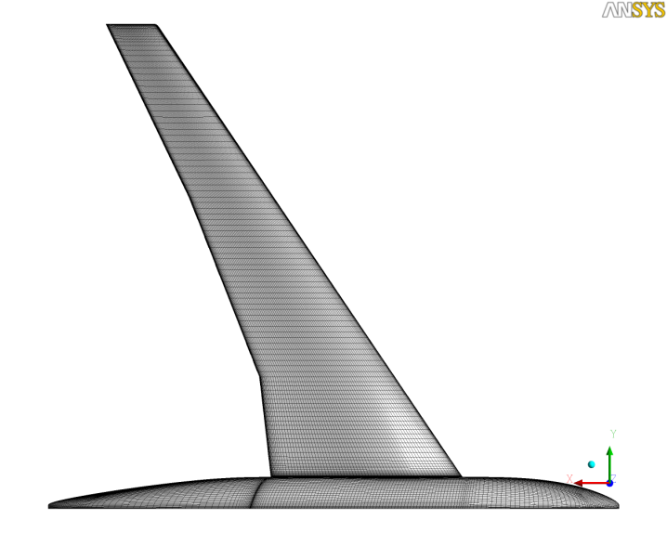
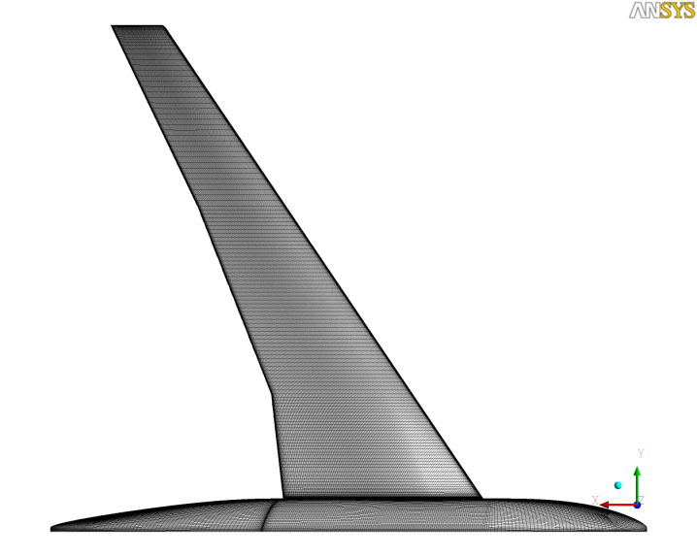
Grid Information
Grid 1
Grid 2
Grid 3

Slide 8
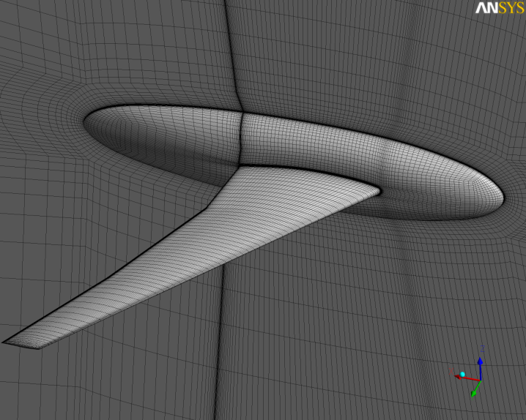
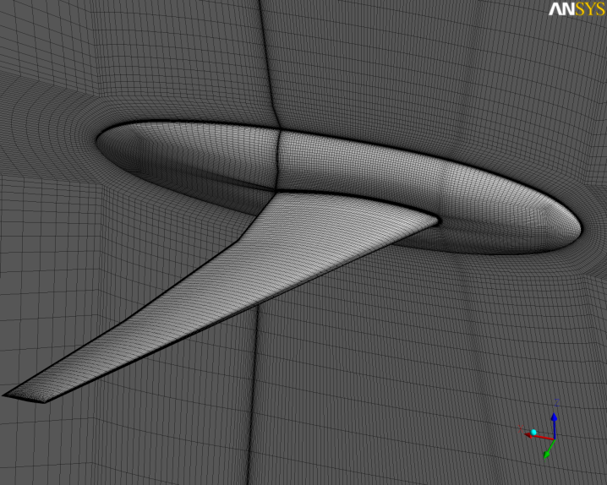
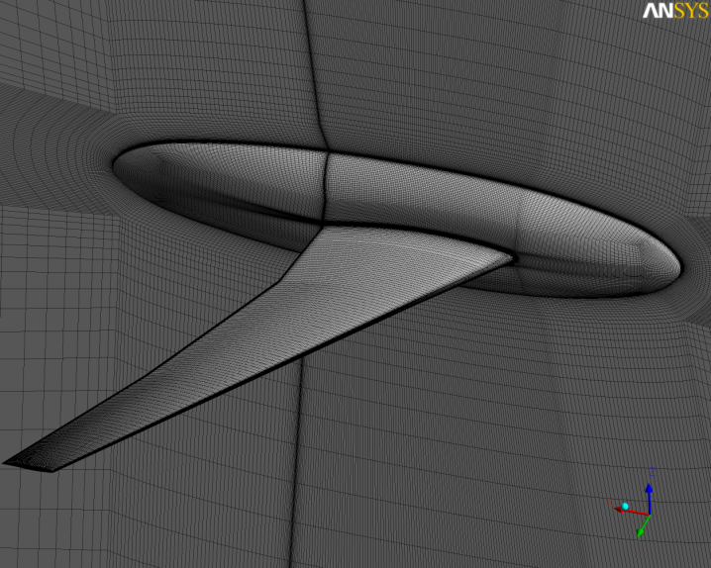
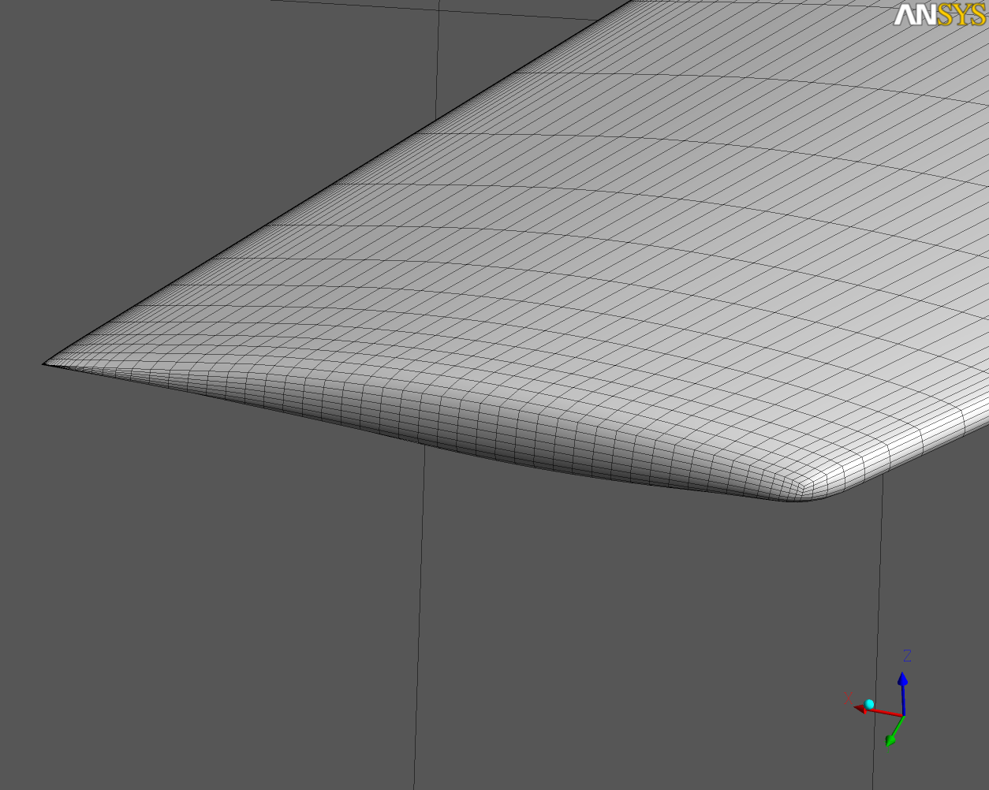
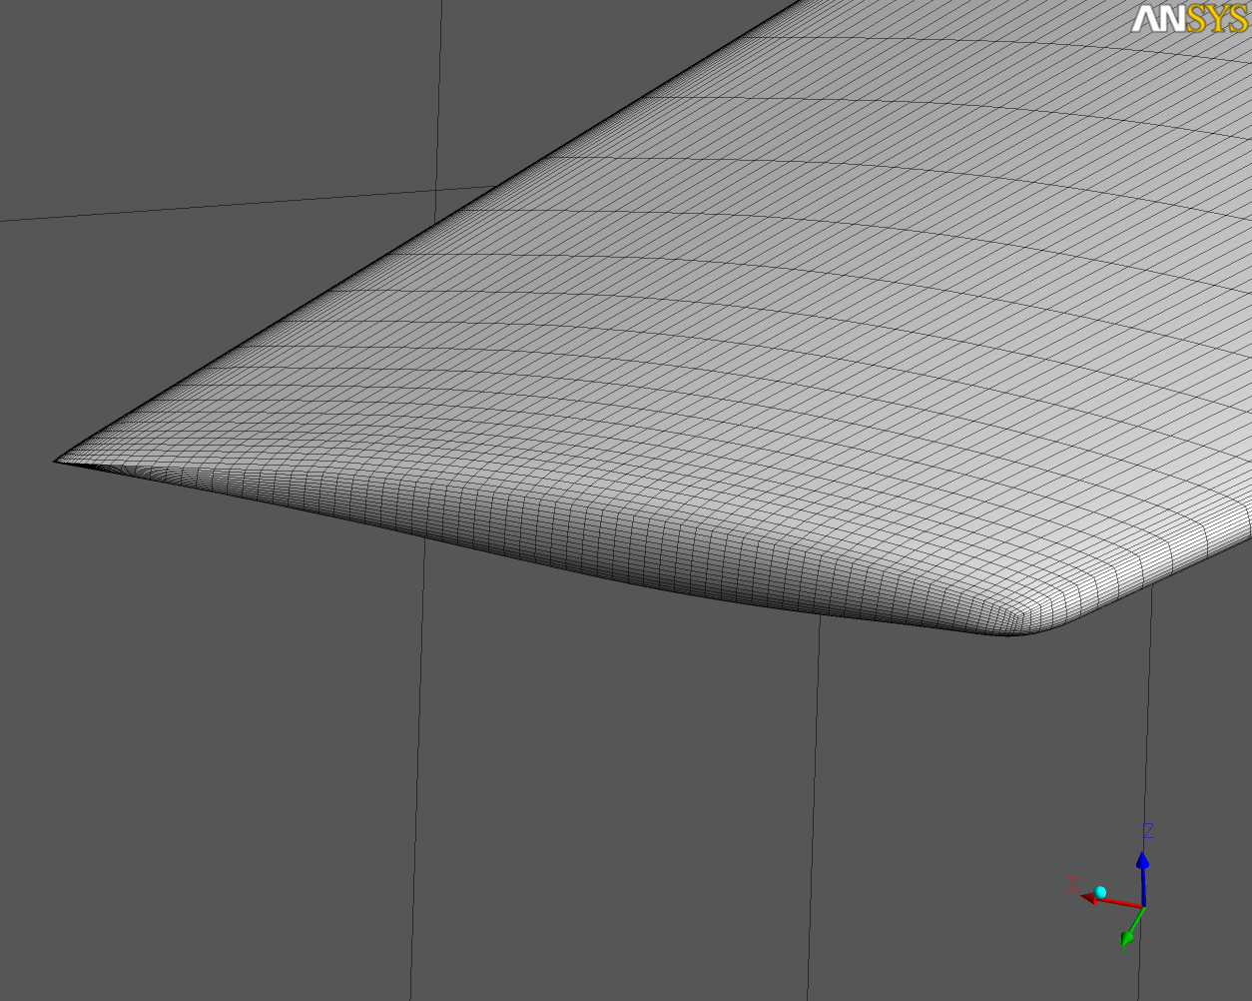
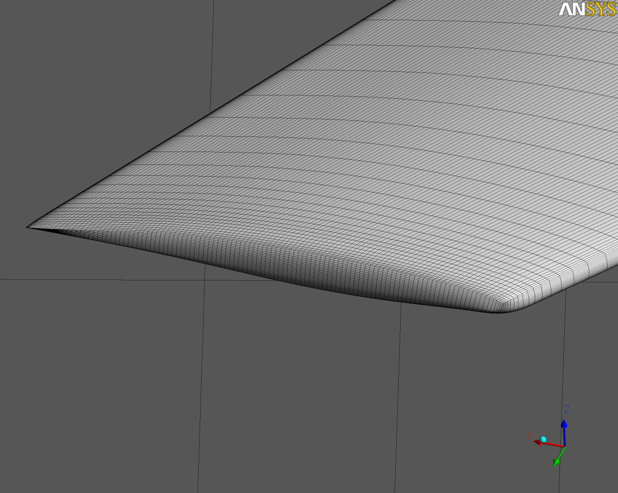
Grid Information
Grid 1
Grid 2
Grid 3

Slide 9
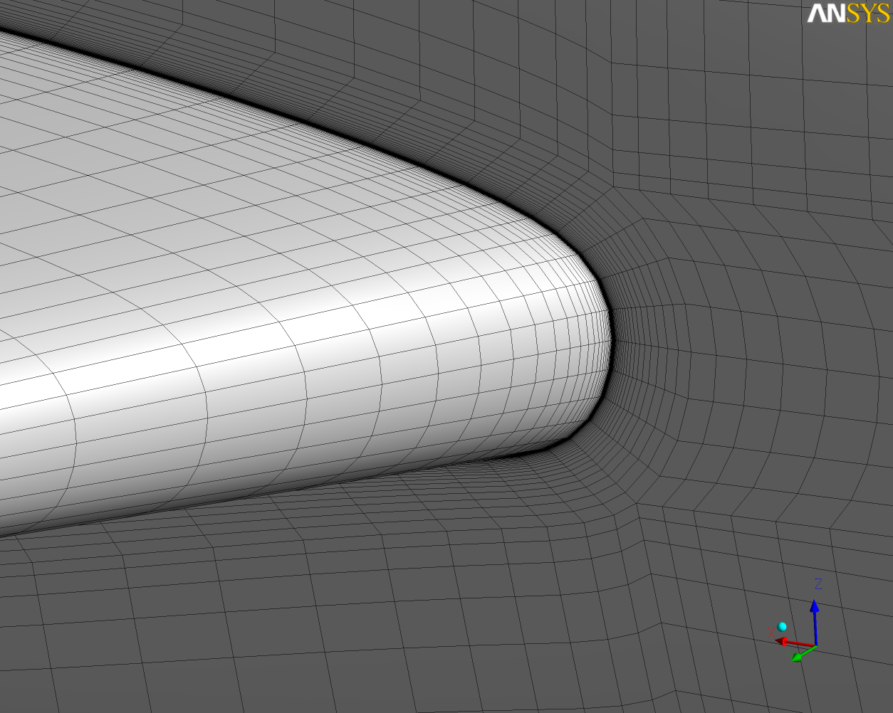
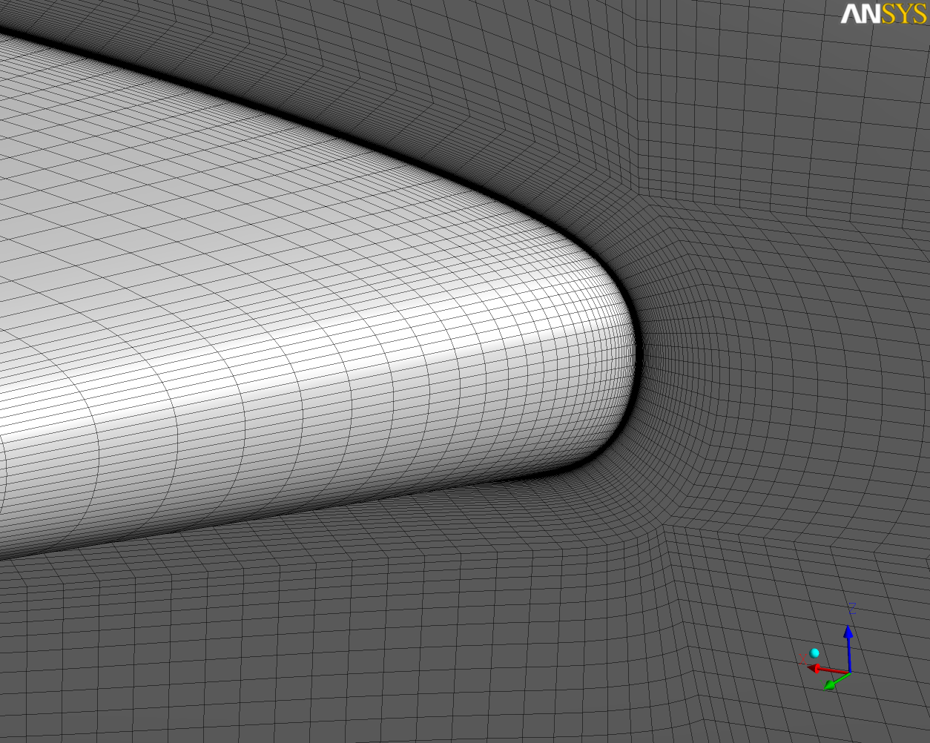
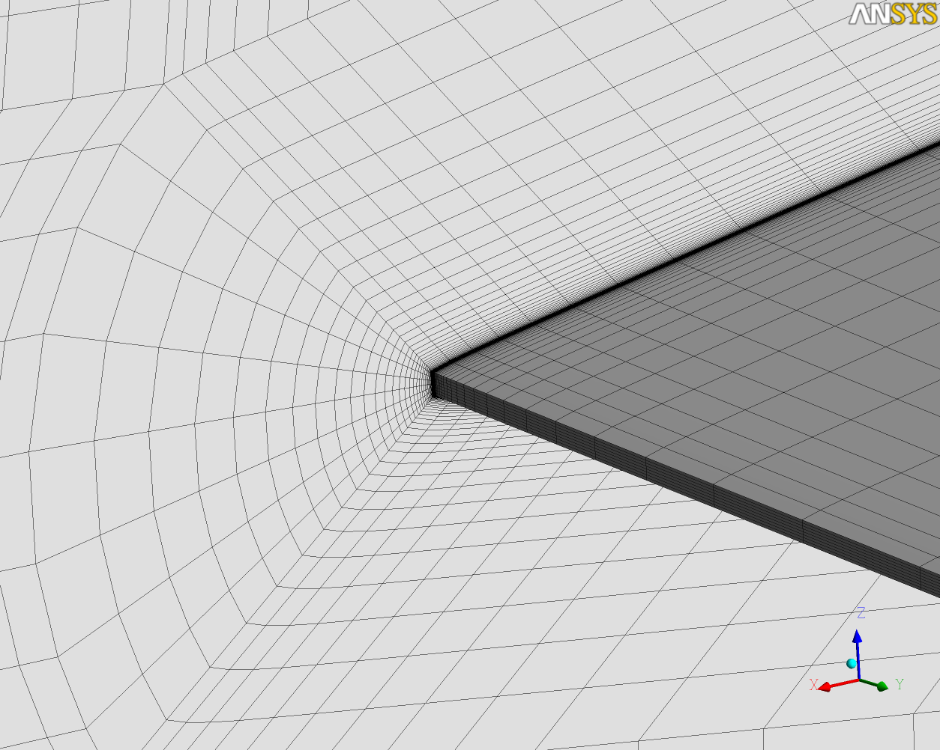
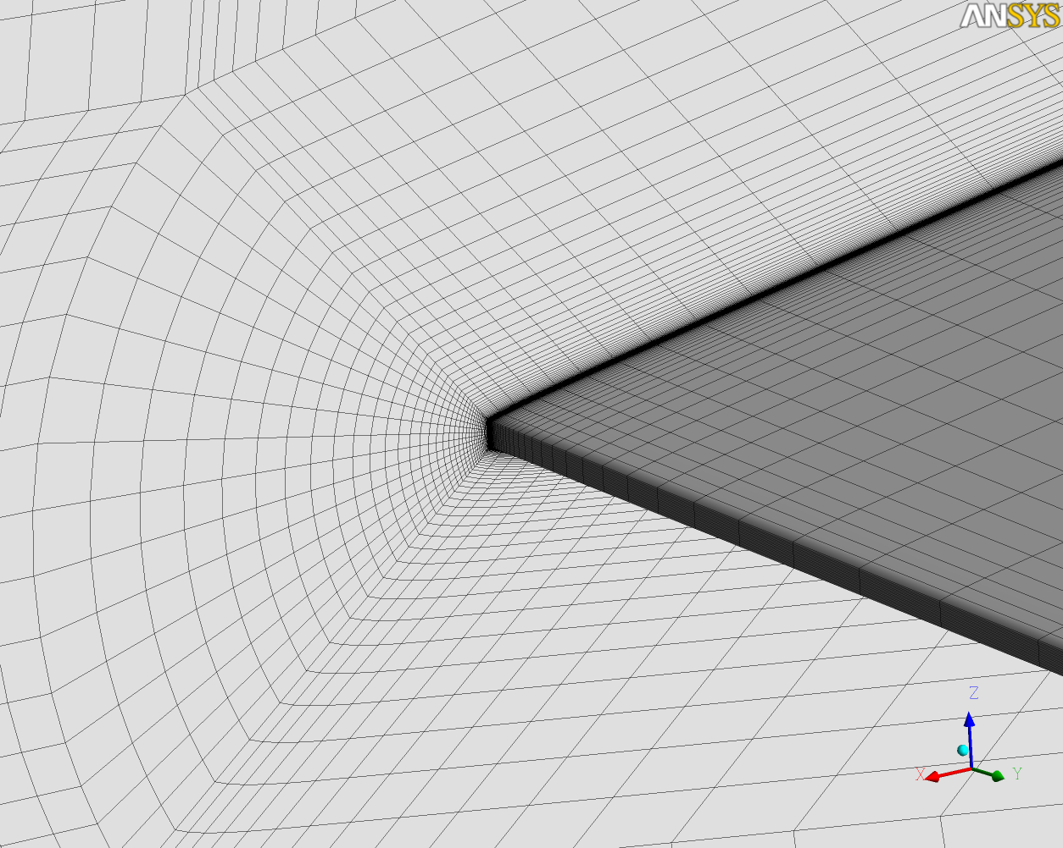
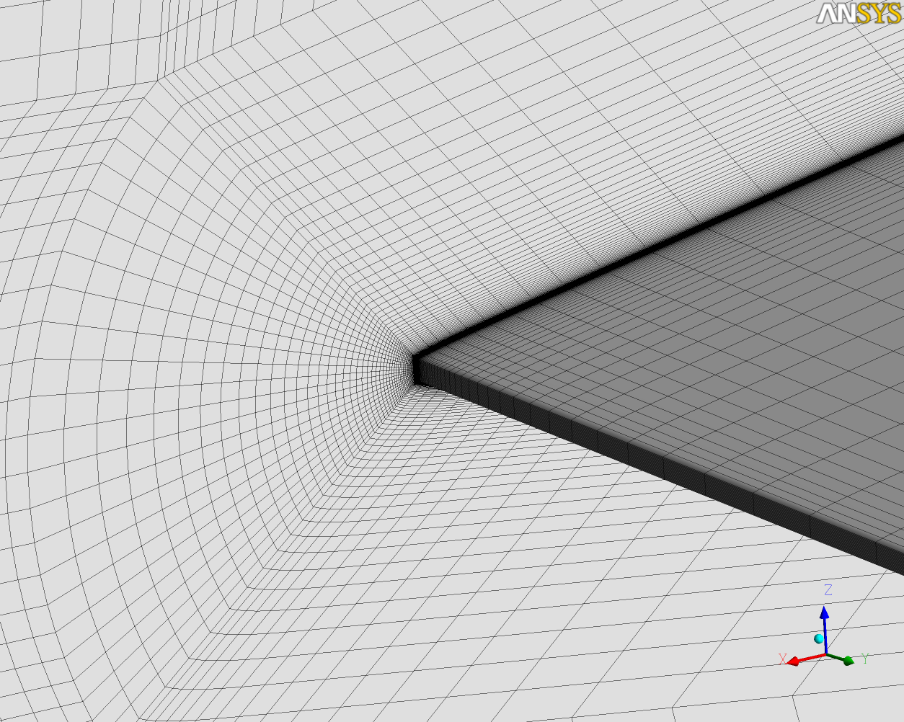
Grid Information
Grid 1
Grid 2
Grid 3

