Slide 1
Benchmark Supercritical Wing (BSCW)
Thorsten Hansen
ANSYS Germany

Slide 2
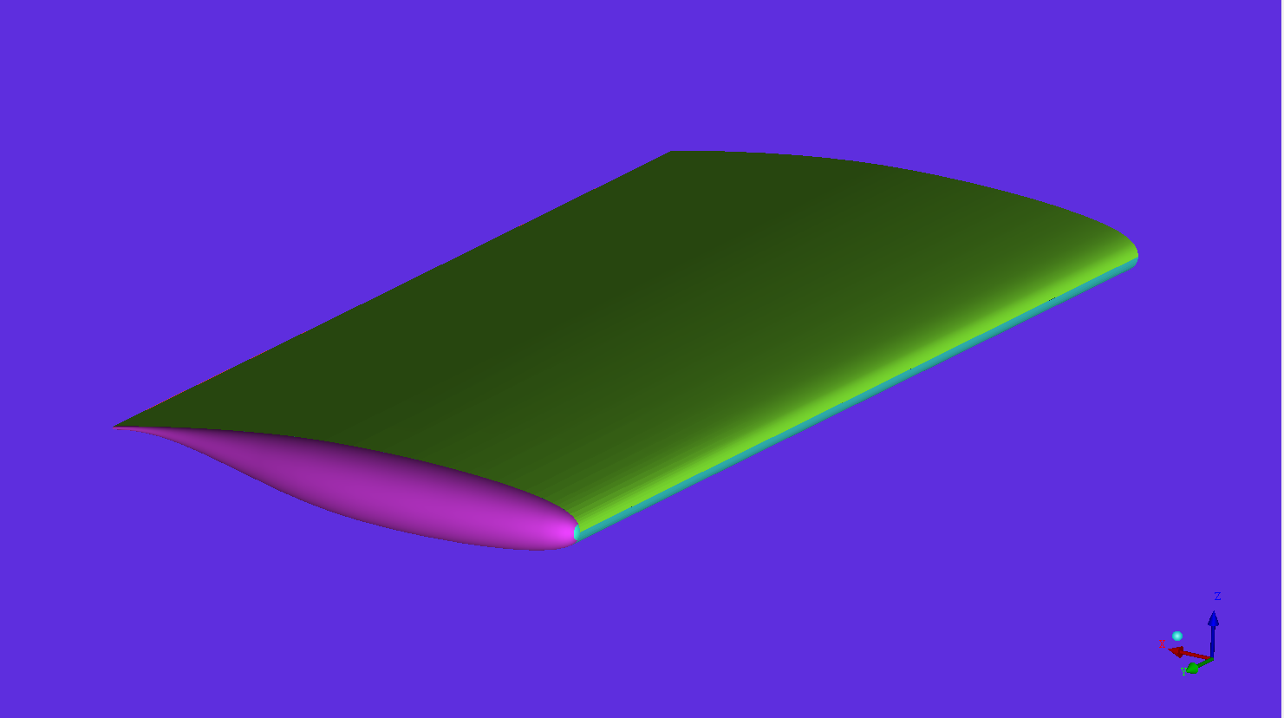
Aeroelastic Prediction Workshop
All data and information downloaded from
https://c3.nasa.gov/dashlink/static/media/dataset/bscw_splitterplate3.igs
Geometry in IGES data format

Slide 3
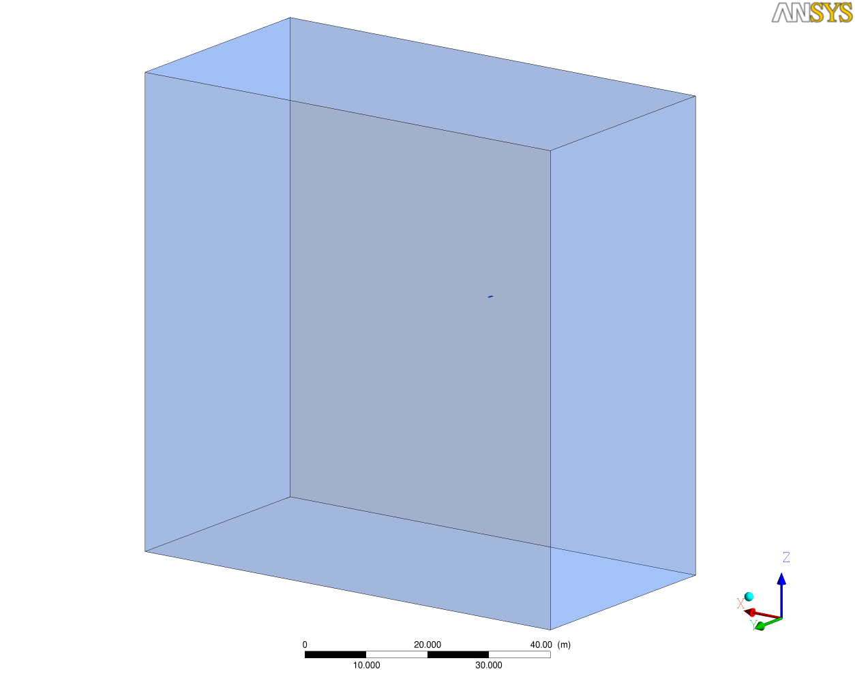
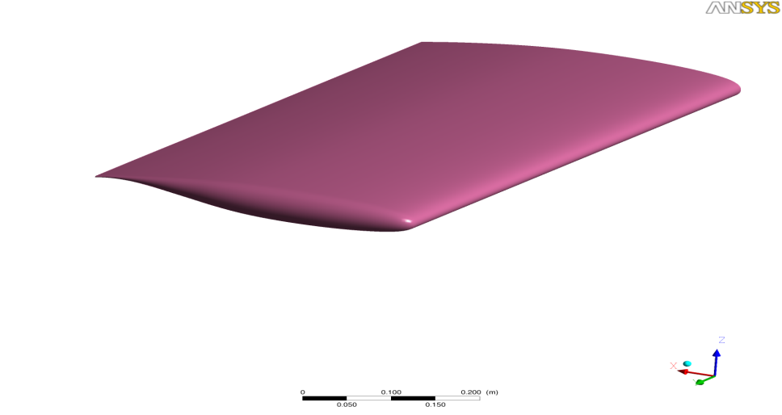
Computational Domain
Cref = 16.0 inches (406.4 mm)
100 * Cref in all directions

Slide 4
Gridding Guidelines for AePW
Adapted from DPW and HiLift Workshops

Slide 5
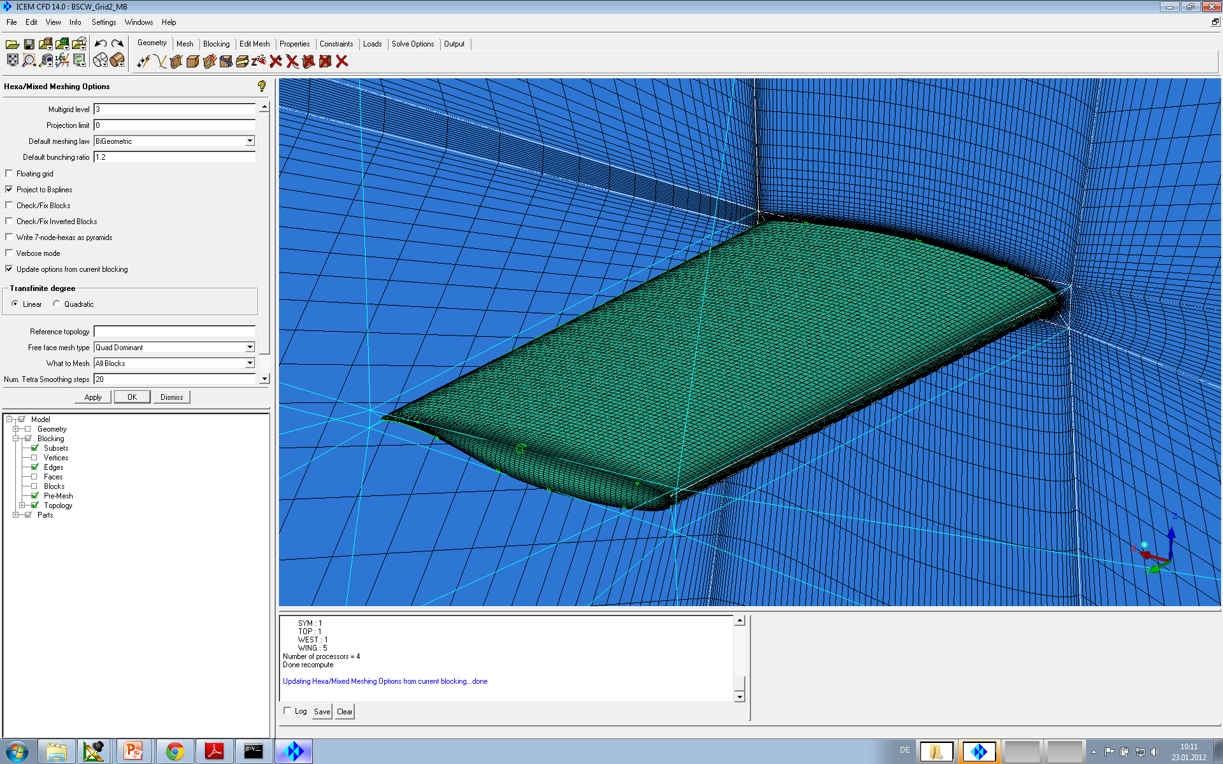
Grid Information
ANSYS ICEM CFD 14
Hexahedral elements
Scalable grids
Consistent mesh quality upon grid refinement
Multigrid
levels = 3

Slide 6
Grid Information
 | Grid 1 | Grid 2 | Grid 3
Number of nodes | 1,488,809 | 5,025,665 | 13,926,249
Number of elements | 1,448,960 | 4,935,680 | 13,747,200
Minimum grid angle | 31.41° | 32.43° | 29.07°
Maximum aspect ratio | 23,250 | 19,356 | 16,387
First grid node @ Wall, inch | 0.000094” (y⁺~1) | 0.000063” (y⁺~2/3) | 0.000042” (y⁺~4/9)

Slide 7
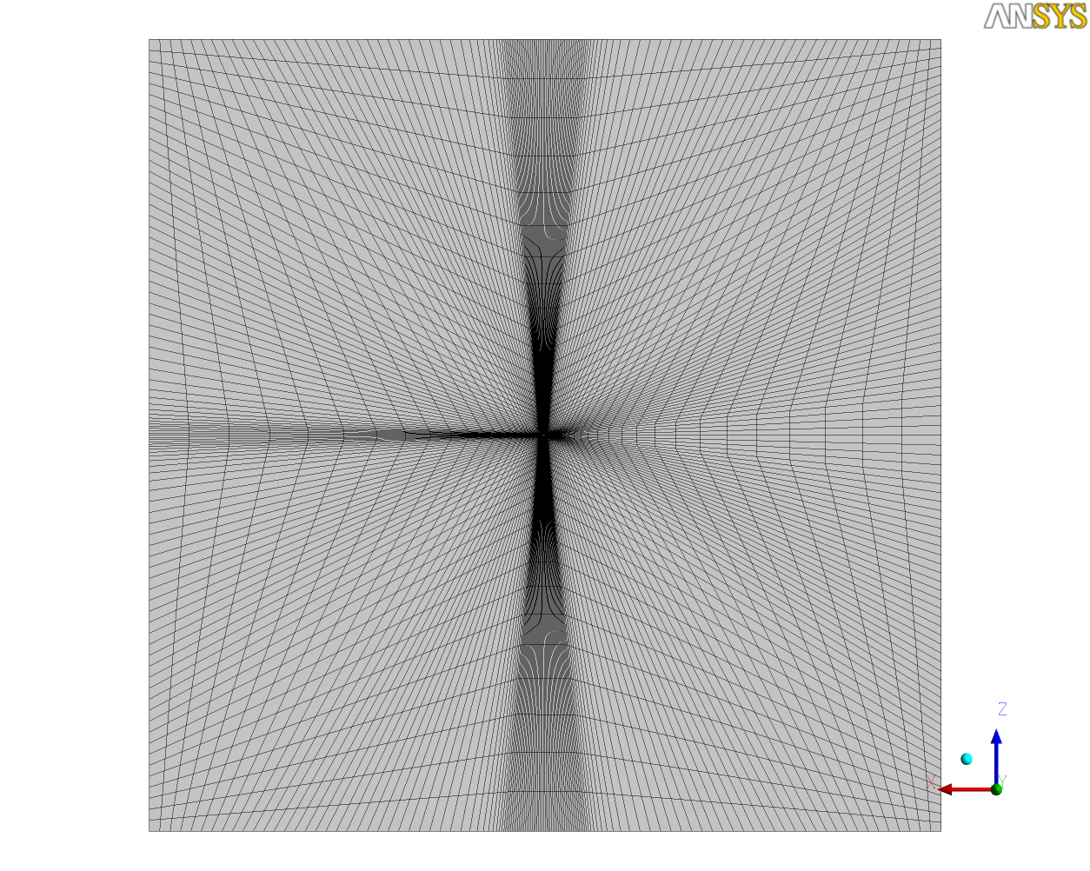
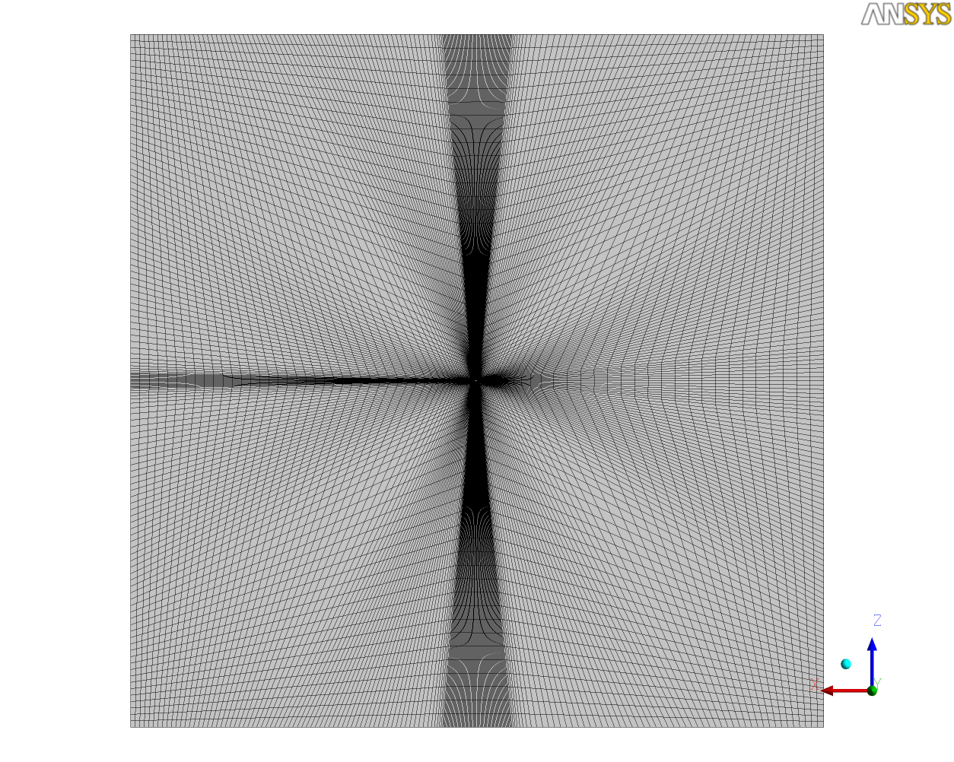
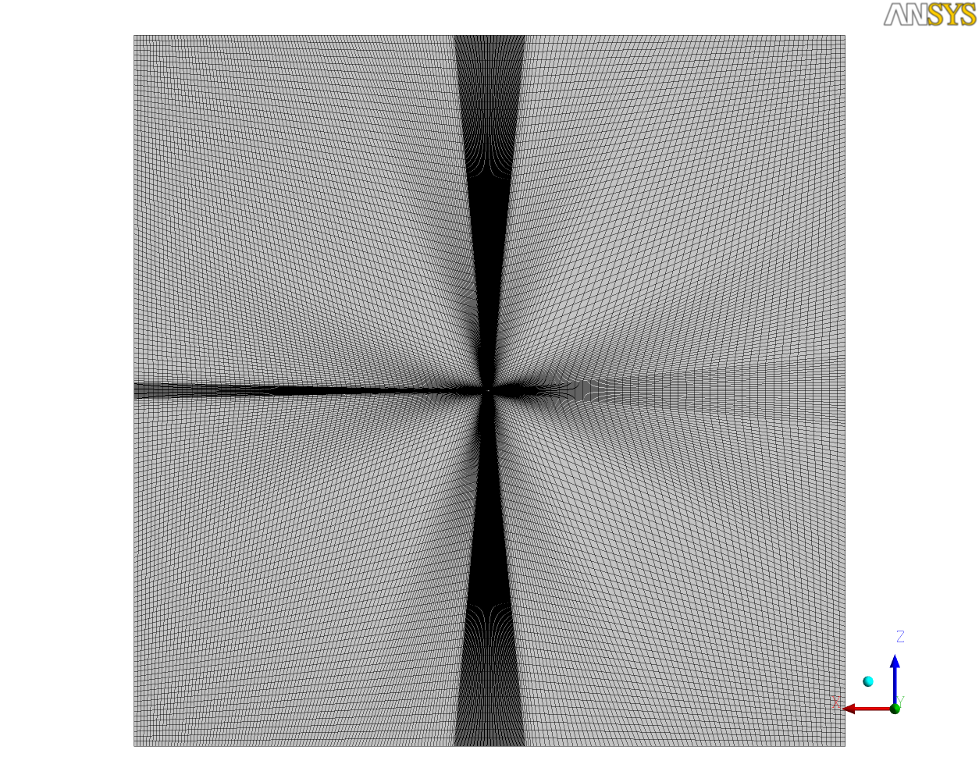
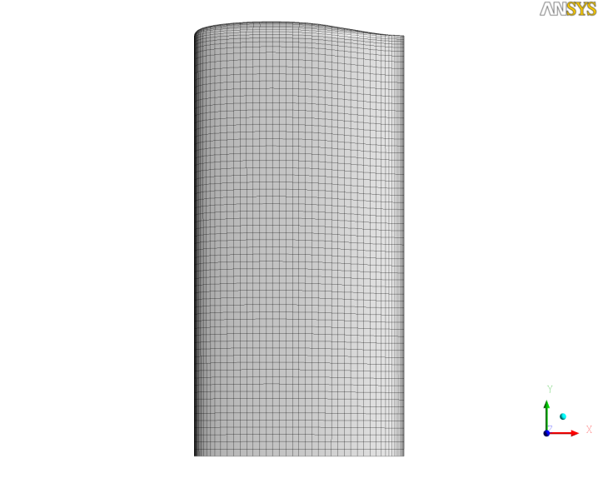
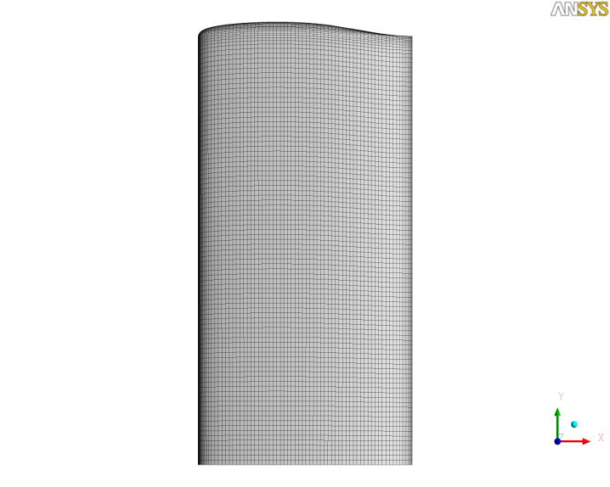
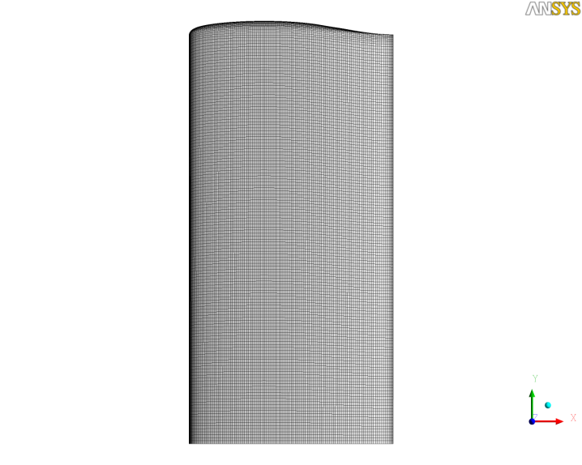
Grid Information
Grid 1
Grid 2
Grid 3

Slide 8
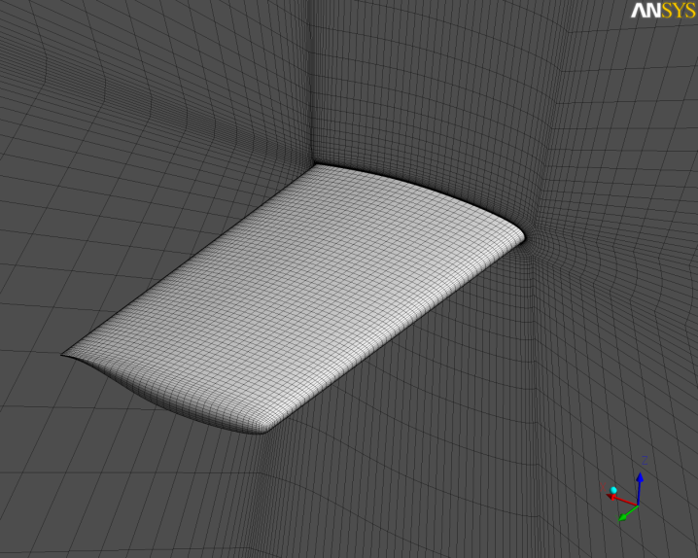
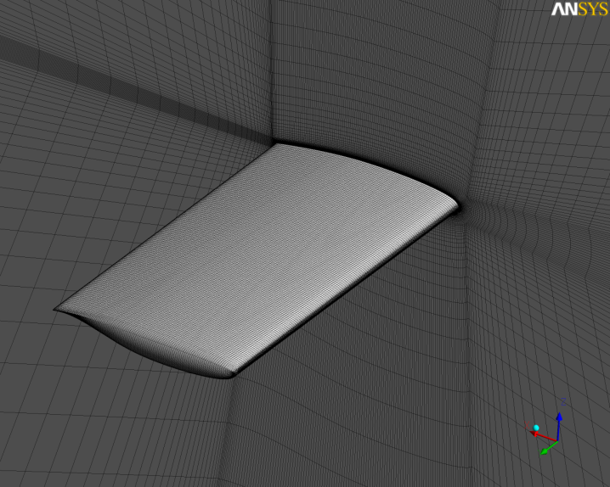
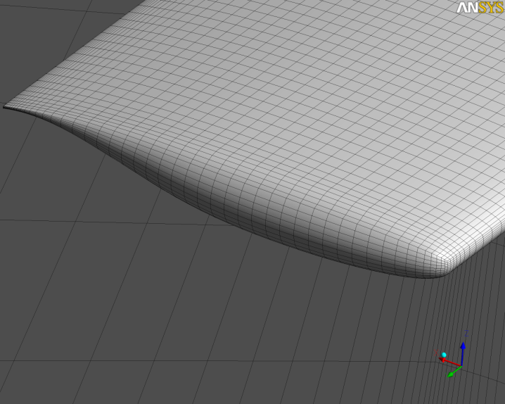
Grid Information
Grid 1
Grid 2
Grid 3

Slide 9
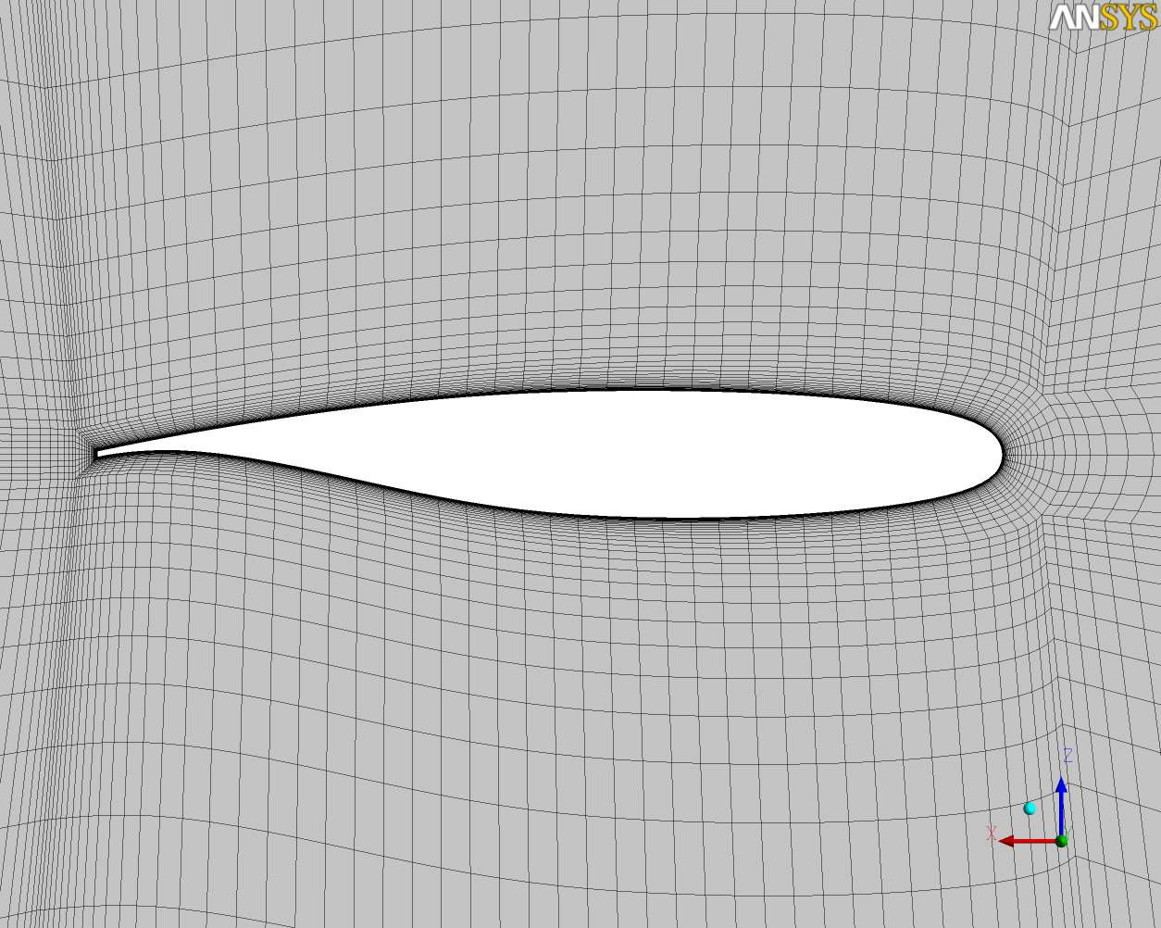
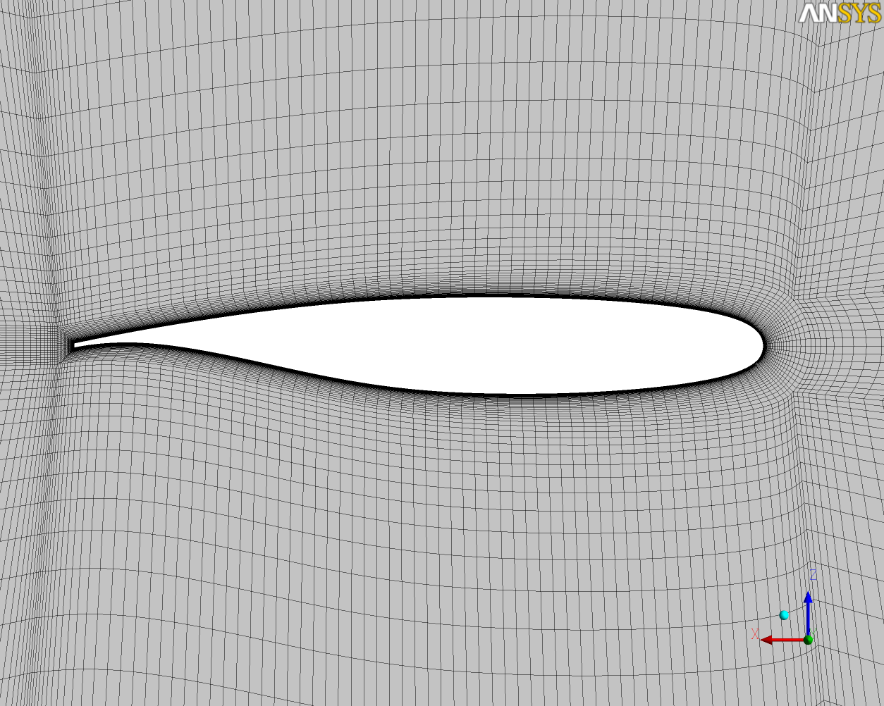
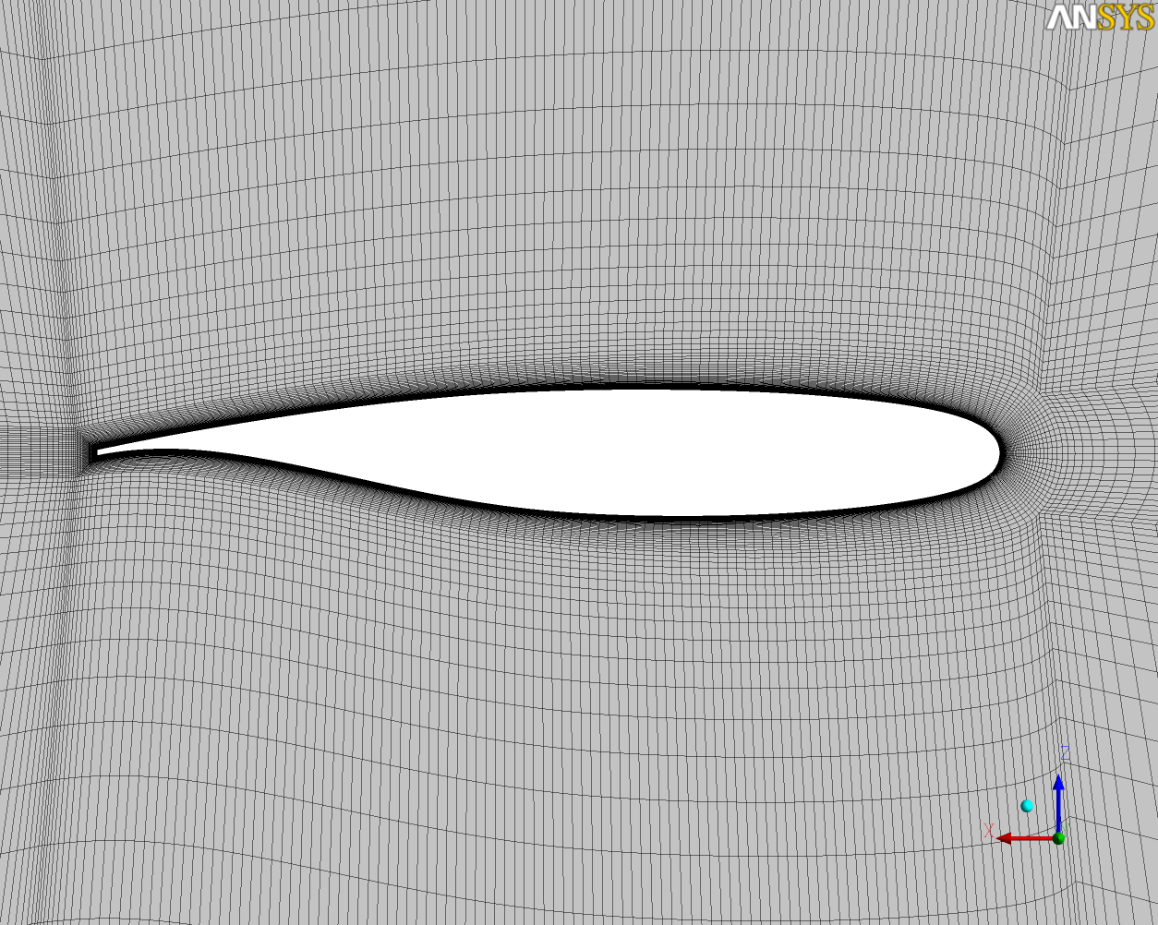
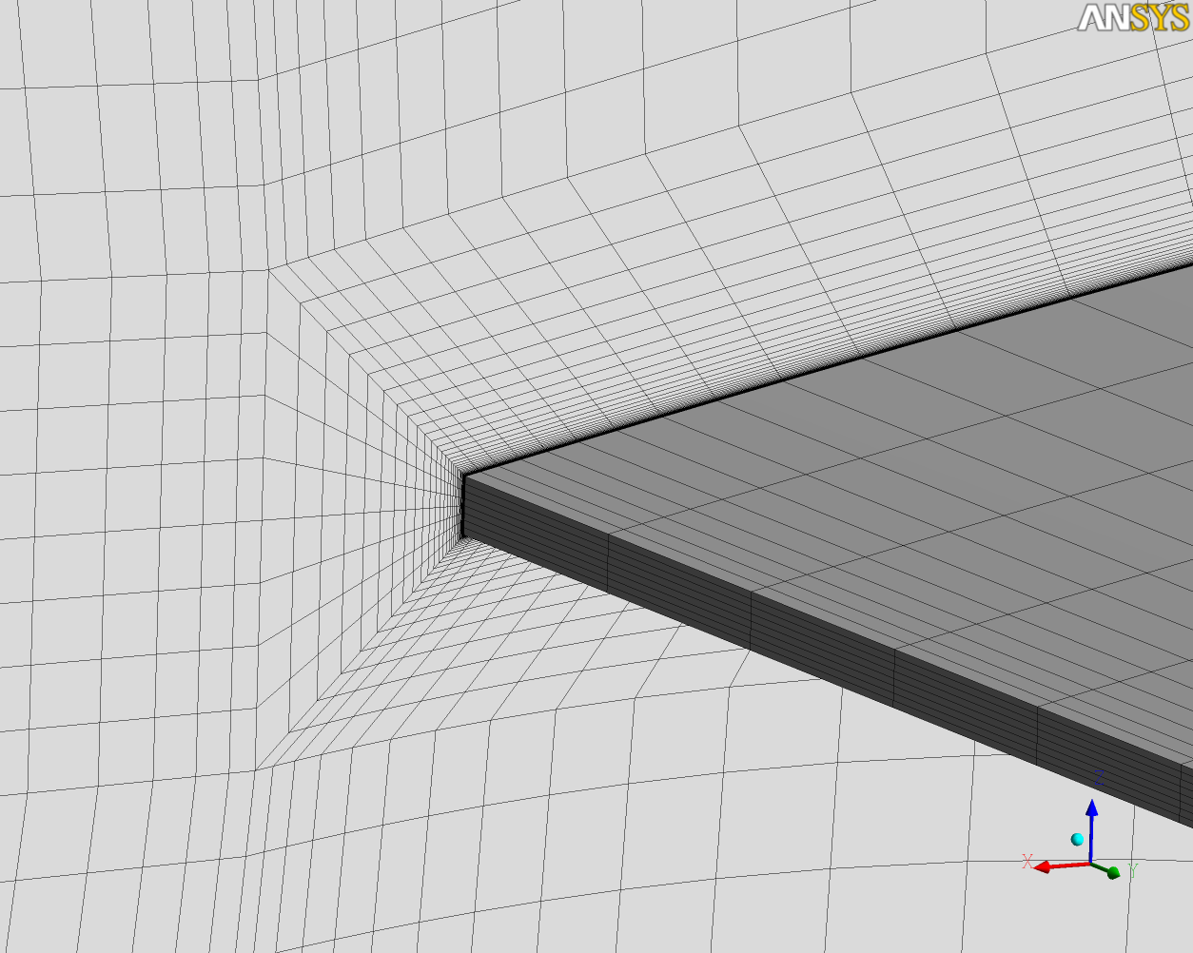
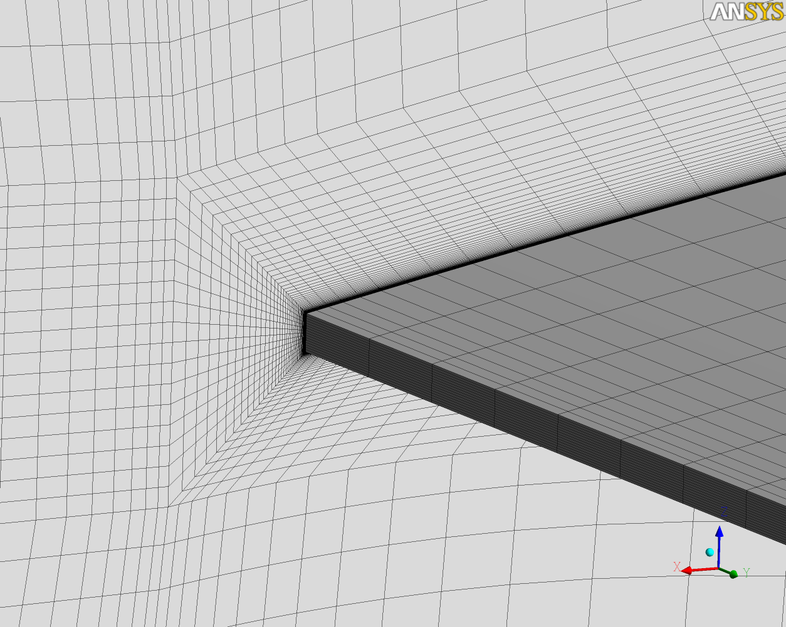
Grid Information
Grid 1
Grid 2
Grid 3

